Slide 1
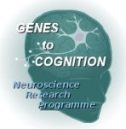
Synapse Complexity
Swartz Foundation
Banbury Meeting, CSHL
15th April 2009
Seth Grant
Genes to Cognition program
www.genes2cognition.org
Wellcome Trust Sanger Institute, Cambridge UK

Slide 2
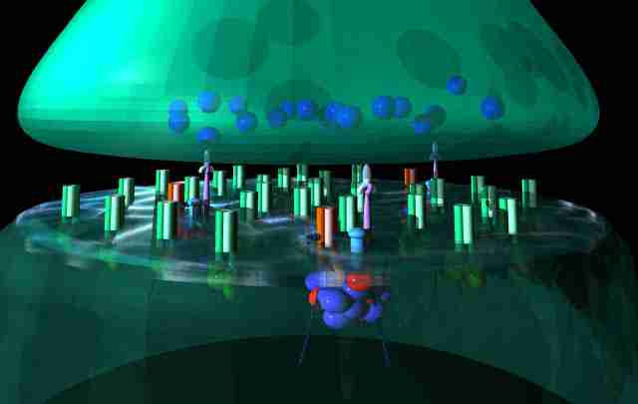
MASC

Slide 3
Post-Synaptic Proteome
Presynaptic terminal
MASC
Postsynaptic terminal
PSD
MASC MAGUK Associated Signaling Complex
PSD Post Synaptic Density
------------------------------------------------------------------------------------------
PSP Post Synaptic Proteome (total set of postsynaptic proteins)

Slide 4

Genetic evidence for postsynaptic complexes
NMDA receptor
NR2
MAGUK proteins
fyn
PSD-95
Learning impairments
Plasticity impairments
Grant, et al, Science. 258, 1903-10. 1992
Migaud et al, Nature, 396; 433-439. 1998
Sprengel et al, Cell 92, 279-89. 1998

Slide 5
Proteomic characterisation of complexes

☞

NR
PSD95
2.5 Mda
77 proteins (2000)
186 (2005)
158 (2009)
118 core (2009)
Husi et al. Nature Neuroscience, 3 (7), 661-669. 2000.
Husi & Grant. J. Neurochem, 77, 281-291. 2001
Collins et al, J. Neurochem. 2005
Fernandez et al, submitted

Slide 6
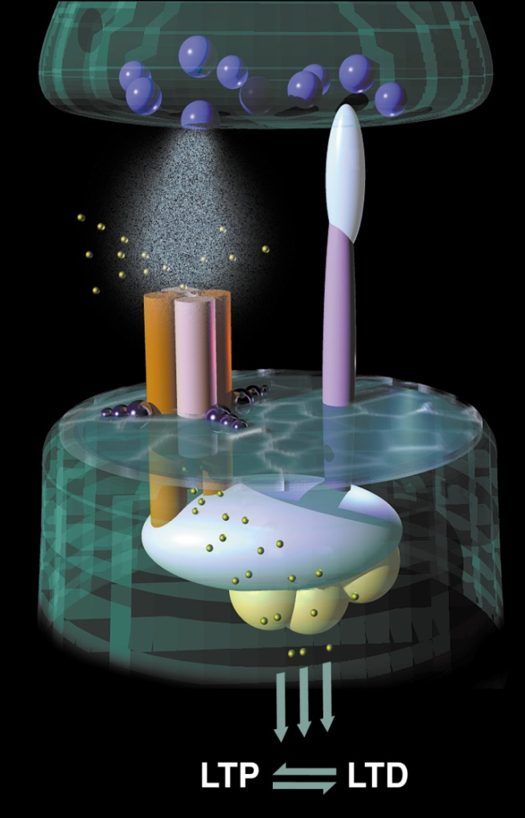
NRC / MASC
2-3 MDa
186 proteins
47 genes in human disease
48 synaptic plasticity
42 rodent behaviour
synaptic strength
gene expression
mRNA turnover
Protein turnover
Behaviours
Cognition & plasticity
Migaud et al, Nature, 396; 433-439. 1998;
Husi et al, Nature Neuroscience, 2000

Slide 7
Complexity
PSD 700 -1500 proteins
MASC 77 - 185 proteins
MASC
PSD
MASC occupies ~10 % of the PSP
- a core subset
- same classes of proteins
- ideal model of PSP
- multiple isolation methods available

Slide 8
Post Synaptic Density 1124
ER:microsomes 491
Splicesome 311
NRC/MASC 186
Nucleolus 147
Peroxisomes 181
Mitochondria 179
Phagosomes 140
Golgi 81
Choroplasts 81
Lysosomes 27
Exosomes 21
Grant. (2006) Biochemical Society Transactions. 34, 59-63. 2006

Slide 9
Is there some logic to this complexity ?

Slide 10
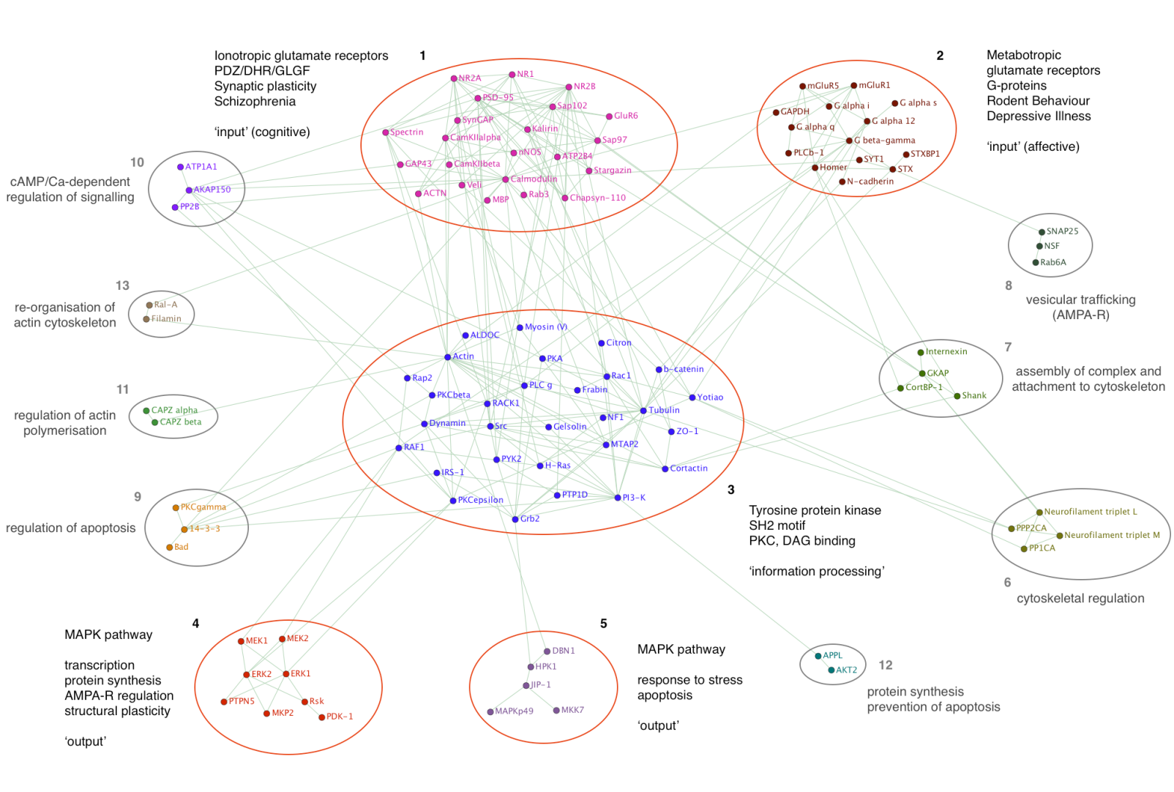
Molecular Networks: modular protein interaction networks
Pocklington, et al, Molecular Systems Biol 2006.

Slide 11
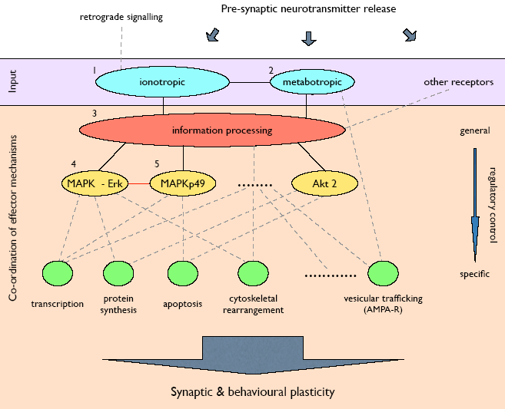
Upstream and Downstream modules
upstream
downstream
A useful tool for handling complexity

Slide 12
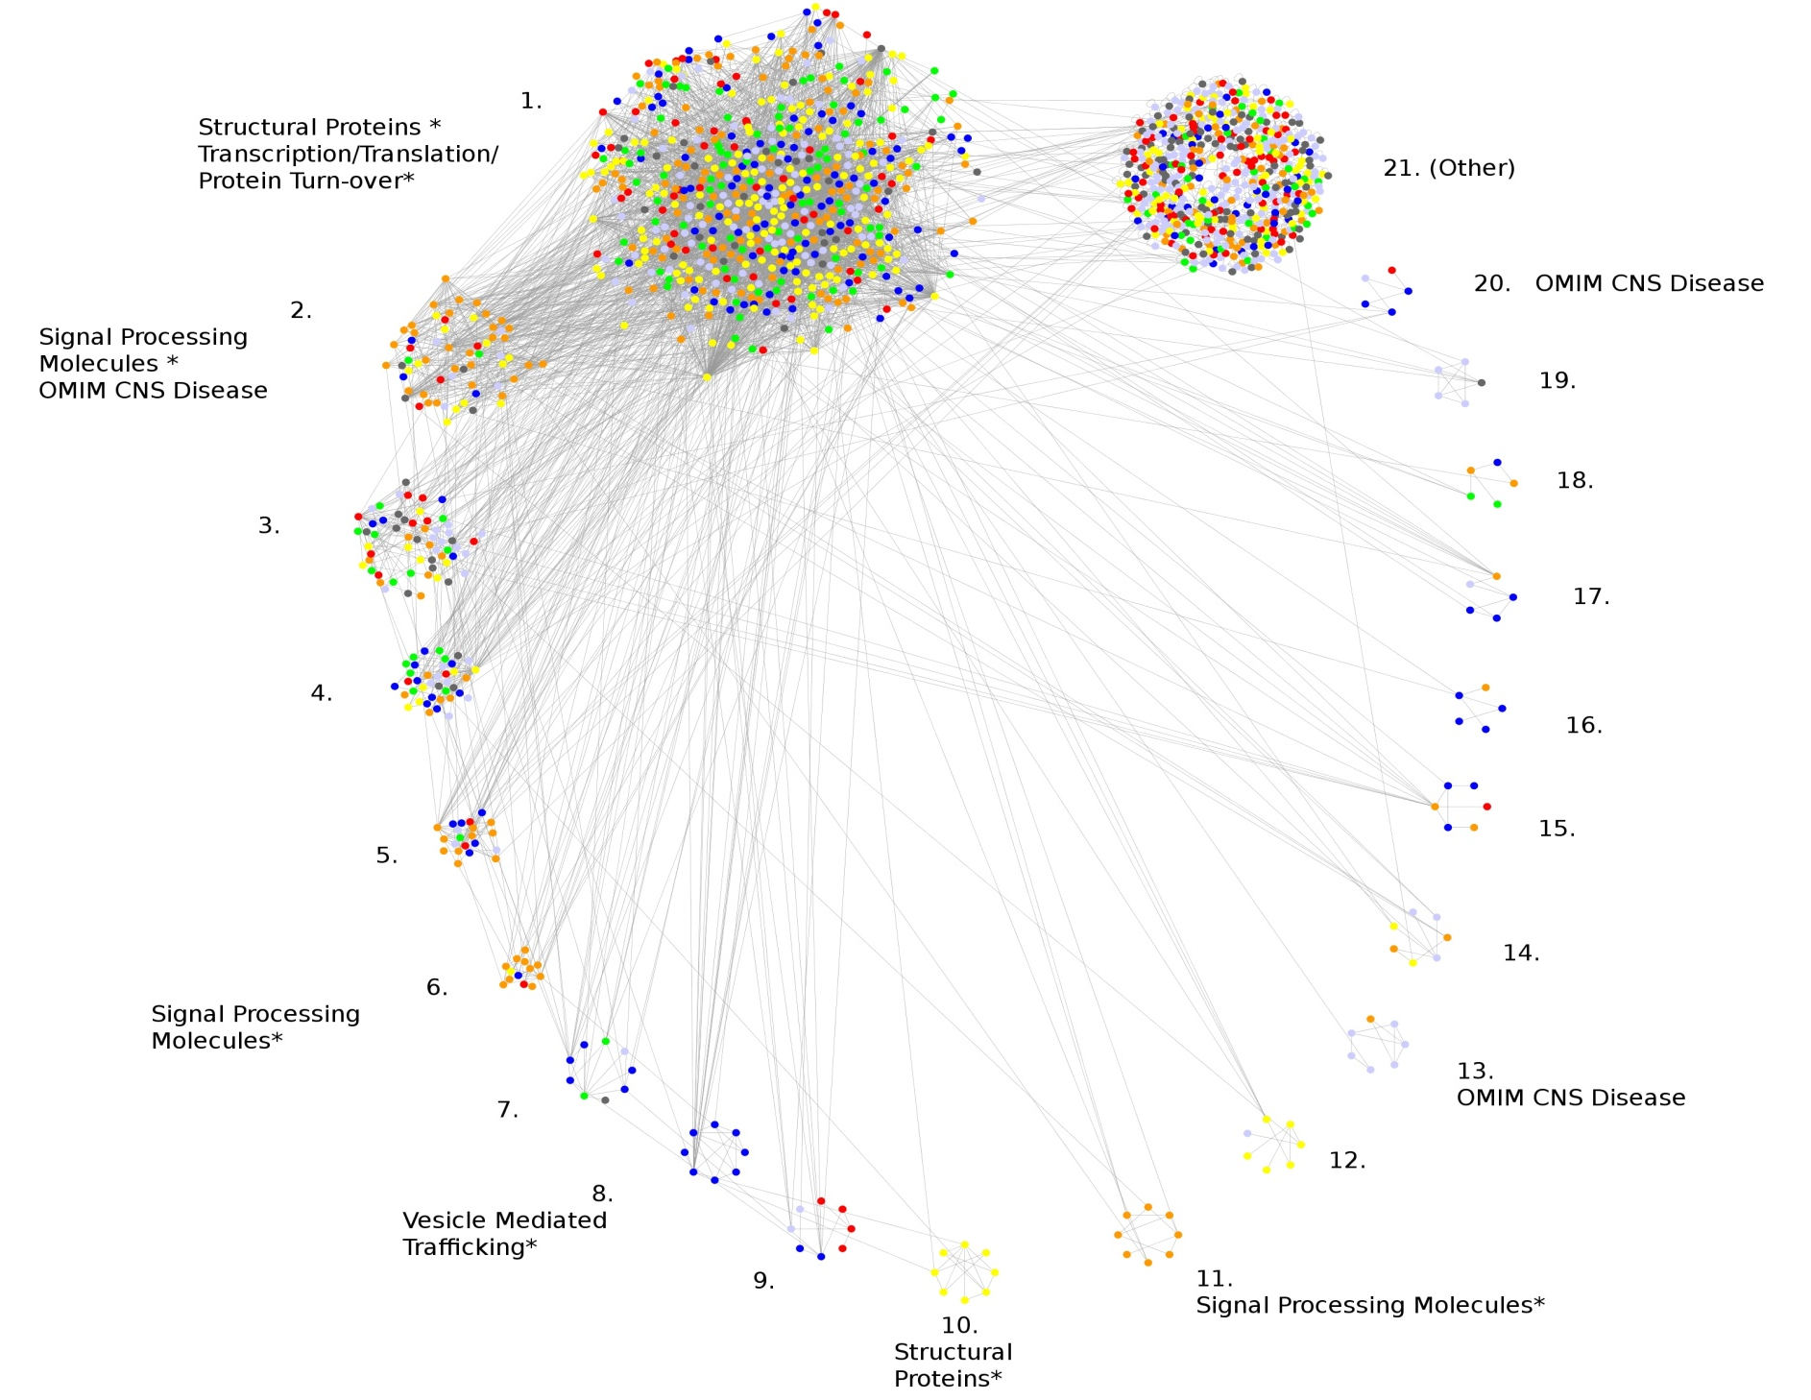
Human cortex PSD: 1462 protein network
Alex Bayes, Mark Collins, Louie Van De Lagemaat,
Ian Whittle, Jyoti Choudhary

Slide 13
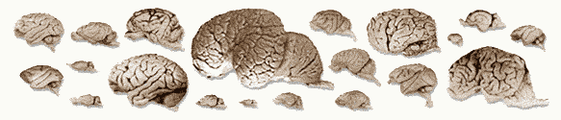
The origin and evolution of synapses and the brain
Emes et al, Nature Neuroscience 11, 799 (2008)

Slide 14



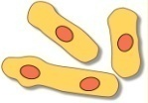
Tree of life
6 myr
75 myr
600 myr
1000 myr

Slide 15

eukaryotes
metazoans
chordates
6 myr
75 myr
600 myr
Origin of the brain
1000 myr

Slide 16
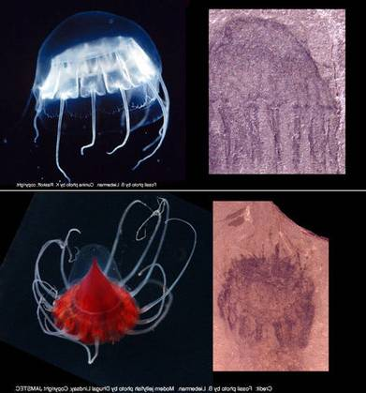
The first neurons and first brains

Slide 17
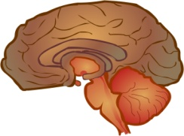
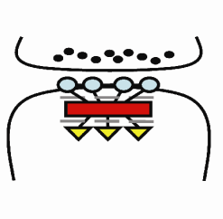










combinations
expansion
protosynapse
Emes et al, Nature Neuroscience 11, 799 (2008)

Slide 18
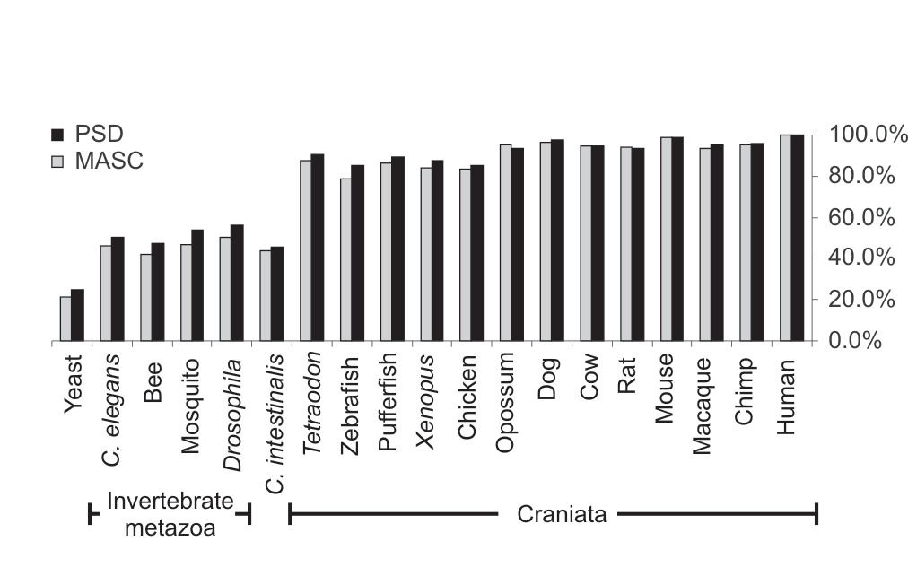
Comparative genomics
570 genes: 186 NRC/MASC; 570 PSD
Number of orthologues compared to mouse

Slide 19
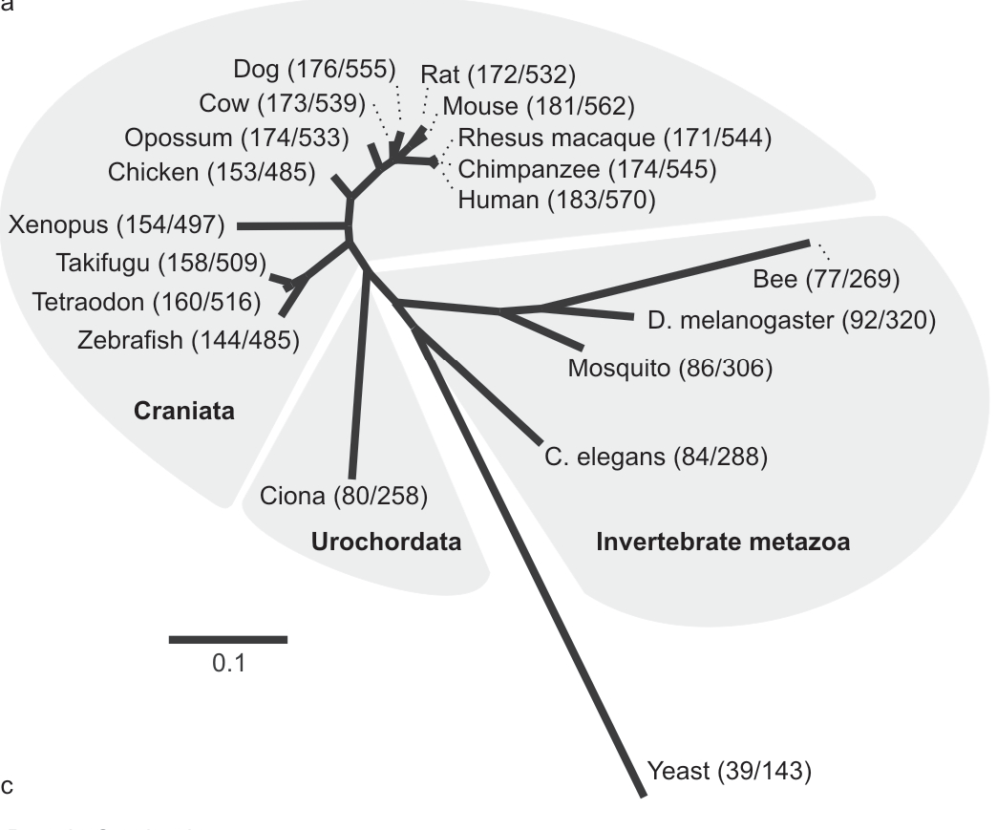

Synapse orthologues in single cell eukaryotes control
response to environment
Yeast behaviours:
Environmental responses
  - stress
  - nutrients
  - pH
143 PSD proteins

Slide 20
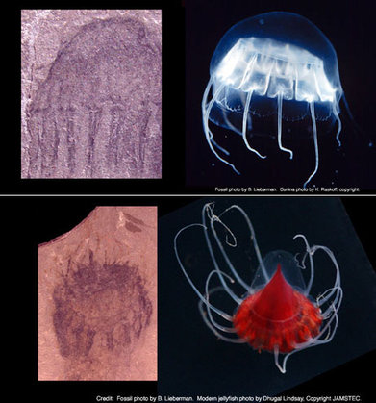

Origin of the brain
neuron first model
synapse first model

Slide 21
eukaryotes
metazoans
chordates
6 myr
75 myr
600 myr
Origin of the brain
1000 myr
protosynapse

Slide 22
Evolutionary elaboration and expansion of the protosynapse
Unicellular
eukaryotes
Invertebrates
Vertebrates

Slide 23
upstream
downstream

Slide 24
Origins of functional classes
upstream
Method: Proportion of each functional class with
earliest identifiable orthologue
downstream
Y yeast
I invertebrate
V vertebrates

Slide 25
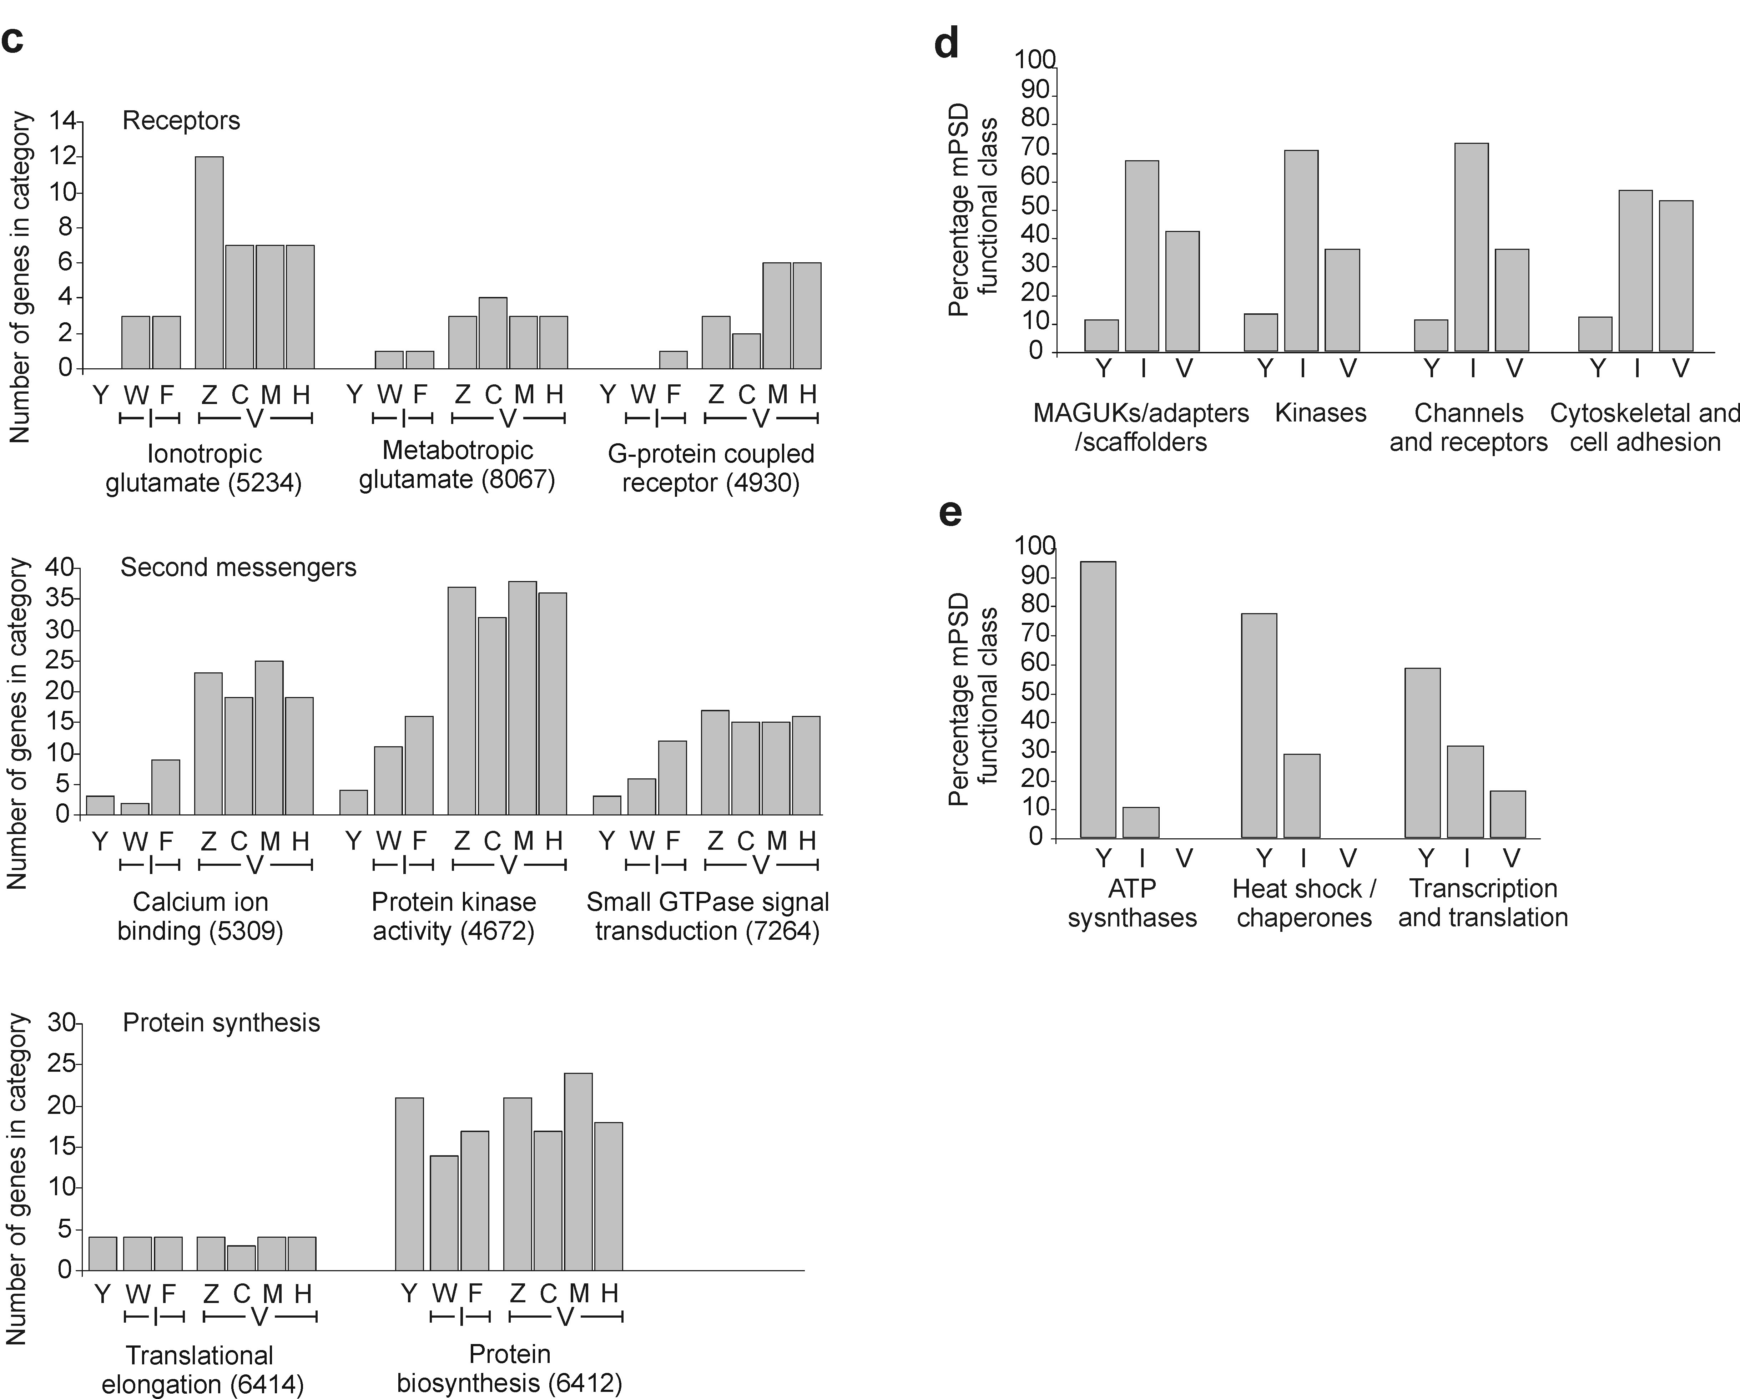
Evolution of ‘learning molecules’
neurotransmitter receptors
second messengers
protein synthesis
GO terms
Y yeast
W worm
F fly
Z zebrafish
C chicken
M mouse
H human

Slide 26
Increased combinations of complexes in vertebrates
from expansion in paralogues
NRC / MASC
Invertebrates Vertebrates
Proteins
NR1 1 1
NR2 1 4
DLG 1 4
Complexes
1 16
NR1
NR2
DLG
Theoretically possible MASC combinations in mammals >10³⁰

Slide 27
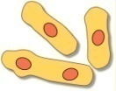

Synapse evolution
Protosynapse
‘first synapse’

Slide 28


Synapse evolution
Protosynapse
‘first synapse’
first neurons

Slide 29

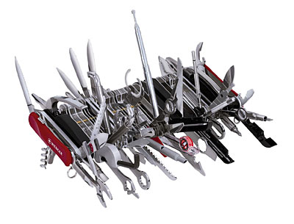
Synapse evolution
Protosynapse
‘first synapse’
first neurons

Slide 30

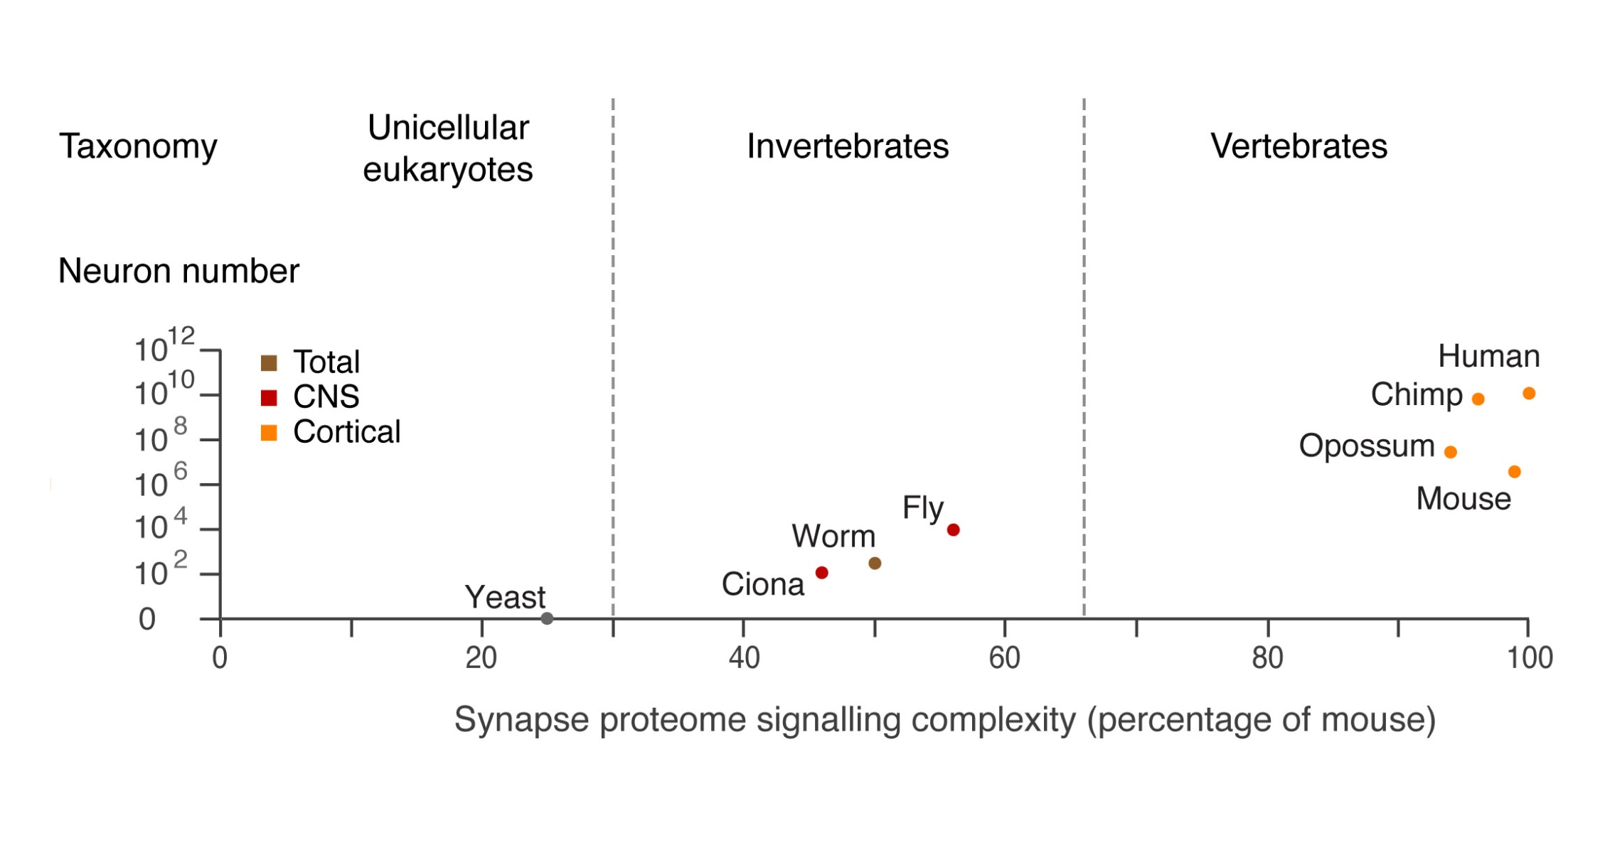
Brain size vs Synapse complexity

Slide 31
Big synapse proteomes evolved before big brains
6 myr
75 myr
600 myr
big brains
complex synapses
1000 myr

Slide 32
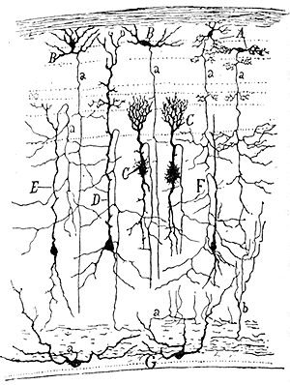
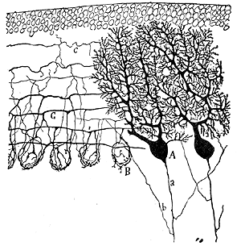
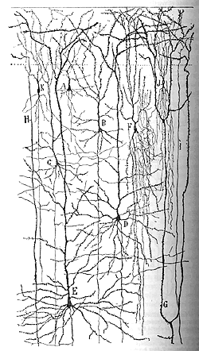
How are complex synapses used in complex brains ?
Examine synapse proteome composition in different in classes of neurons in mouse
Chris Anderson, Cathy Vickers, Andrew Pocklington

Slide 33
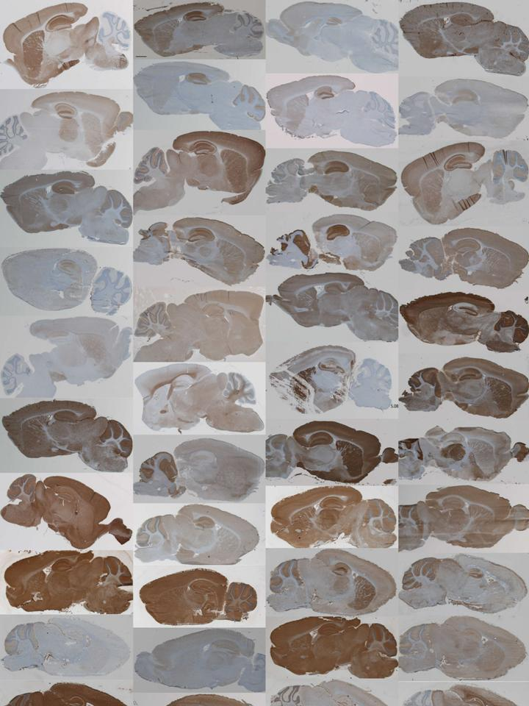
anatomical expression level profiling
>150 MASC/PSD proteins in 22 regions of mouse brain
Measured:
mRNA
  in situ
  microarray
protein
  immunohistochem
  western
variation in levels & overlap

Slide 34

Combinations of synapse proteome define brain regions, neuron types

Slide 35
MASC
Expression
barcode
anatomical
variation
phylogeny
recent
upstream
0
4
4
3
1
1
4
3
2
3
downstream
2
3
2
2
1
ancient

Slide 36
MASC
Expression
barcode
anatomical
variation
phylogeny
recent
upstream
0
4
4
3
1
1
4
3
2
3
downstream
2
3
2
2
1
ancient
Protosynapse has most conserved & uniform expression pattern

Slide 37
Evolutionary expansions gave combinations used to generate anatomical diversity
Combinations

Slide 38
Signaling networks in the PSP
a complex combinatorial signalling machine

Slide 39
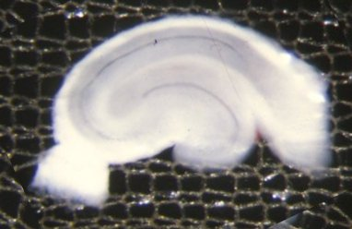
NMDA receptor activation with a synaptic plasticity protocol
how many substrates change?
NMDA stimulation
(long term depression, LTD)
> 200 phosphorylation sites.
> 120 proteins
PSD
Marcelo Coba, Andrew Pocklington, Mark Collins, Jyoti Choudhary (Science Signalling 2009)

Slide 40
NMDA receptor activation with a synaptic plasticity protocol
how many kinases change?
9 of 21 kinases tested
Marcelo Coba

Slide 41
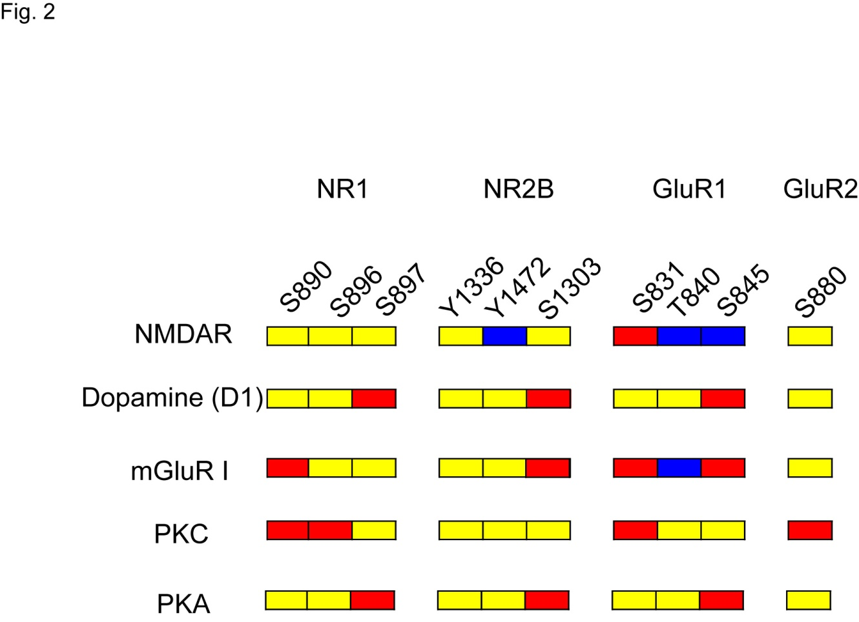
Combinatorial outputs
10 phosphorylation sites on 4 proteins
Stimulus:
No change
Increase phos
Decrease phos
Marcelo Coba

Slide 42
Combinatorial outputs
10 phosphorylation sites on 4 proteins
Stimulus:
No change
Increase phos
Decrease phos

Slide 43
Combinatorial outputs
10 phosphorylation sites on 4 proteins
Stimulus:
No change
Increase phos
Decrease phos

Slide 44
Combinatorial outputs
10 phosphorylation sites on 4 proteins
Stimulus:
No change
Increase phos
Decrease phos

Slide 45
Combinatorial outputs = states
sites states
GluR1 3 8 (2³)
10 proteins 100 10³⁰ (2¹⁰⁰)
PSP 10⁴ 10⁶⁰
Are any two synapses the same?
Can a synapse ever be in the same state twice?
What are the physiological constraints?

Slide 46
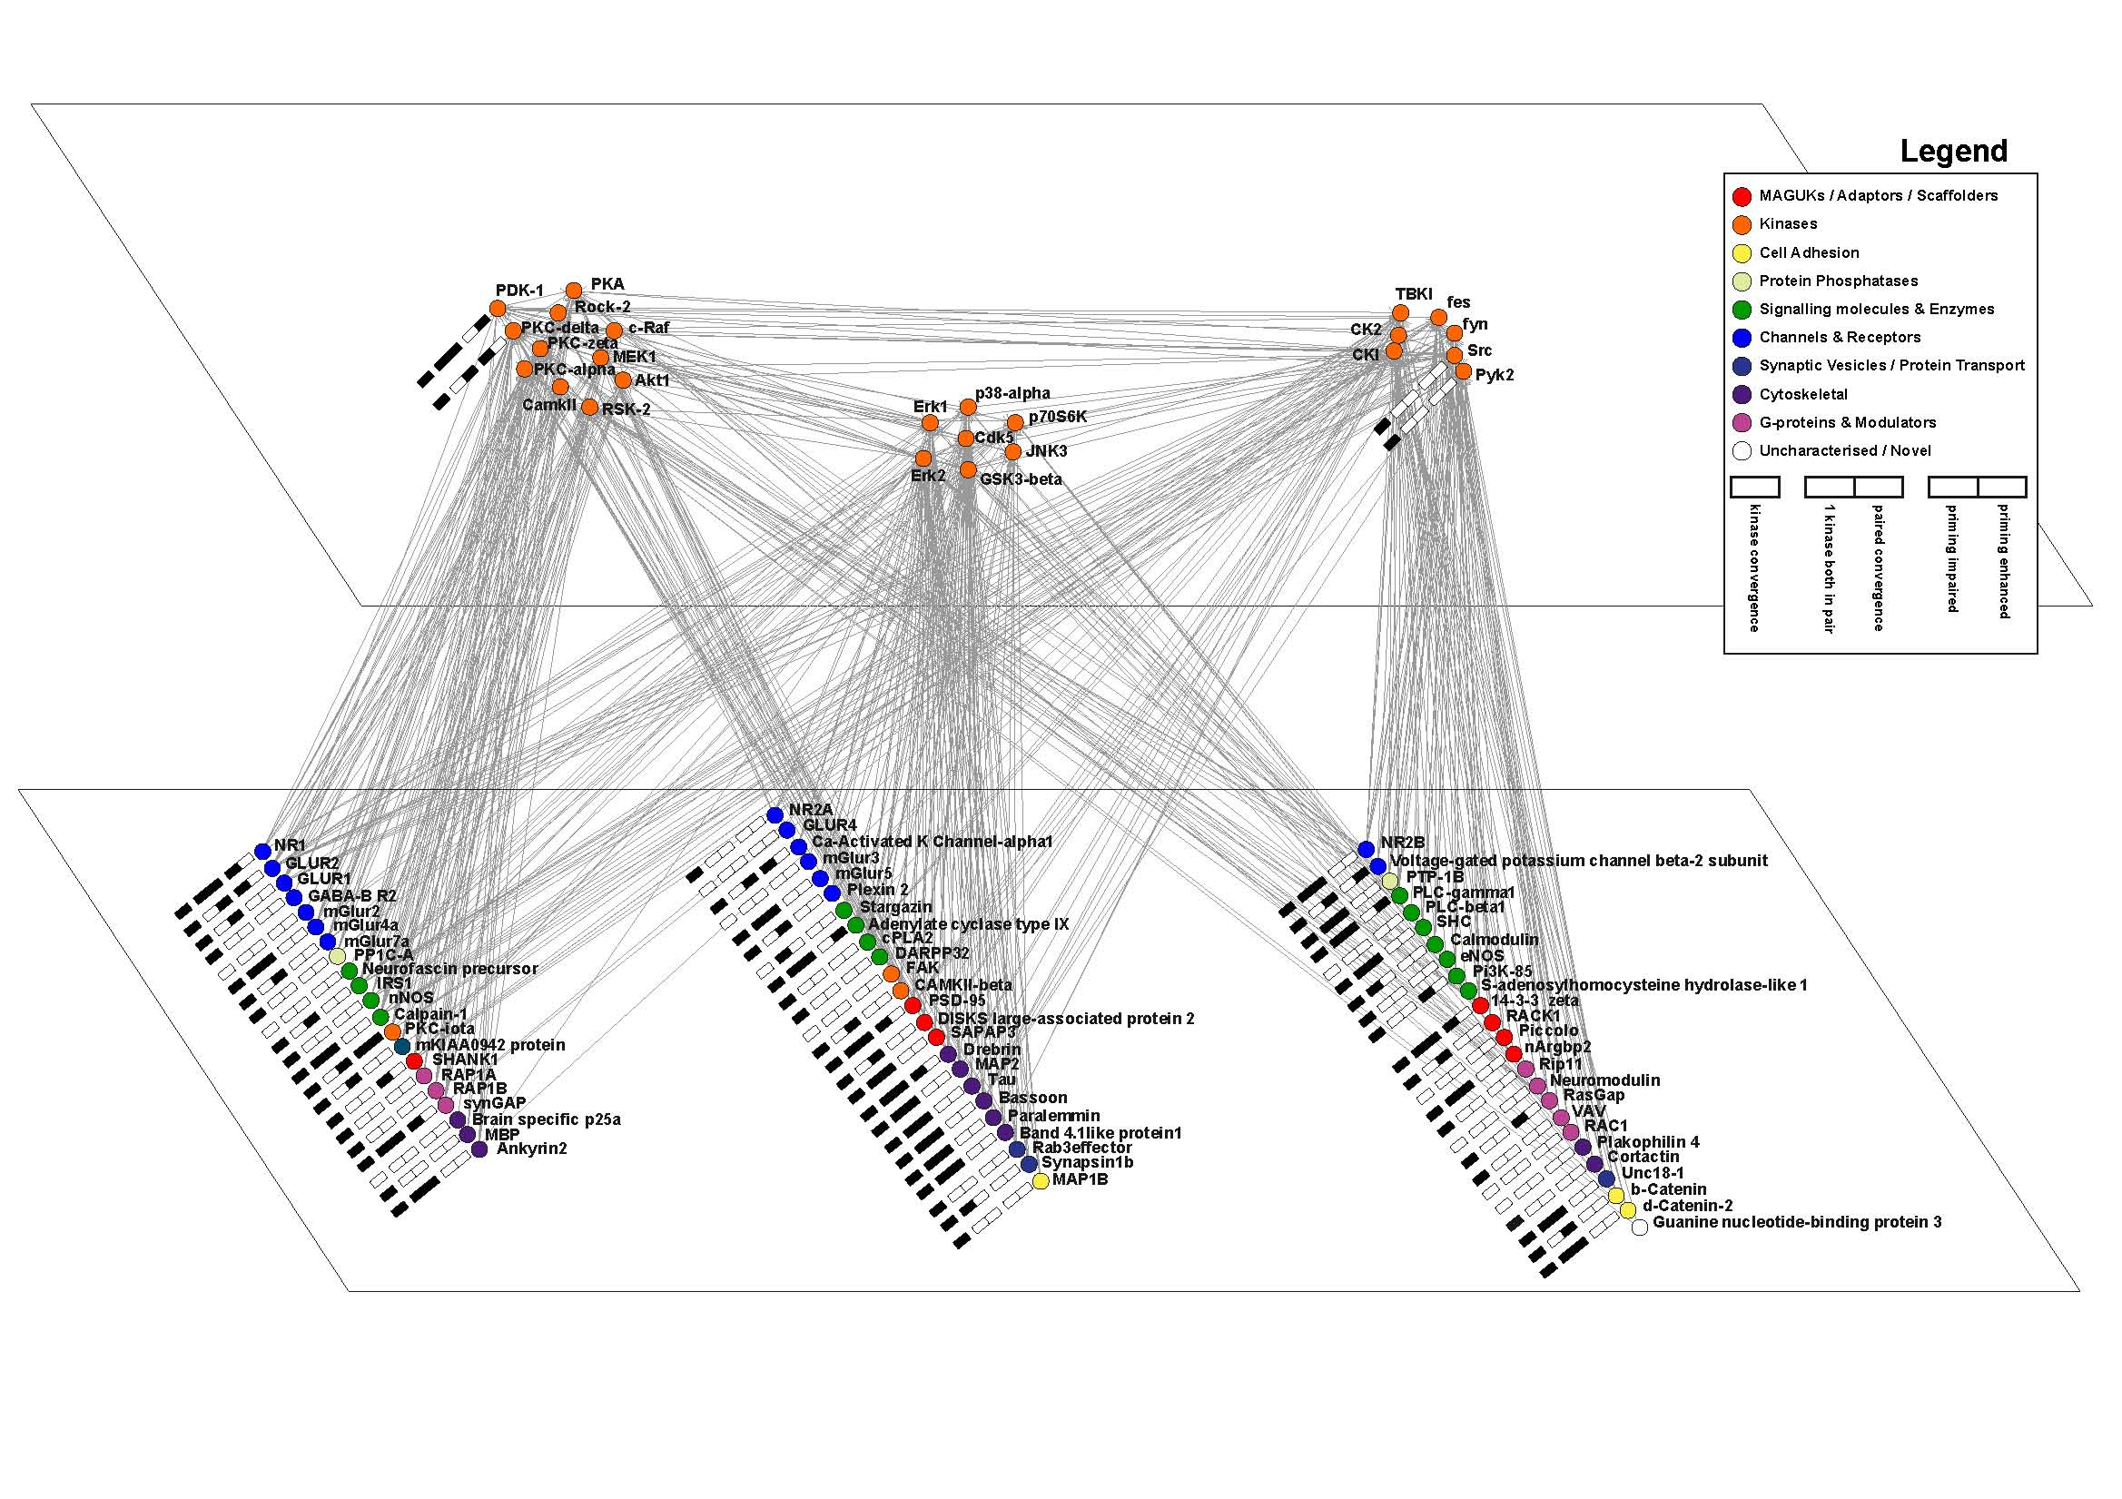
Postsynaptic kinase-substrate network - mapping 743 phosphorylation events
kinases
substrates
Marcelo Coba, Andrew Pocklington

Slide 47
Building the network
defining minimal units

Slide 48
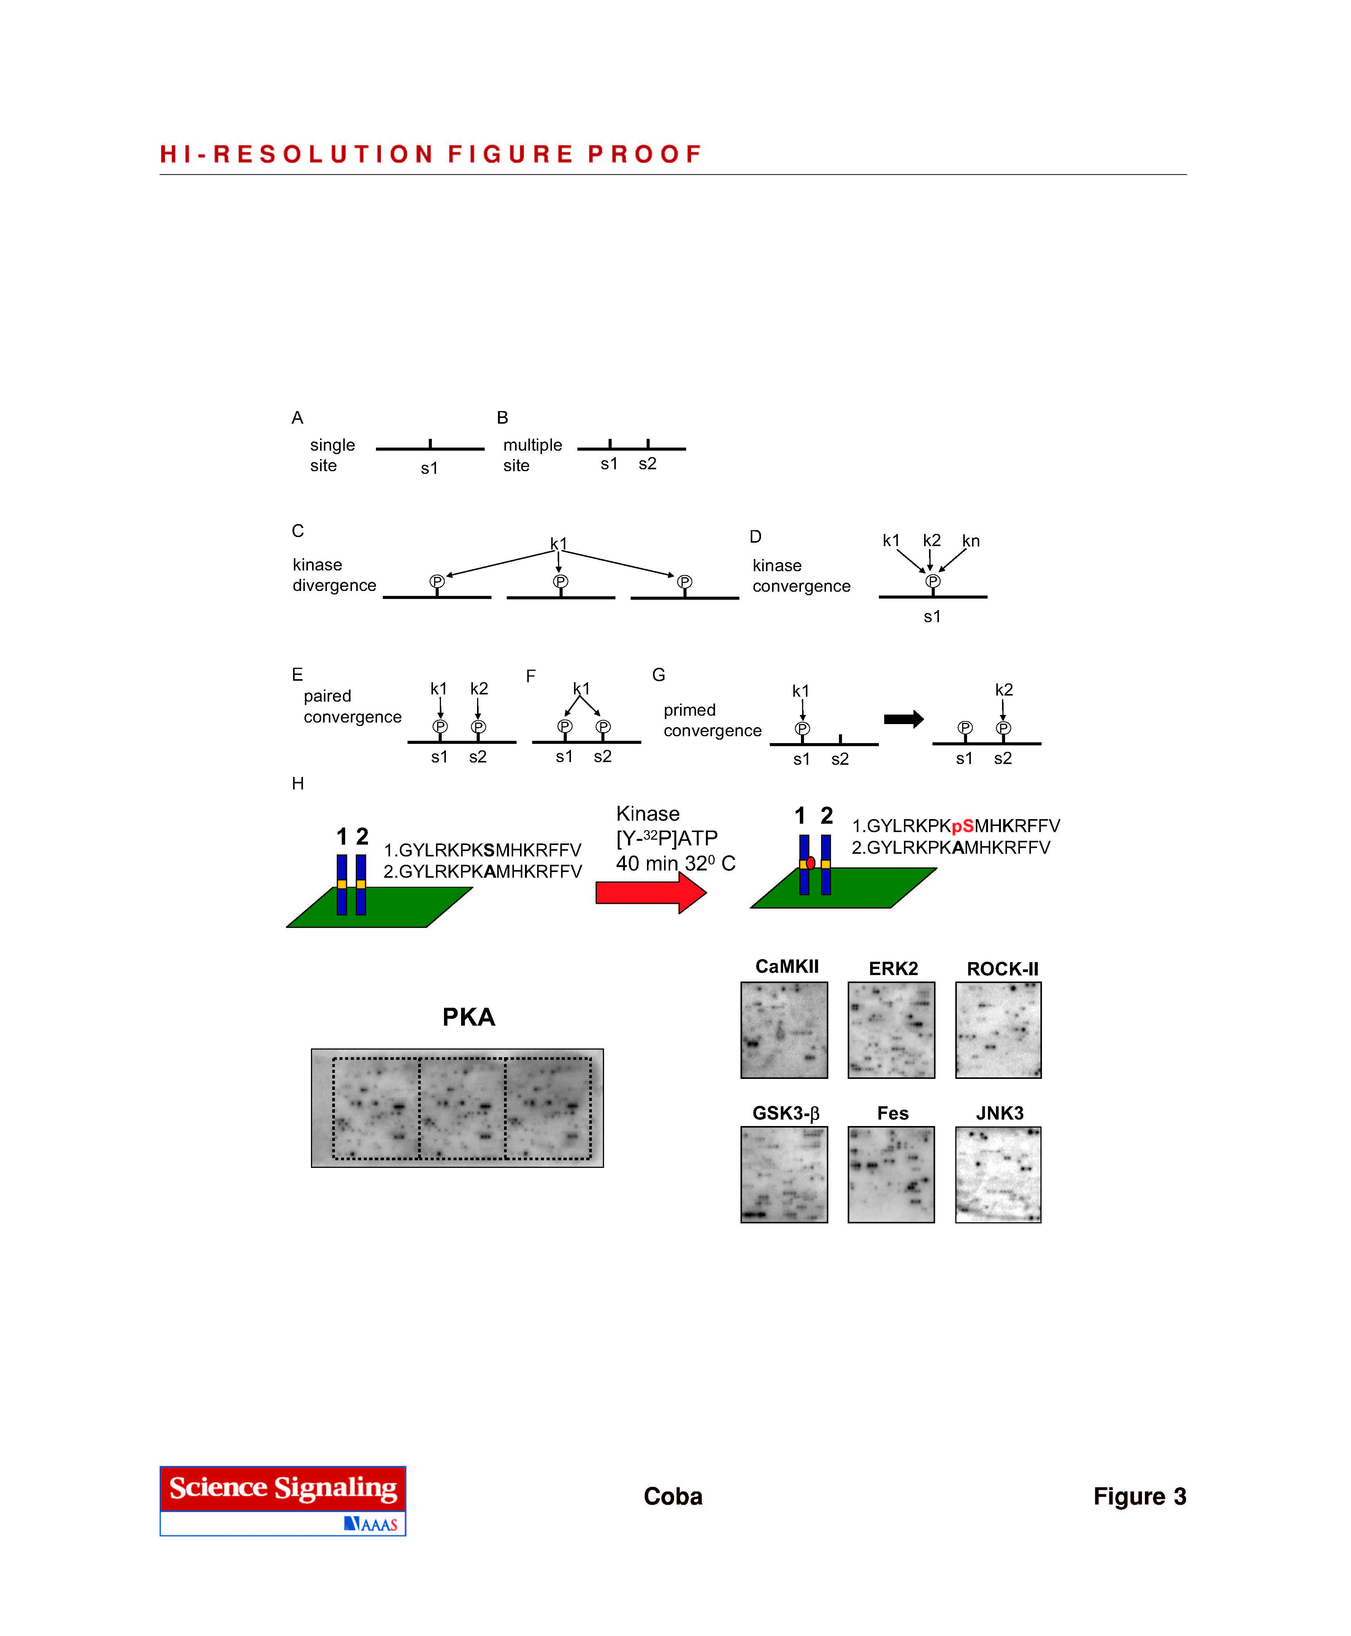

Slide 49
How many substrates for a kinase?
k1
kinase
divergence
P
P
P
20.5 (± 8.3) protein substrates phosphorylated by each kinase

Slide 50
How many sites were phosphorylated by more than one kinase?
k1
k2
kn
redundance / robustness
multiple upstream receptors
kinase
convergence
P
65% (129) sites phosphorylated by multiple kinases

Slide 51
Hubs – highly connected
Proteins
Sites

Slide 52
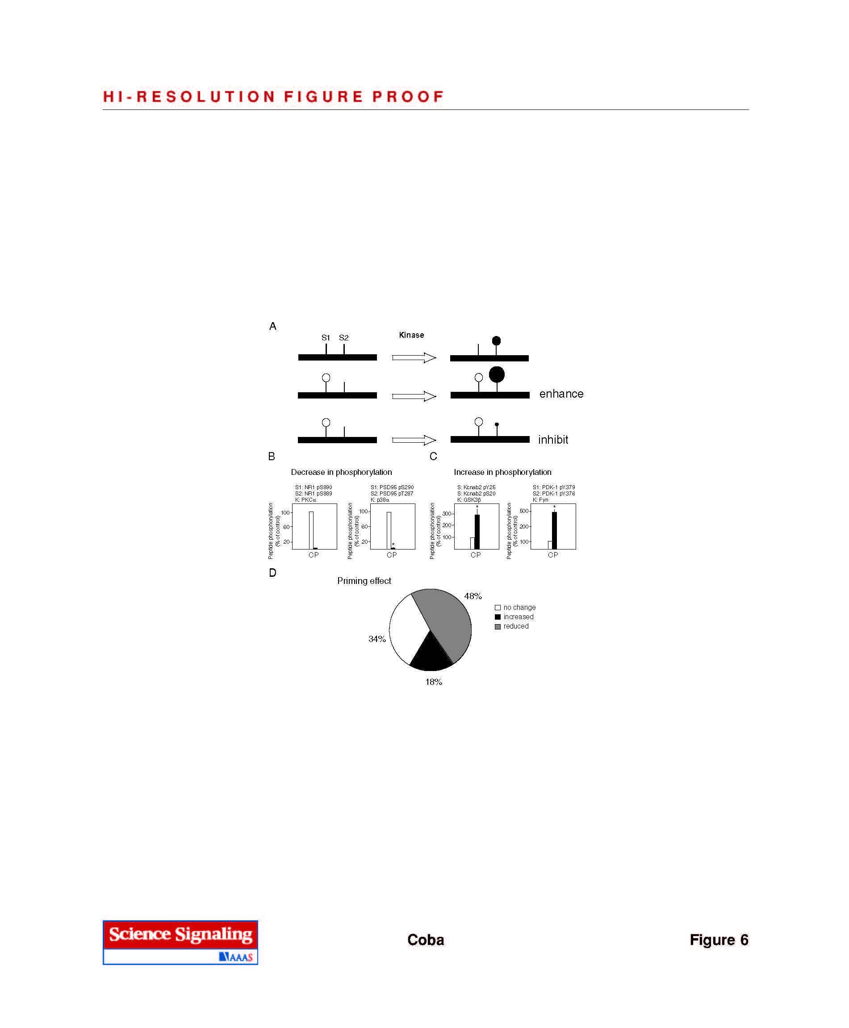
coincidence detectors

Slide 53
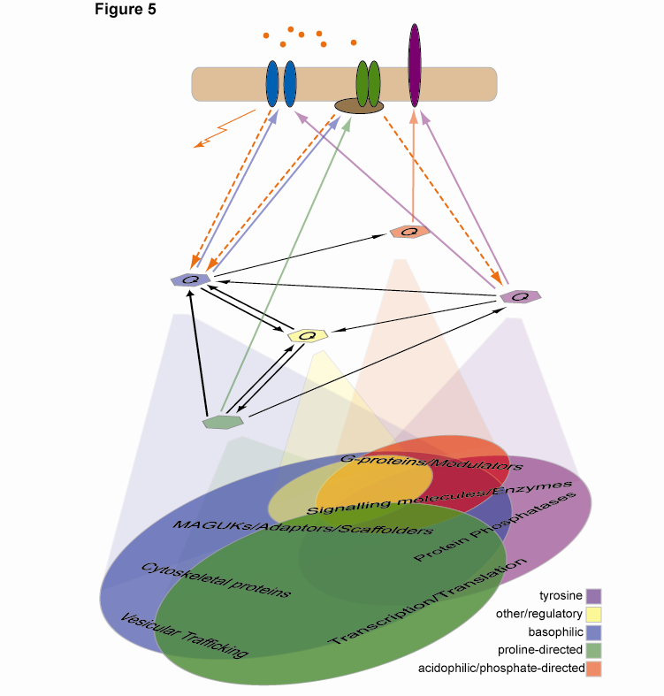
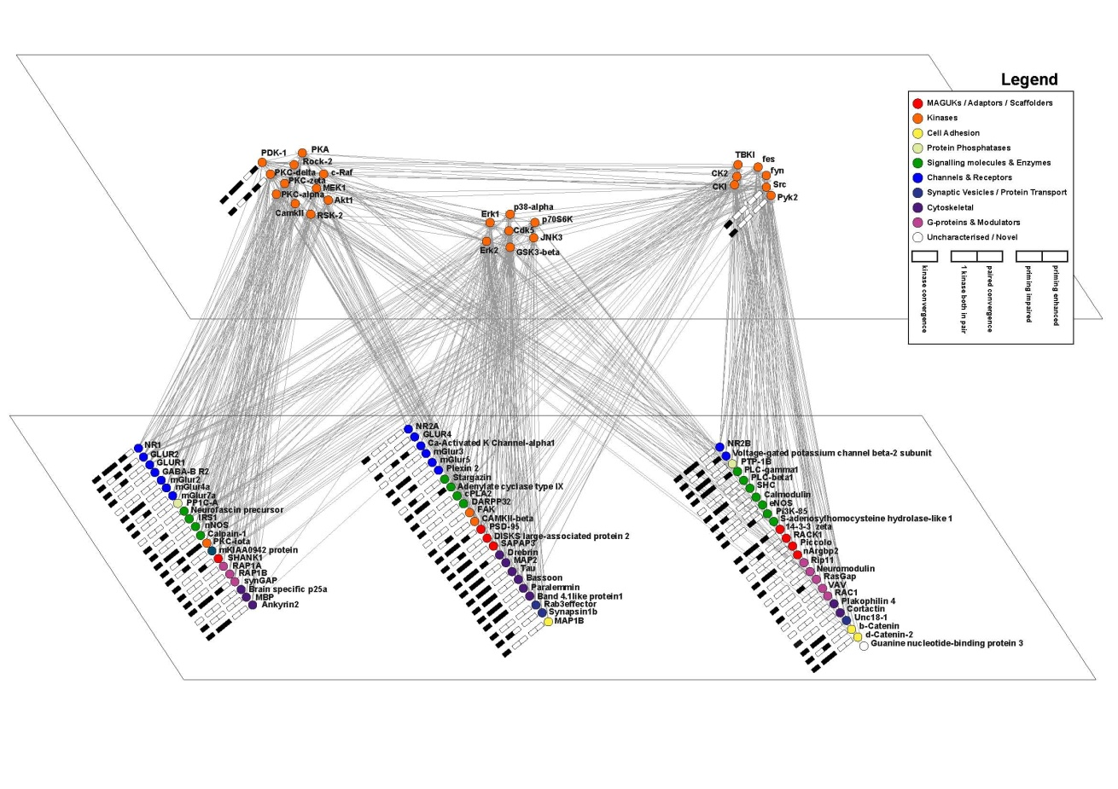
NMDA
receptor
mGluR
receptor
Dopamine
receptor
Combinations of sites
Functional orchestration

Slide 54

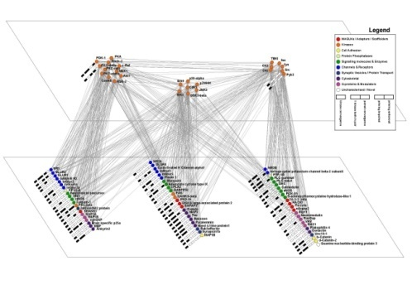






Synapse evolution and expansion model of synapse diversity and behaviour

Slide 55

Acknowledgements
Proteomics
Marcelo Coba
Alex Bayes
Bilal Malik
Mark Collins
Jyoti Choudhary
Expression
Christopher Anderson
Cathy Vickers
Informatics
Andrew Pocklington
J. Douglas Armstrong
Mike Croning
Richard Emes
Support
Wellcome Trust
Medical Research Council
European Union
www.genes2cognition.org
www.g2conline.org

