Slide 1
Episodic Control:
Singular Recall and Optimal Actions
Peter Dayan
Nathaniel Daw Máté Lengyel Yael Niv

Slide 2
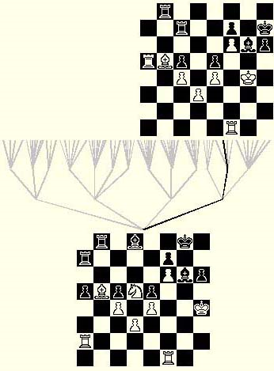
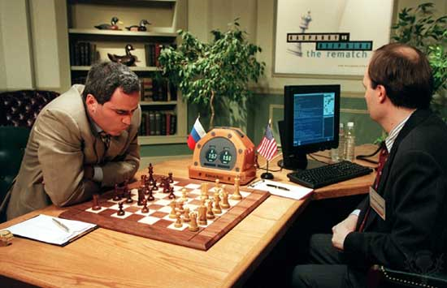
Two Decision Makers
tree search
position evaluation

Slide 3
Two Decision Makers
Three
tree search
position evaluation
situation memory: whole, bound episodes

Slide 4
Goal-Directed/Habitual/Episodic Control
why have more than one system?
  statistical versus computational noise
  DMS/PFC vs DLS/DA
why have more than two systems?
  statistical versus computational noise
(why have more than three systems?)
when is episodic control a good idea?
is the MTL involved?

Slide 5
Two Decision Makers
Three
tree search:
  model-based reinforcement learning (PFC; DMS)
position evaluation:
  model free reinforcement learning (DA; DLS)
    δ(t)=r(t)+V(t+1)-V(t)
Pavlovian control
  evolutionary preprogramming
  misbehaviour

Slide 6



Reinforcement Learning
S₂
S₃
S₁
forward model (goal directed)
caching (habitual)
Hunger
Cheese
Thirst
(NB: trained hungry)
= 4
= 2
= -1
H;S₂,L
4
L
S₂
H;S₂,R
0
L
R
= 0
= 0
= 0
H;S₁,L
4
S₁
R
L
= 2
= 4
= 2
H;S₁,R
3
S₃
H;S₃,L
2
R
= 3
= 1
= 3
H;S₃,R
3
acquire with simple learning rules
acquire recursively
δ(t)=r(t)+V(t+1)-V(t)

Slide 7
Learning
uncertainty-sensitive learning for both systems:
  model-based: (propagate uncertainty)
    data efficient
    computationally ruinous
  model-free (Bayesian Q-learning)
    data inefficient
    computationally trivial
  uncertainty-sensitive control migrates from actions to habits
Daw, Niv, Dayan

Slide 8
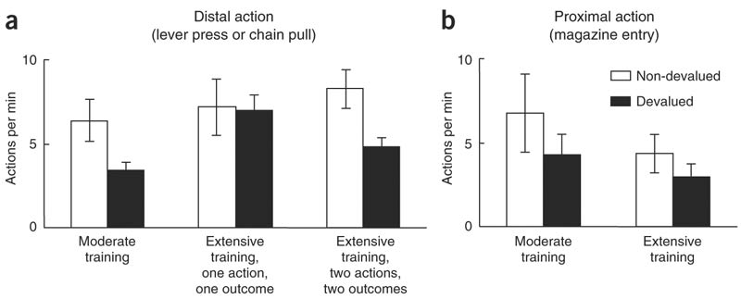
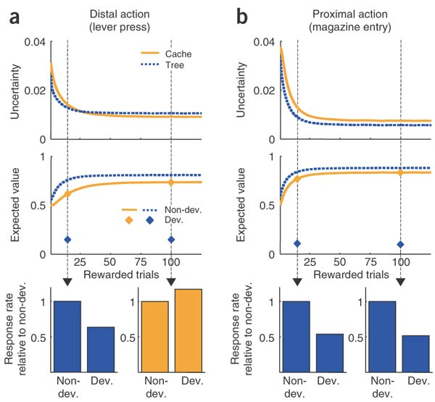
One Outcome
uncertainty-
sensitive
learning
shallow tree
implies
goal-directed
control
wins
Daw, Niv, Dayan

Slide 9
One Outcome
uncertainty-
sensitive
learning
Daw, Niv, Dayan

Slide 10
Actions and Habits
model-based system is Tolmanian
evidence from Killcross et al:
  prelimbic lesions: instant devaluation insensitivitity
  infralimbic lesions: permanent devalulation sensitivity
evidence from Balleine et al:
  goal-directed control: PFC; dorsomedial thalamus
  habitual control: dorsolateral striatum; dopamine
both systems learn; compete for control
arbitration: ACC; ACh?

Slide 11

But...
top-down
  hugely inefficient to do semantic control given little data
  different way of using singular experience
bottom-up
  why store episodes?
  use for control
situation memory for Deep Blue

Slide 12
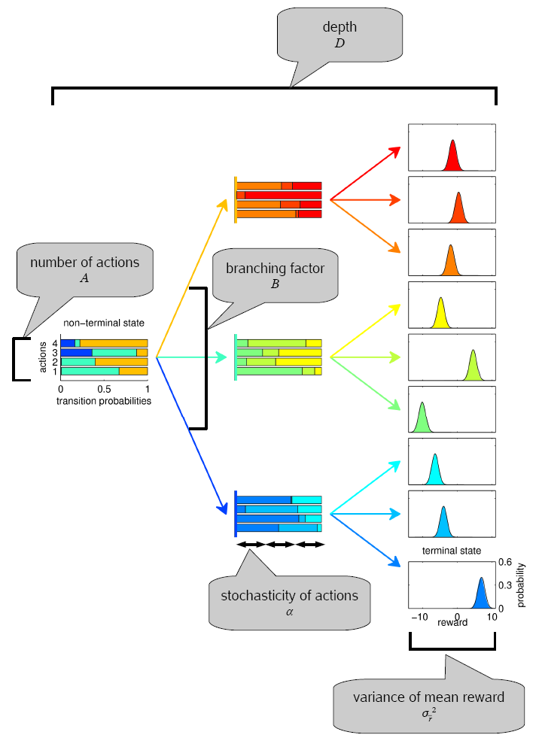
The Third Way
simple domain
model-based control:
  build a tree
  evaluate states
  count cost of uncertainty
episodic control:
  store conjunction of states, actions, rewards
  if reward > expectation, store all actions in the whole episode (Düzel)
  choose rewarded action; else random

Slide 13
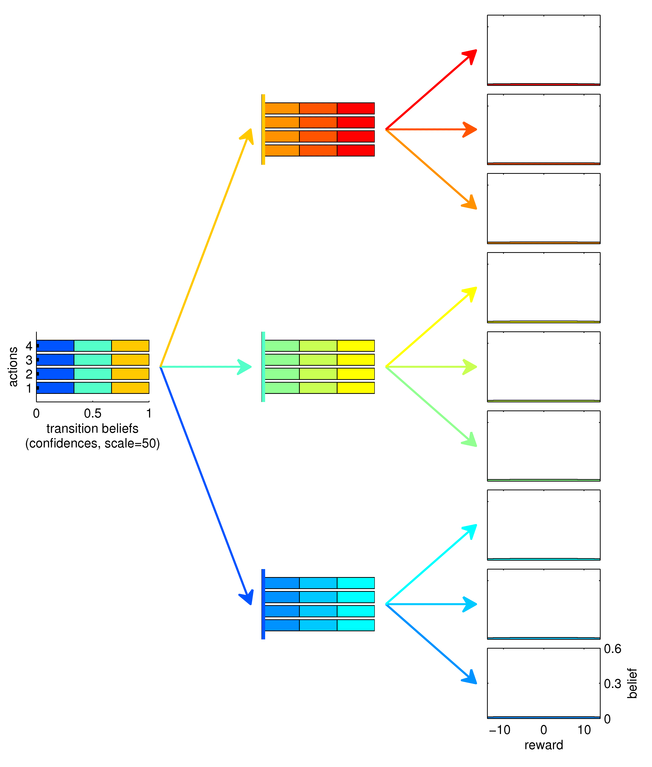
Semantic Controller
T=0

Slide 14
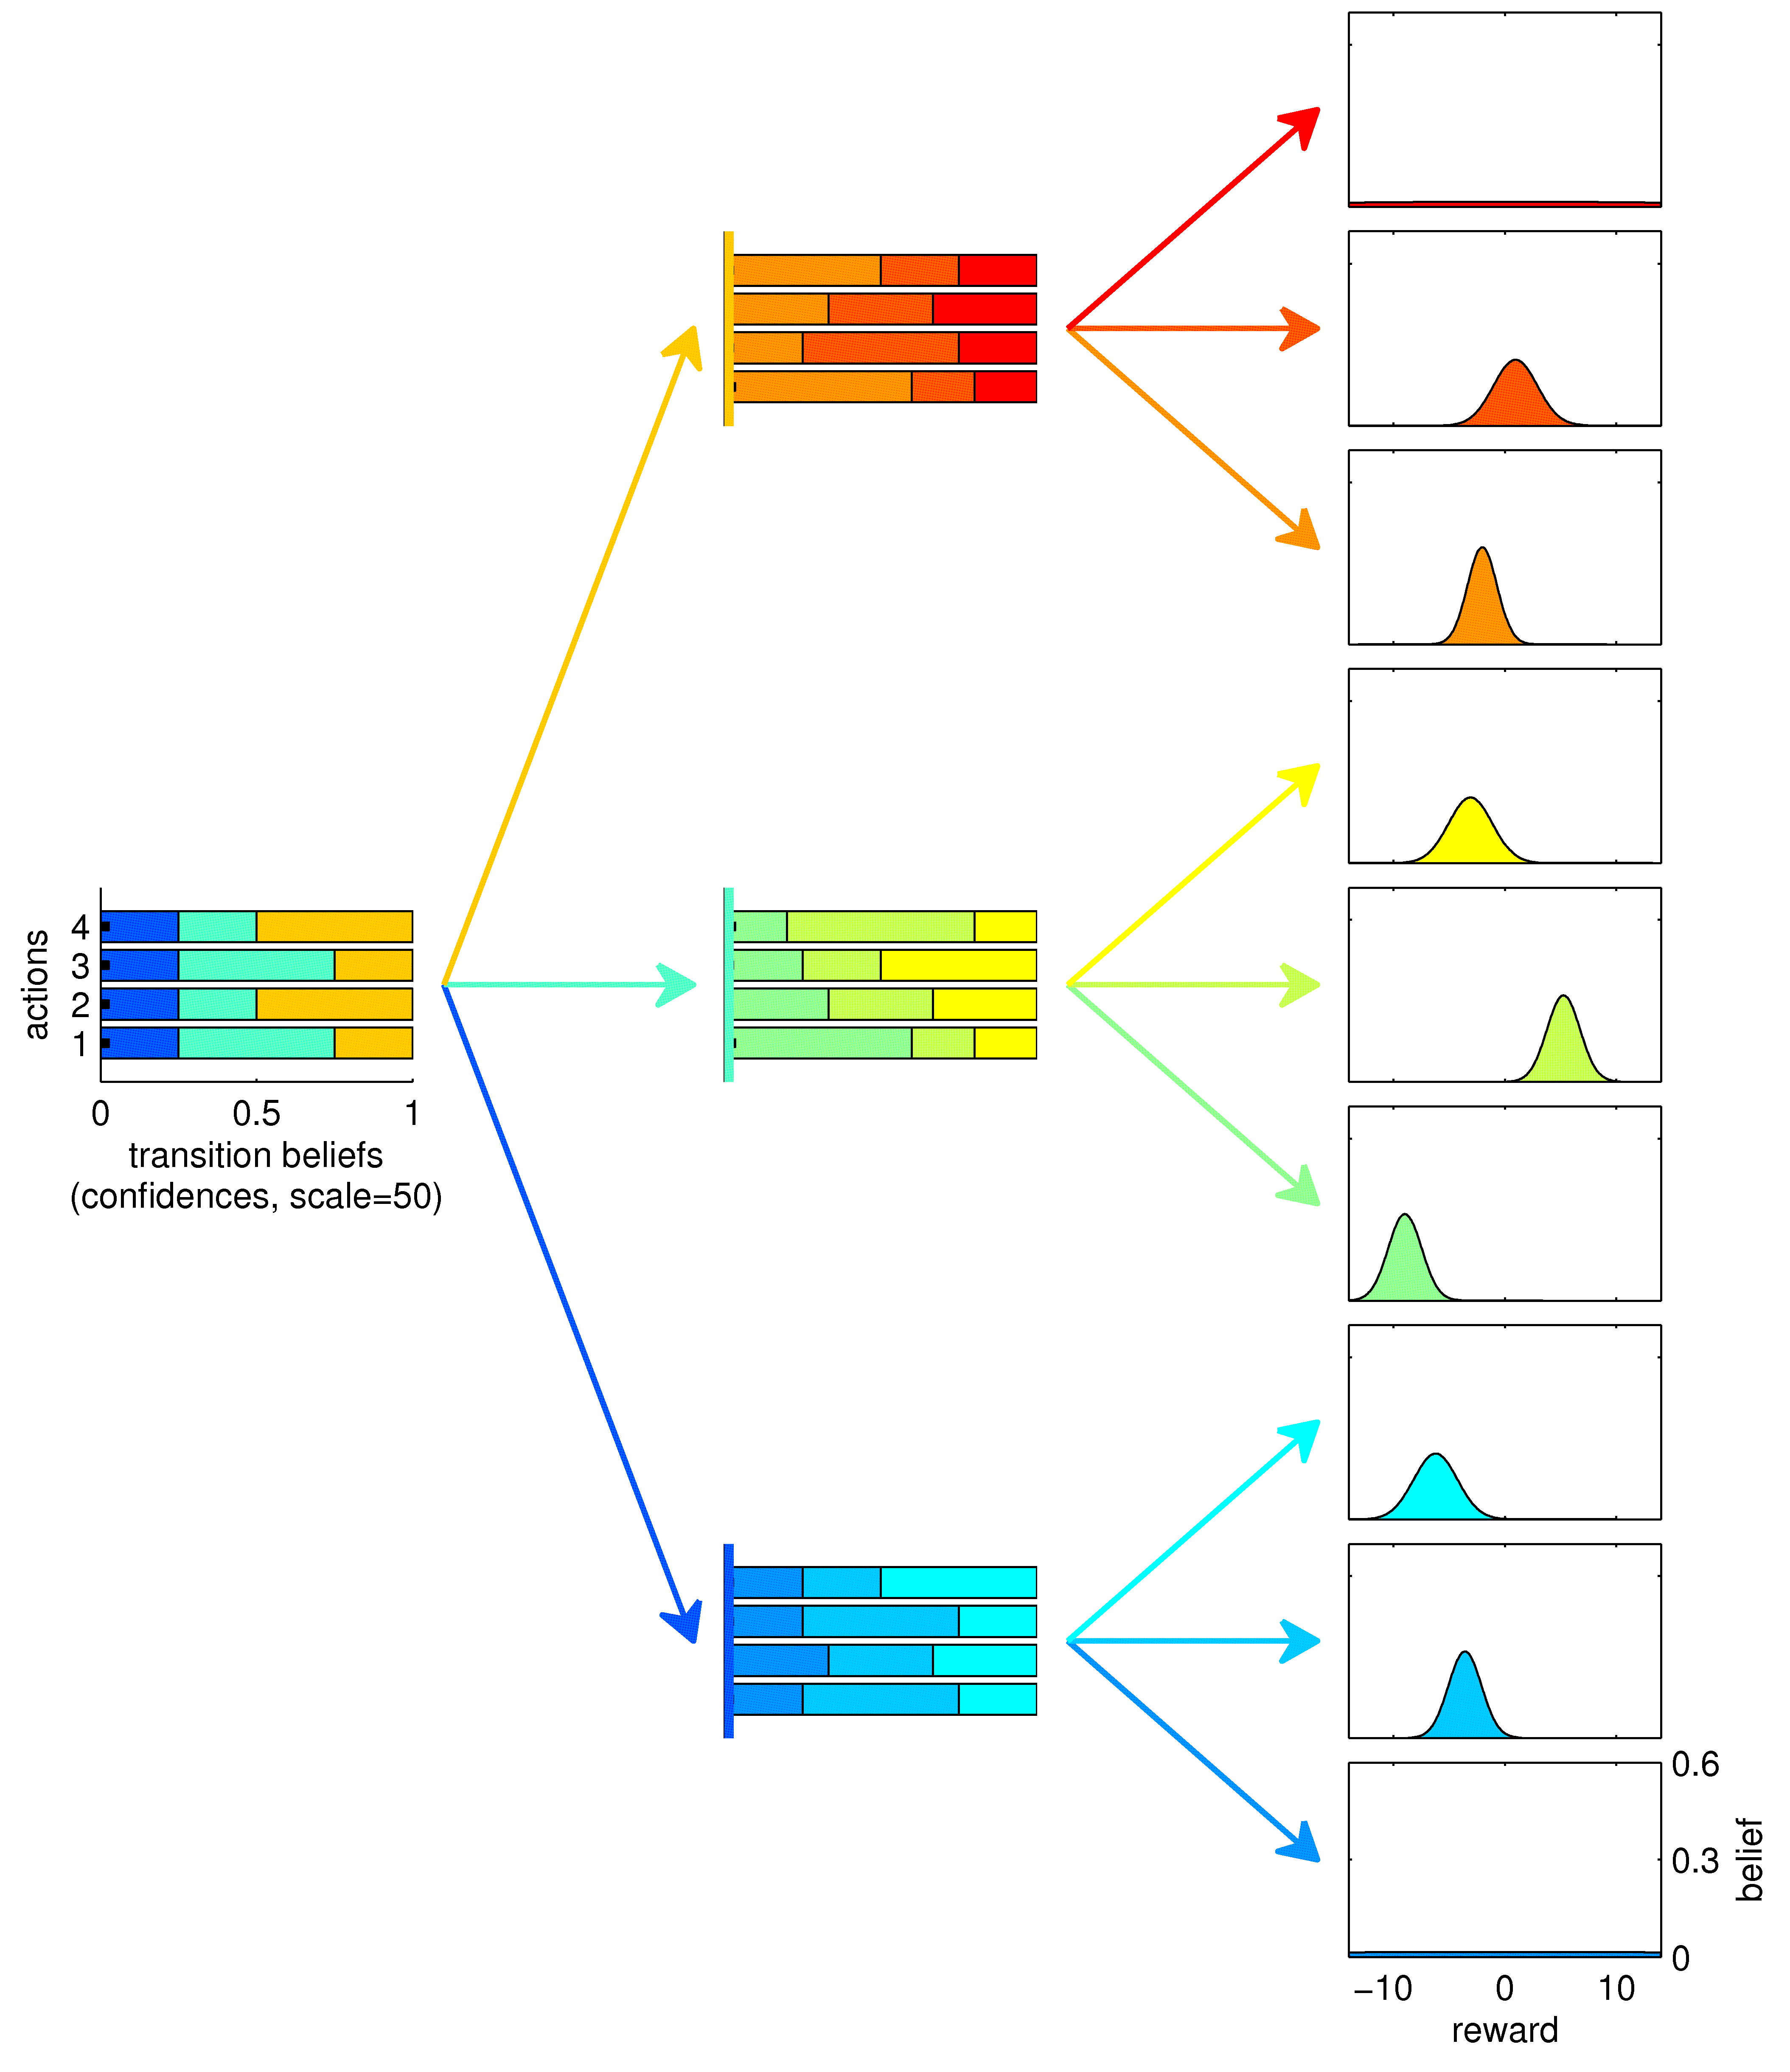
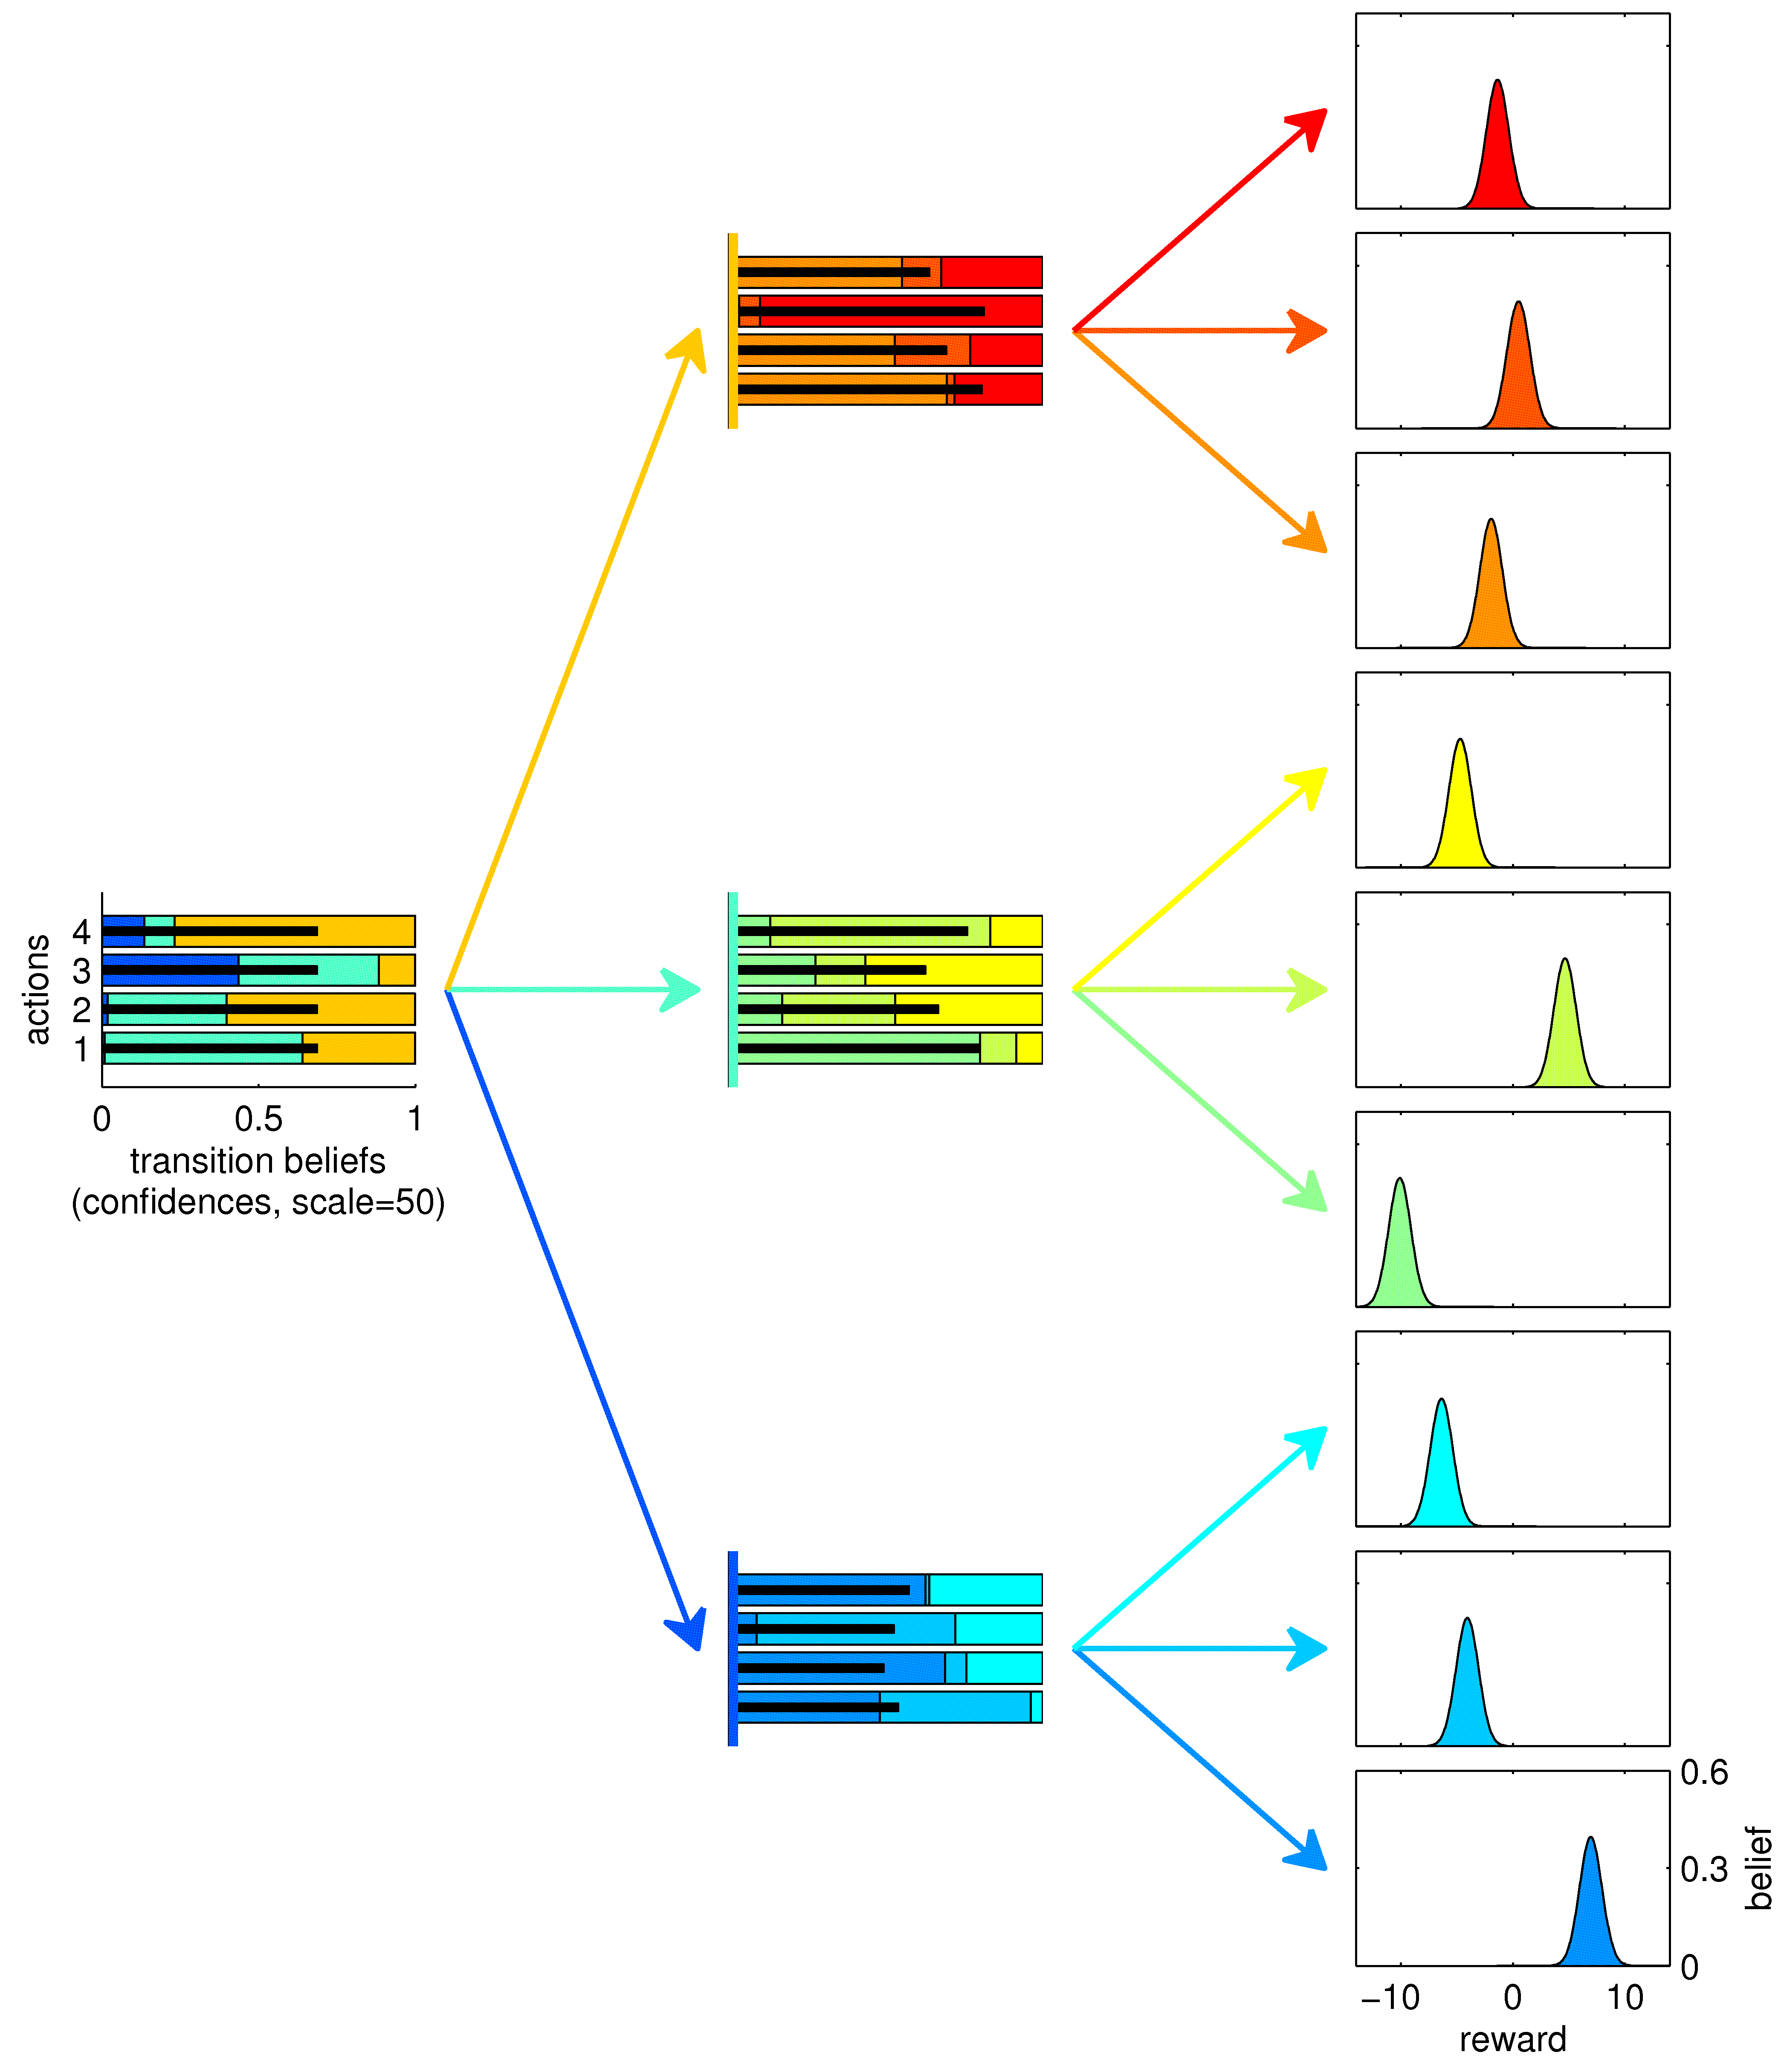
Semantic Controller
T=1
T=100

Slide 15
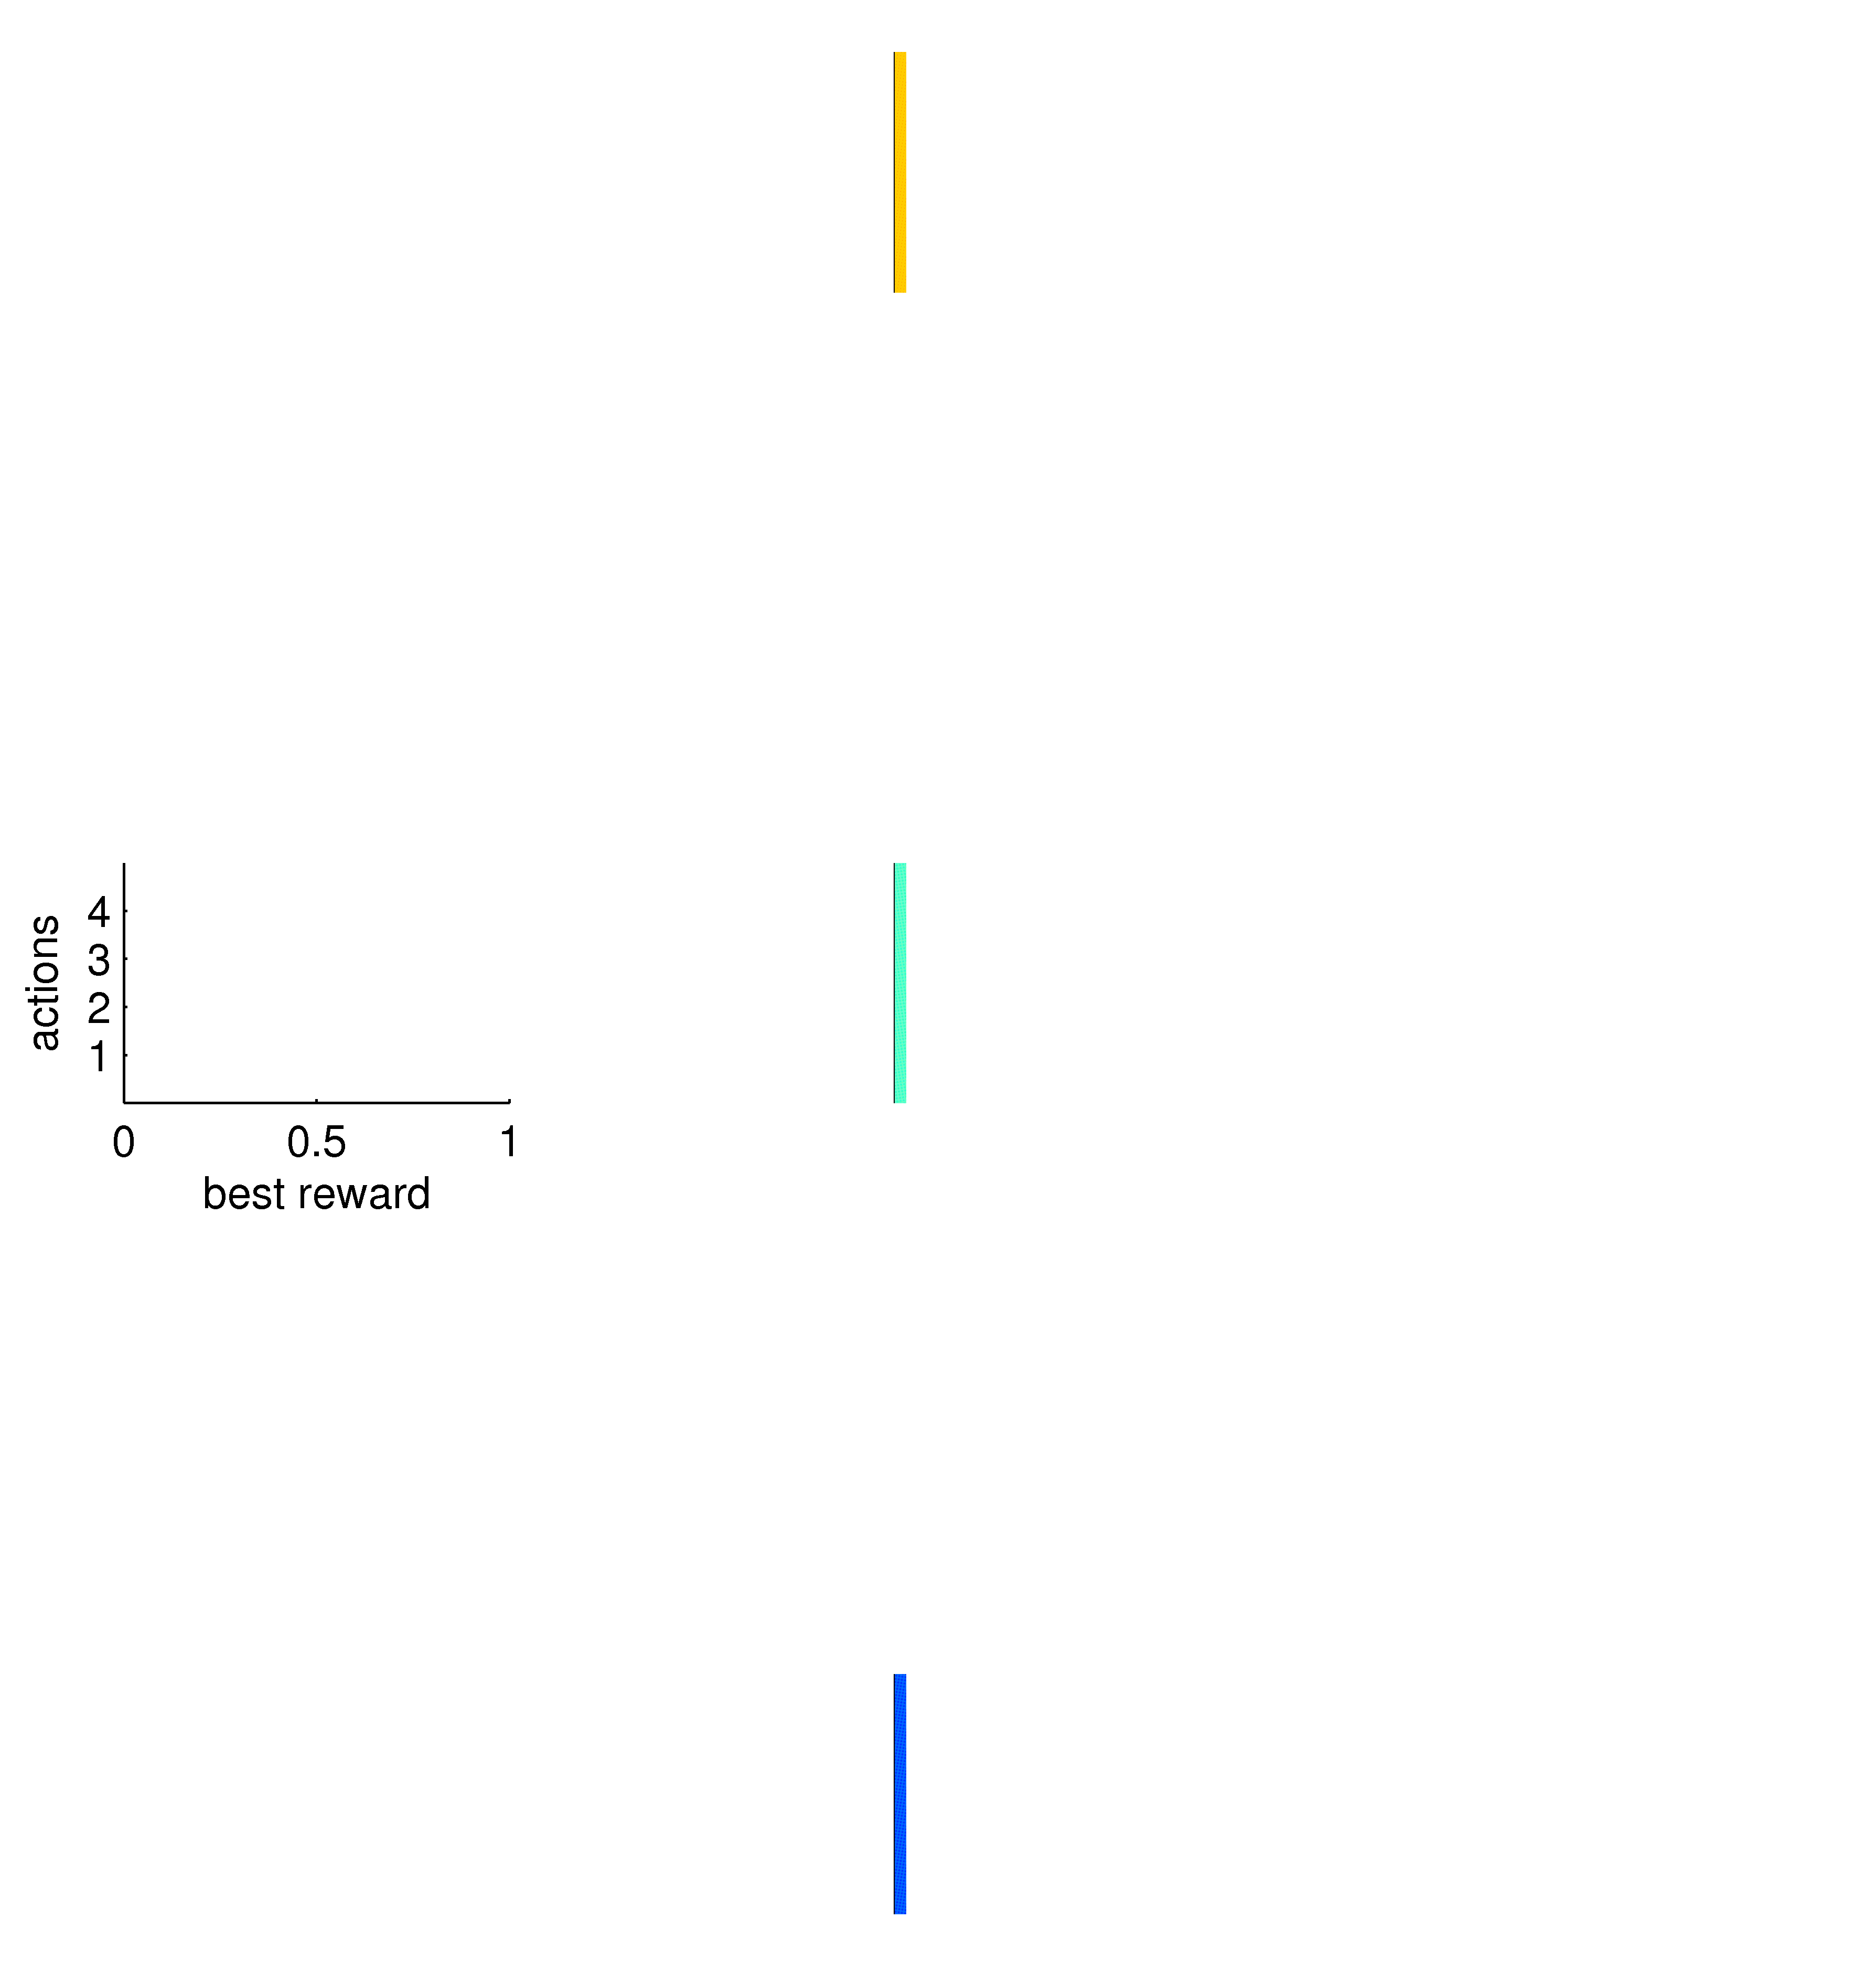
Episodic Controller
T=0
best
reward

Slide 16
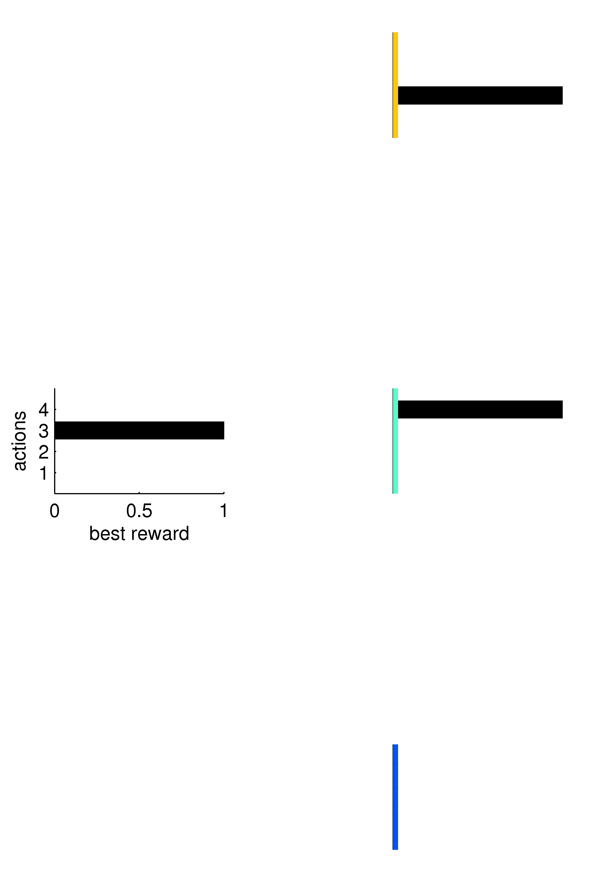
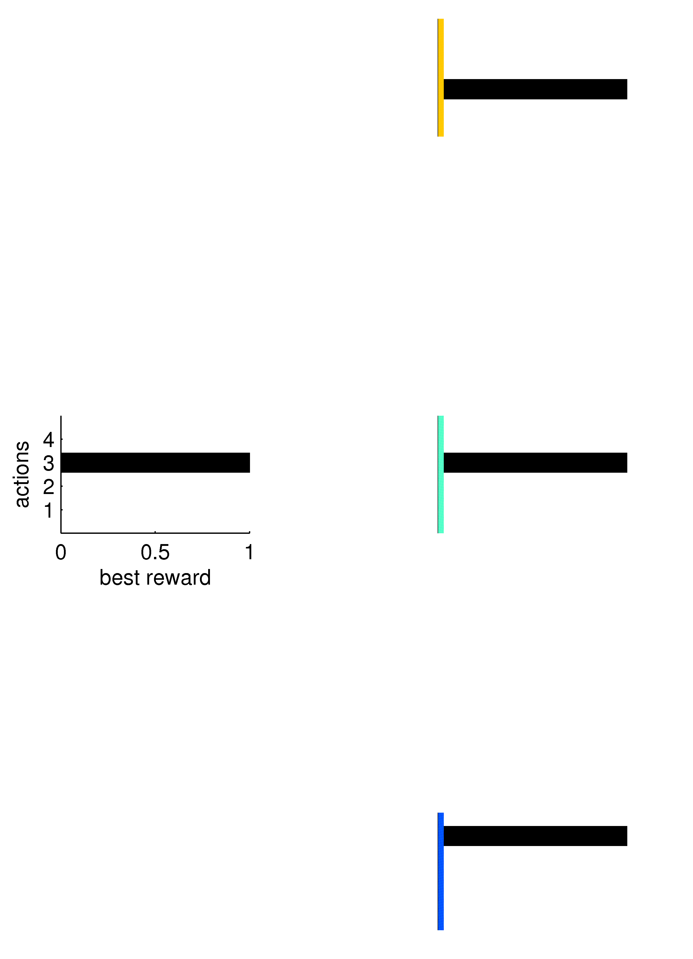
Episodic Controller
T=1
T=100
best
reward
best
reward

Slide 17
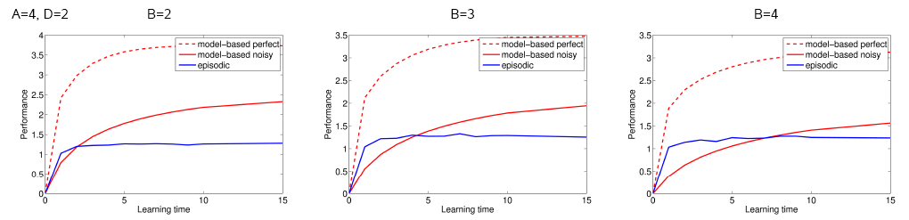
Performance
episodic advantage for early trials
lasts longer for more complex environments
can’t compute statistics/semantic information

Slide 18
Hippocampal/Striatal Interactions
Packard & McGaugh ’96
inactivate dorsal HC; dorsolateral caudate 8;16 days along training
place
action
test day 8
test day 16
12
place
action
8
# animals
4
0
S
S
S
L
S
L
L
L
CN
HC
CN
HC

Slide 19
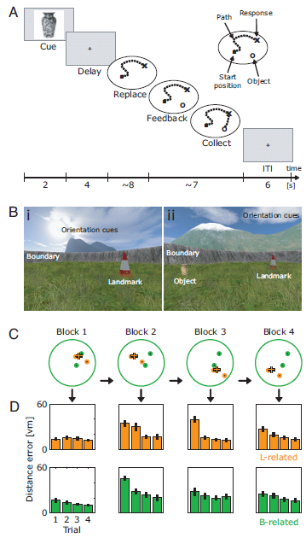
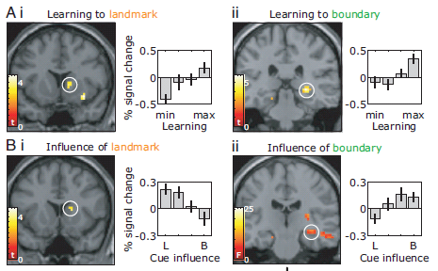
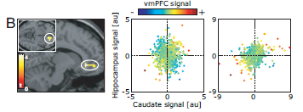
Hippocampal/Striatal Interactions
Doeller, King & Burgess, 2008 (+D&B 2008)

Slide 20
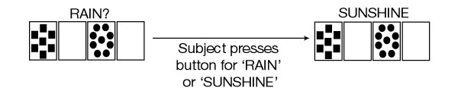
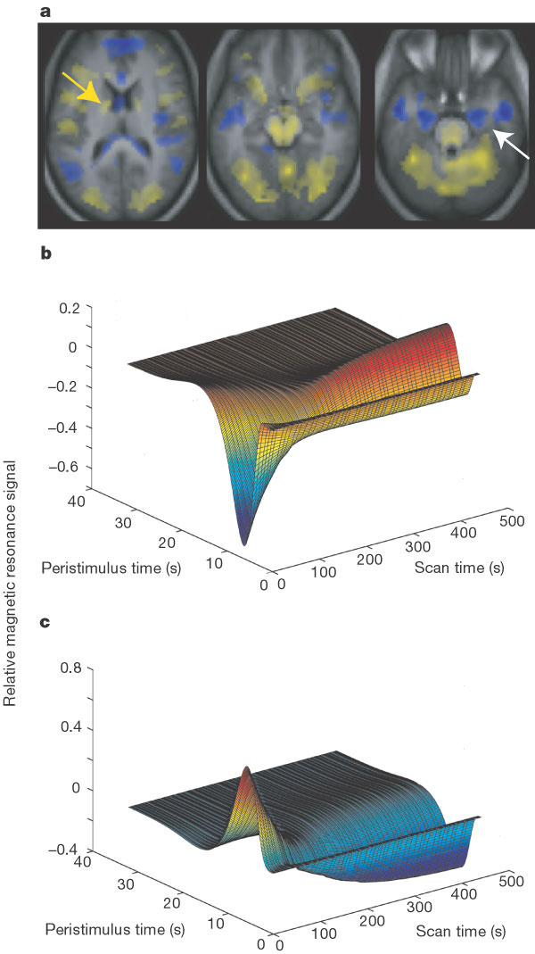
Hippocampal/Striatal Interactions
Poldrack et al: feedback condition
event related analysis
caudate
MTL

Slide 21
Hippocampal/Striatal Interactions
simultaneous learning
  but HC can overshadow striatum (unlike actions v habits)
competitive interaction?
  contribute according to activation strength
  but vmPFC covaries with covariance
content:
  specific – space
  generic – weather

Slide 22
Discussion
multiple memory systems and multiple control systems
episodic memory for prospective control
transition to PFC? striatum
uncertainty-based arbitration
memory-based forward model?
  but episodic statistics are poor?
Tolmanian test?
overshadowing/blocking
representational effects of HC (Knowlton, Gluck et al)

