Slide 1
Slow down and remember: behavior modulates information flow in the hippocampus
Caleb Kemere
Frank Lab, UCSF
Sloan-Swartz Meeting 2010

Slide 2
hippocampal circuit: simple model
Rapidly encode new information
neocortex
(slow plasticity)
(EC)
hippocampus
(rapid plasticity)
Sensory
Input
(CA1)
Provide spatial information (“Where am I now?“)
Retrieve recently learned sequences (“What was I doing?”)
Consolidate into long term storage (“What did I do?”)

Slide 3
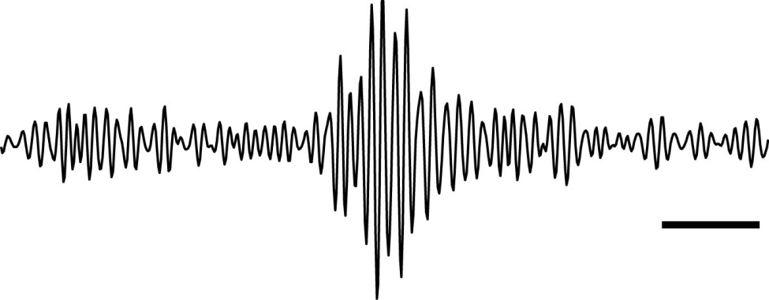
modes of ensemble activity
~ 200 Hz
50 ms
1
2
3
Cells
2 s
time
Place Activity
Ripple/Replay
Notes:
In addition to place field activity, there is at least one other pattern CA1 neurons also exhibit, sometimes while the rats are exploring, but more often when they’ve stopped moving.
During these times, unlike the sparseness during place field firing, a group of CA1 cells will rapidly spike. These spiking events are accompanied by a rapid about 200 Hz oscillation in the local field potential that we call a ripple.
What’s neat is that it appears that the majority of these events correspond to an ordered recapitulation of recently experienced place field firing – as if the cells are replaying a recent sequence of events.
Replay events are really neat – they appear to represent the memory of a sequence of events. “How did I get here?” “Where am I going?” “How did/or do I get from A to B?”. This sort of episodic memory could be really useful for guiding ongoing behavior – retrieval – or for training cortex about sequences of events – consolidation. Given that their timescale is appropriate for spike-timing dependent plasticity, this last possibility has become quite popular.

Slide 4
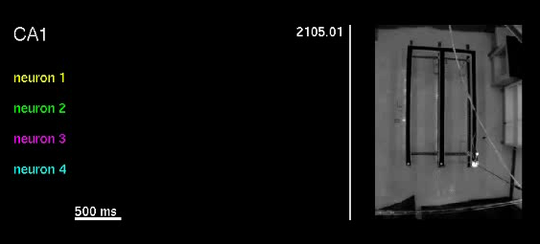
behavior and ensemble activity

Slide 5
outline
How does behavior modulate the hippocampal circuit as it transitions among different modes of operation?
Are there two distinct circuit states?
Is the whole circuit modulated by
behavior?
Can we see functional consequences?
(no – smooth)
(pathway specific)

Slide 6
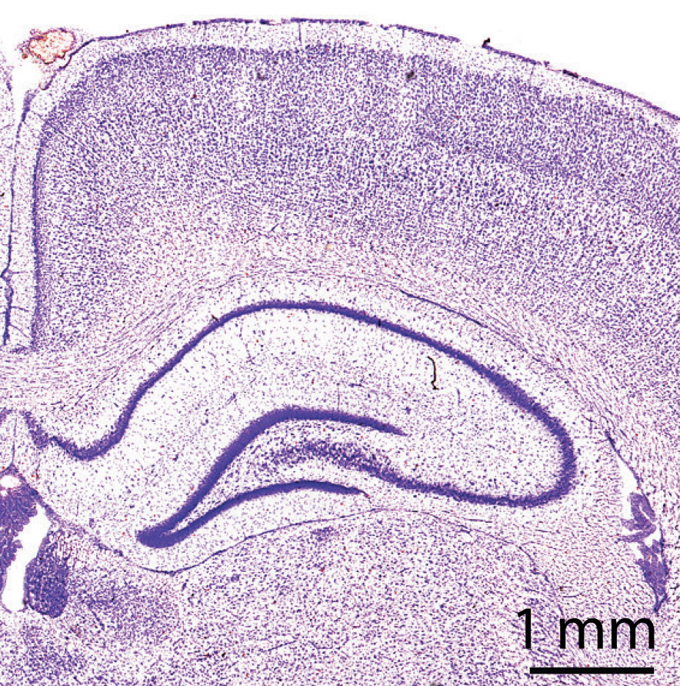
probing the hippocampal circuit
EC
CA1
CA1
DG
CA3
DG
probe
record
CA3

Slide 7
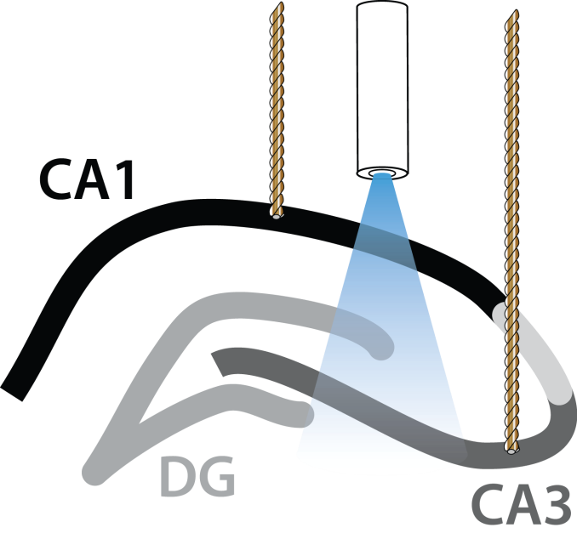
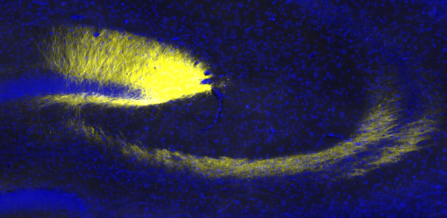
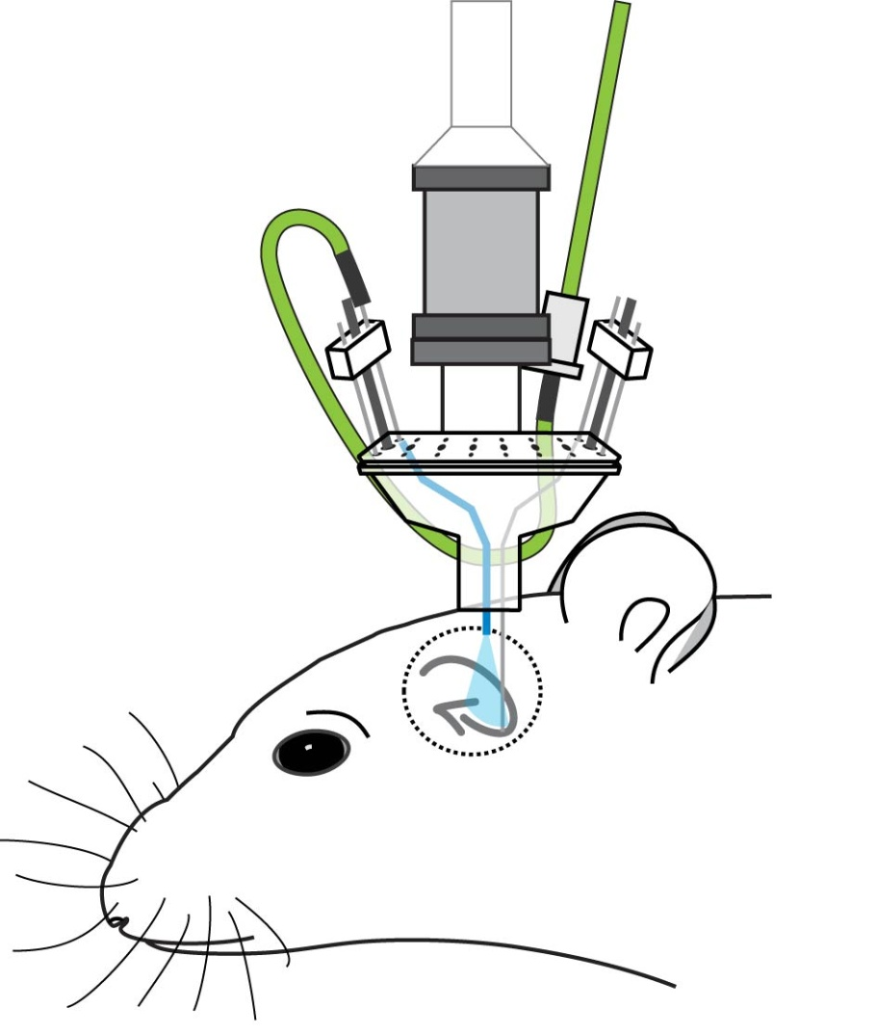
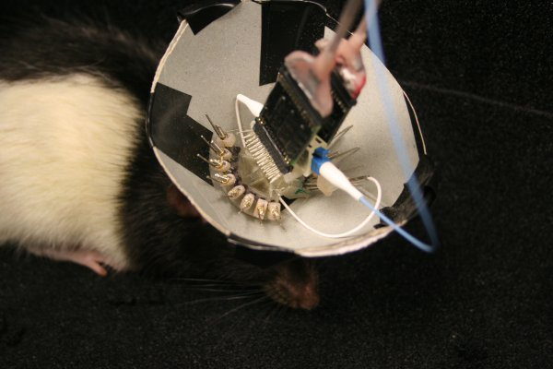
optogenetic approach
Channelrhodopsin-2
CA1
DG
CA3
Expose animals to linear tracks with novel and familiar sections.
Activate the mossy fiber pathway at 0.1 – 0.2 Hz during exploration.
Record units and LFP.
Lentivirus ChR2–eYFP (CaMKII promoter)
Notes:
7/6/2010
7
We made the fortuitous discovery that a combination of a certain kind of virus, and a particular promoter, expressed preferentially in the dentate gyrus granule cells – the ones that project excitation to area CA3. Specifically, this virus will drive expression out here in CA1, but not in CA3, so by injecting it in the right place, we would get selective dentate expression.
This meant that if we could transmit blue light to these cells, we could generate the kind of impulse response we were hoping to use to probe the circuit. And in contrast to the kind of response we would get from electrical stimulation, we would know that this arose only because of excitatory cells spiking.
So, we developed a microdrive that would allow us to chronically implant an optical fiber along with our recording electrodes. During an experiment, we connect the implanted optical fiber to a 473 nm laser.

Slide 8
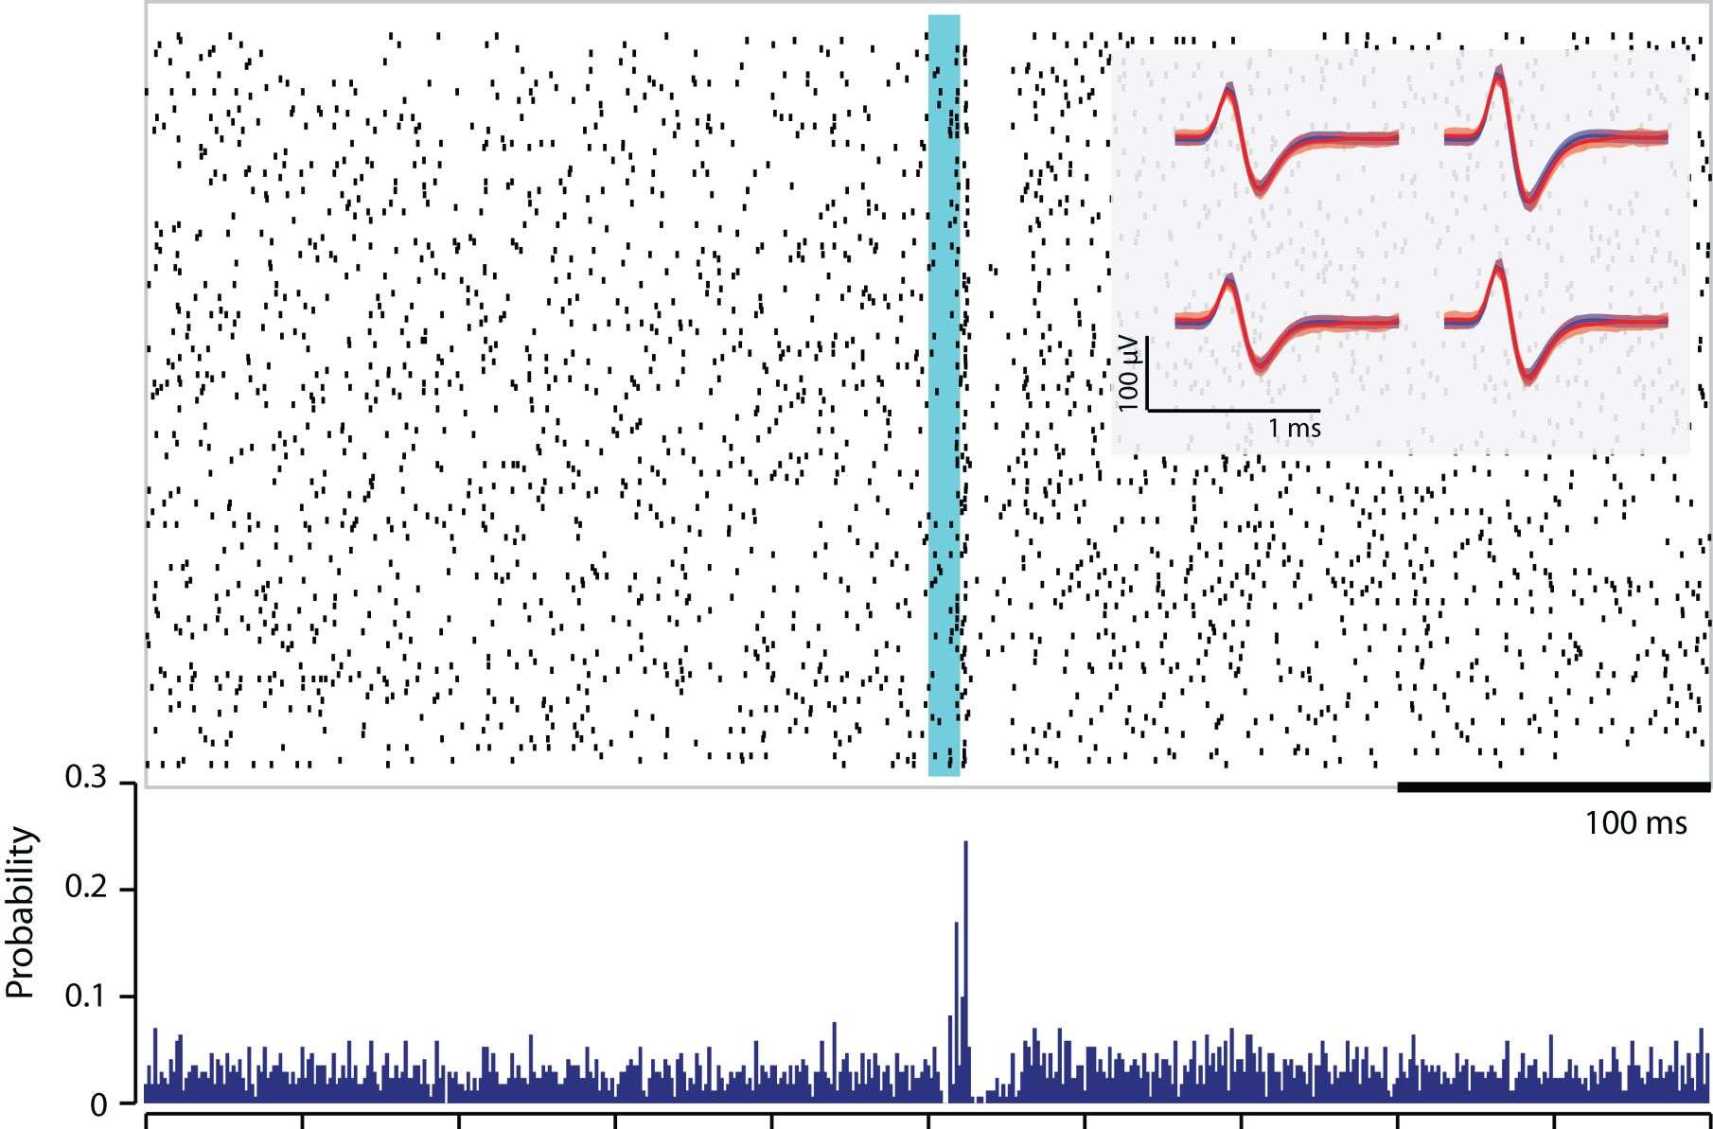
optogenetic excitation
DG
CA3
CA1

Slide 9
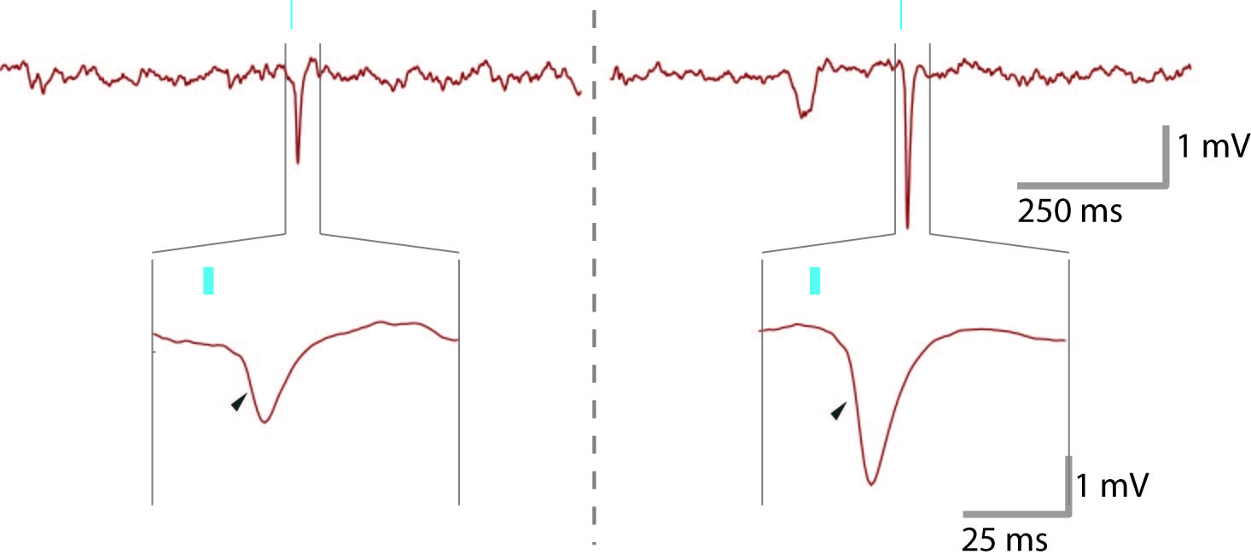
behavior modulates field potentials
DG
CA3
CA1
8 cm/s
0.5 cm/s
Moving
Still
Segal 1978
Notes:
7/6/2010
9
Ok, so here’s our first result
Let’s focus in on the EPSPs we recorded in area CA1. This signal corresponds to a large depolarization of CA1’s inputs. Now notice that this was a case when the rat was moving somewhat quickly, 8 cm/s. Here’s another example, where now, the rat was moving quite a bit slower. Interestingly, the evoked response in CA1 is almost twice as big!
I should point out at this point that in an electrical stimulation experiment back in the late 70’s, people had pointed out that if you stimulate the CA3-CA1 projection electrically, you get a big difference between when the animals are sitting still and when they’re moving. But do two behavioral states really capture the variation of the system – is this going to be like baseline activity and planning?

Slide 10
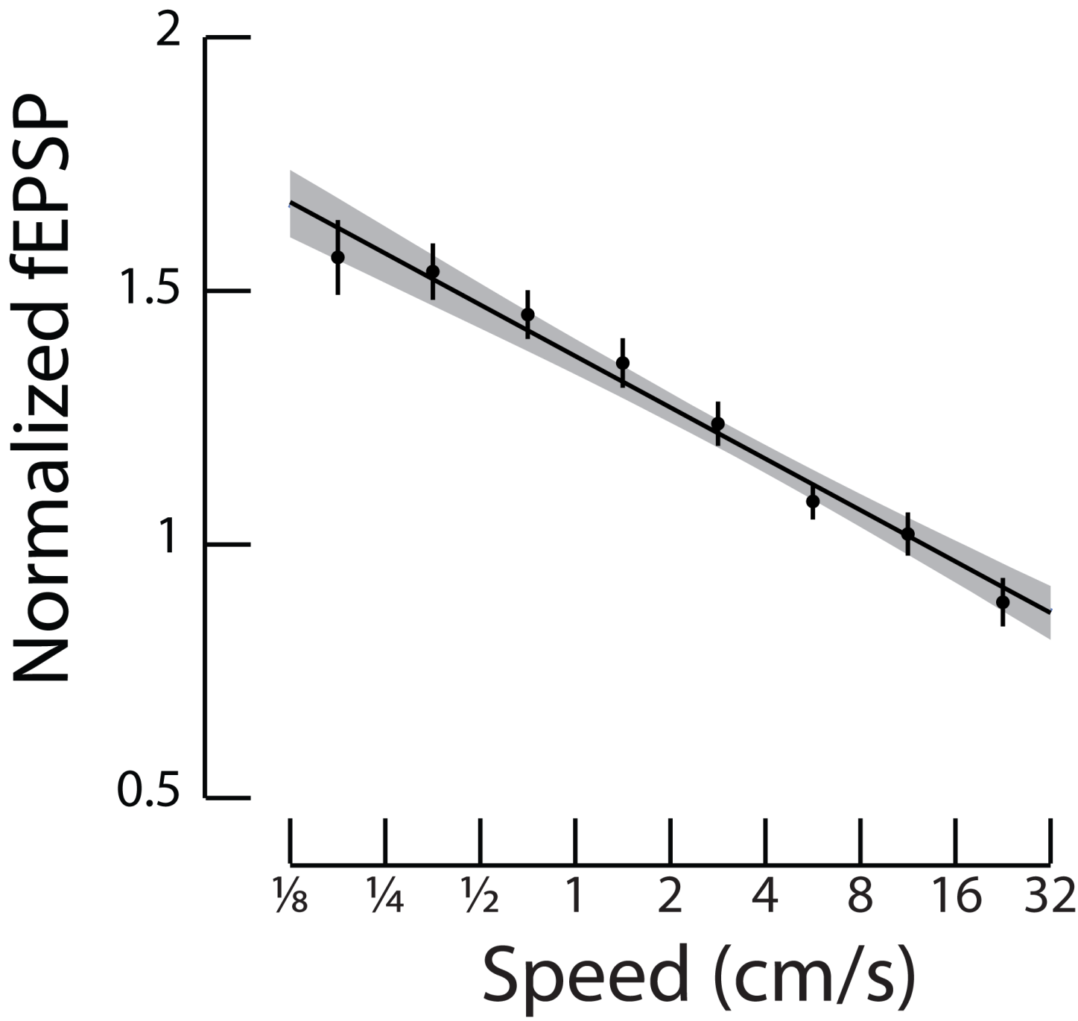
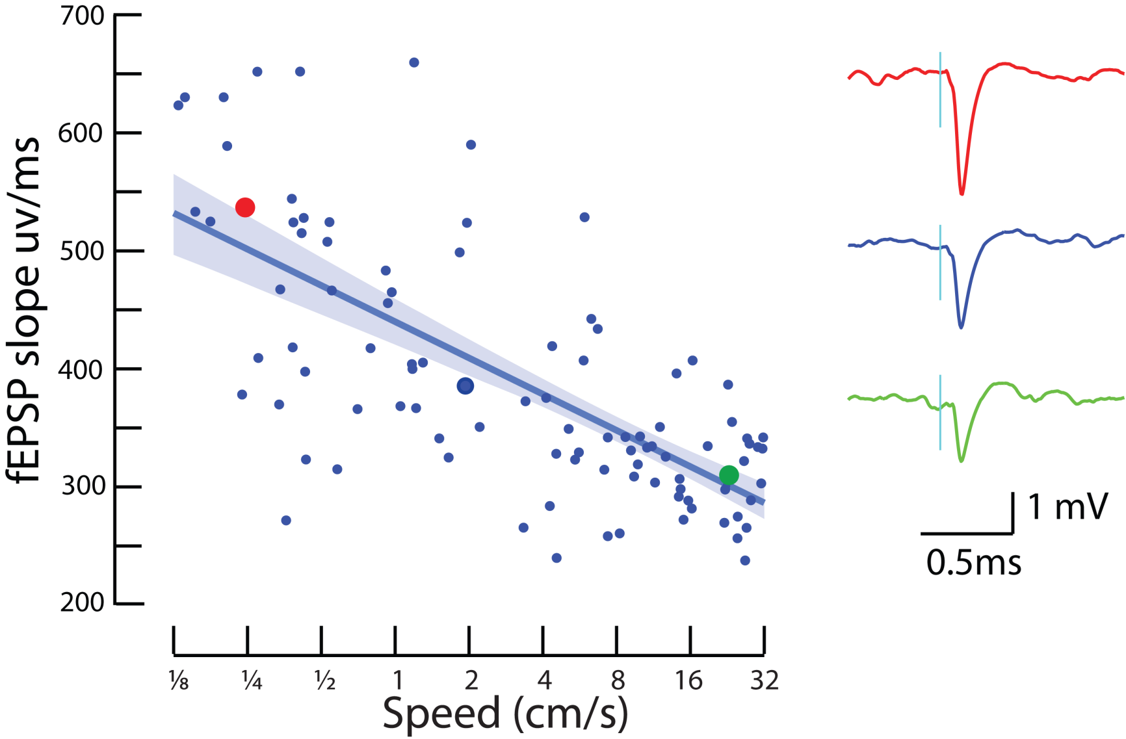
CA1 responses as a function of speed
DG
CA3
CA1
R²=0.5
Notes:
7/6/2010
10

Slide 11
outline
Are there two distinct circuit states?
behavior (speed) smoothly modulates strength
Is the whole circuit modulated by behavior?
Can we see functional consequences?

Slide 12
localizing modulation
DG
Granule cell excitability?
Mossy fiber pathway?
CA3
Schaeffer collateral pathway?
CA1
Notes:
7/6/2010
12

Slide 13
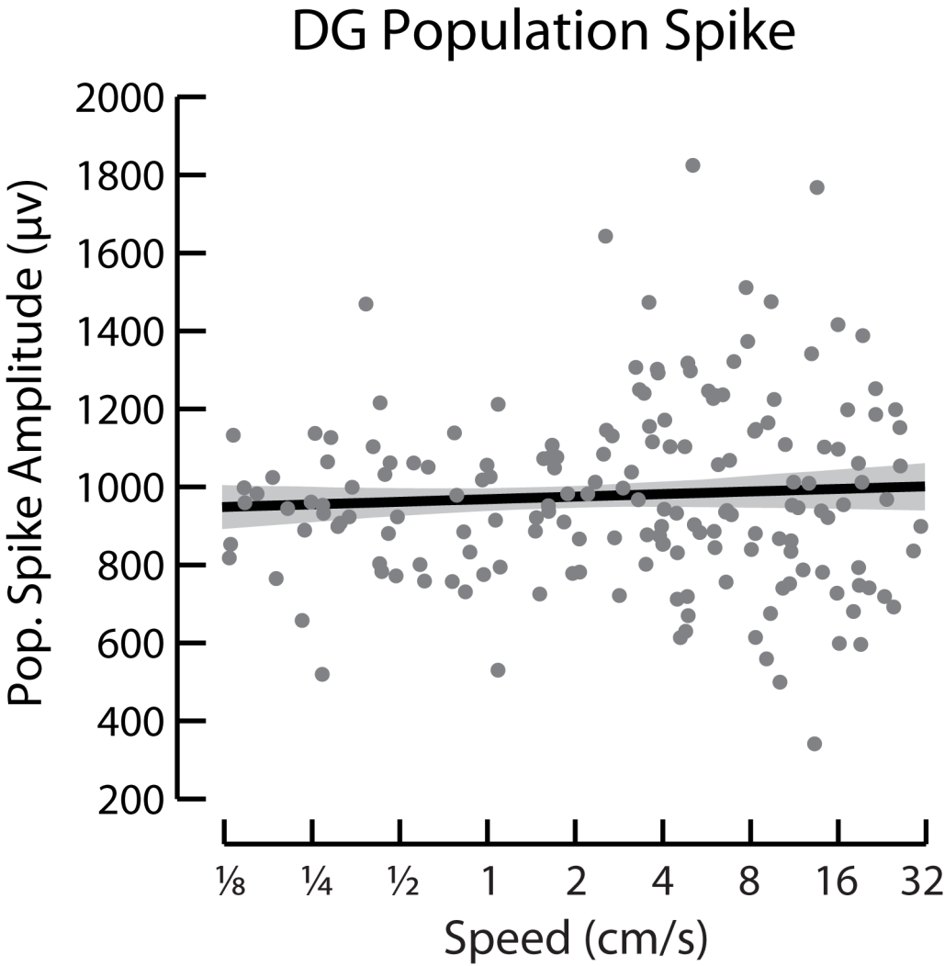
localizing modulation: granule cells?
ChR2 stim
DG Pop. Spike
DG
CA3
CA1
pop spike

Slide 14
localizing modulation
DG
Granule cell excitability?
Mossy fiber pathway?
CA3
Schaeffer collateral pathway?
CA1
Notes:
7/6/2010
14

Slide 15
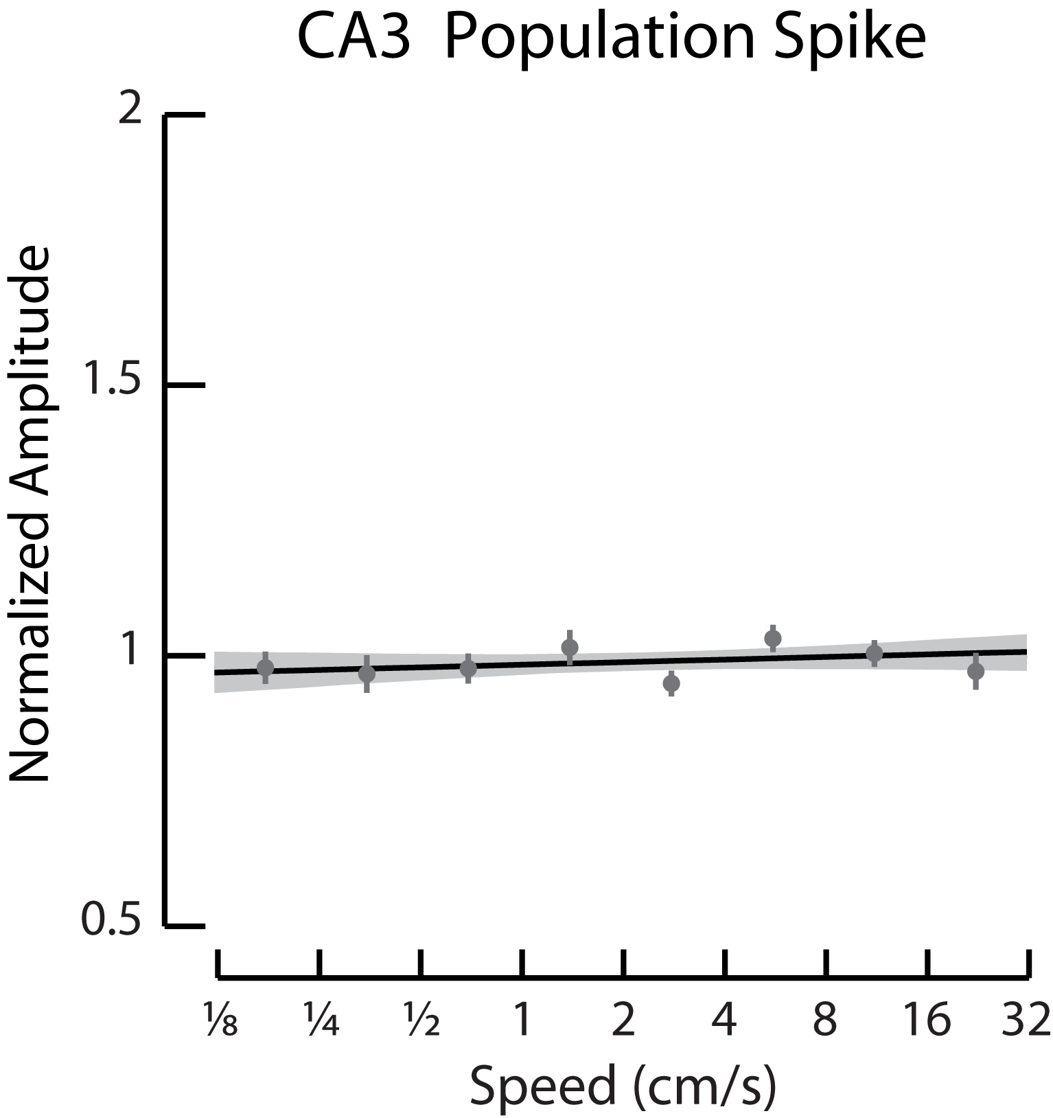
localizing modulation: mossy fibers?
ChR2 stim
CA3 Pop. Spike
DG
CA3
CA1
pop spike

Slide 16
localizing modulation
DG
Granule cell excitability?
Mossy fiber pathway?
CA3
Schaeffer collateral pathway?
CA1
Notes:
7/6/2010
16

Slide 17
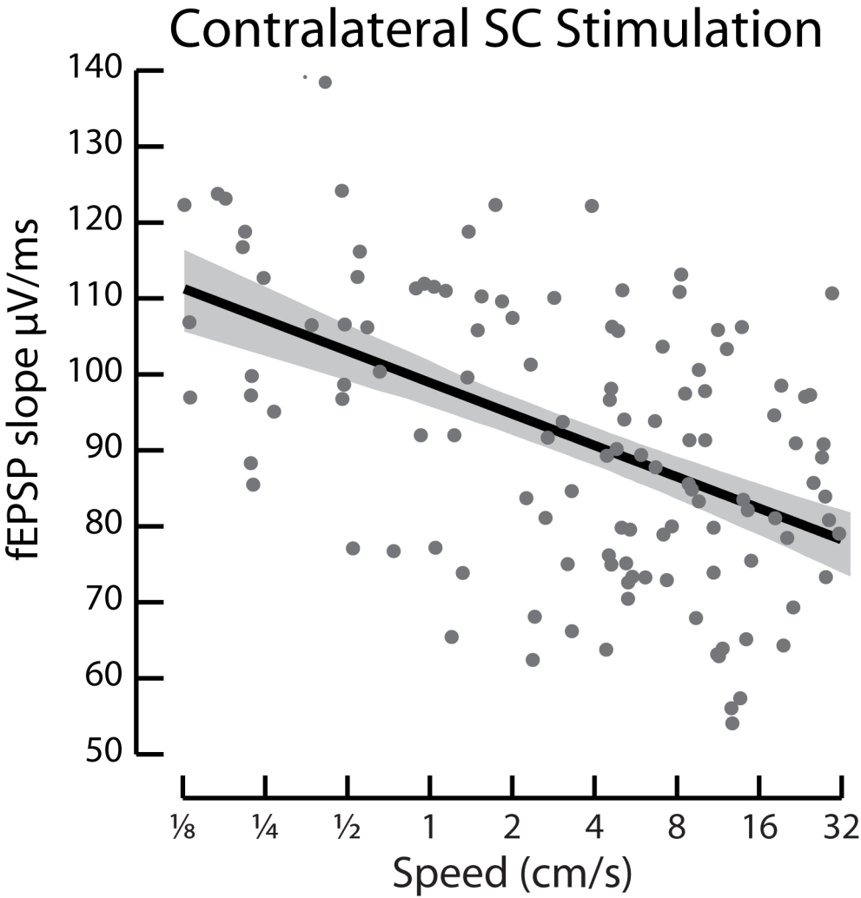
localizing modulation: SC?
Electrical stim
Controls for questions about optogenetics!
CA1 fEPSP
DG
CA3
CA1
fEPSPs

Slide 18
outline
Are there two distinct circuit states?
speed smoothly modulates strength
Is the whole circuit modulated by behavior?
evidence points to Schaffer collaterals
Can we see functional consequences?

Slide 19
speed and information flow
EC
CA1
  Predictions: hippocampal output through CA1 should be
    – driven more by CA3 at low speeds
    – driven more by EC at high speeds?
DG
CA3
    collaboration with Maggie Carr
Notes:
7/6/2010
19

Slide 20
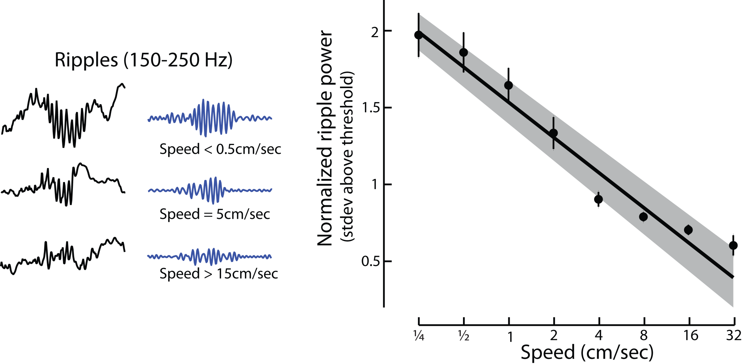
propagation of ripples
DG
CA3
CA1

Slide 21
speed dependence – predictions
  During learning, hippocampal output through CA1 should be
    driven more by CA3 at low speeds
    – driven more by EC at high speeds?
Notes:
7/6/2010
21

Slide 22
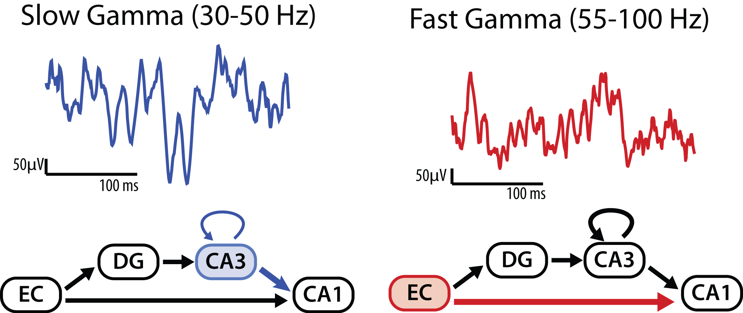
distinct gamma frequencies in CA1
Colgin et. al., Nature (2009)
Notes:
7/6/2010
22

Slide 23
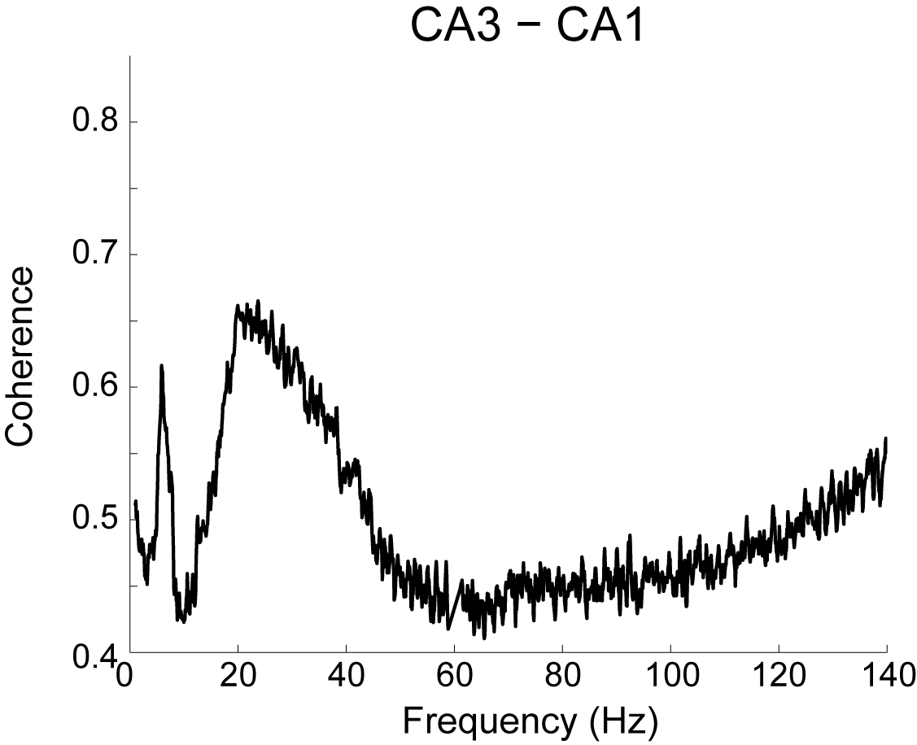
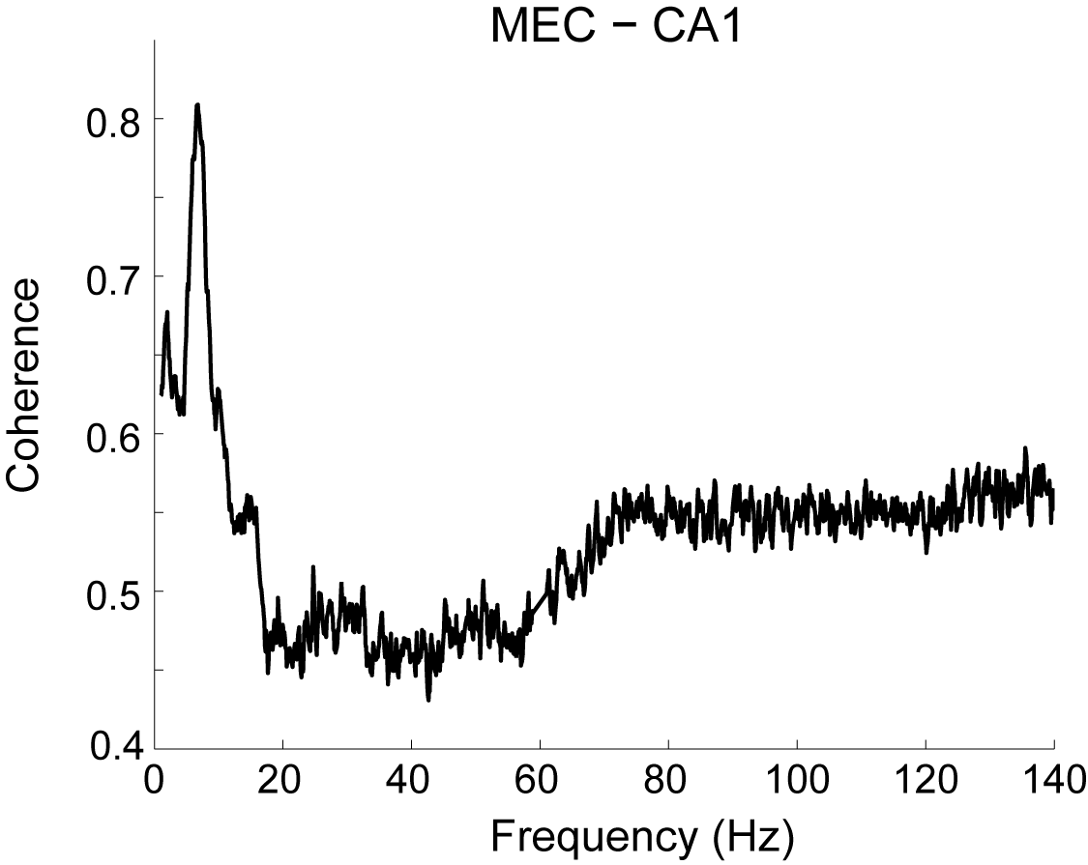
Gamma Frequency Coherence Across Hippocampal Subregions
Replication of Colgin et. al., Nature (2009)
Notes:
7/6/2010
23

Slide 24
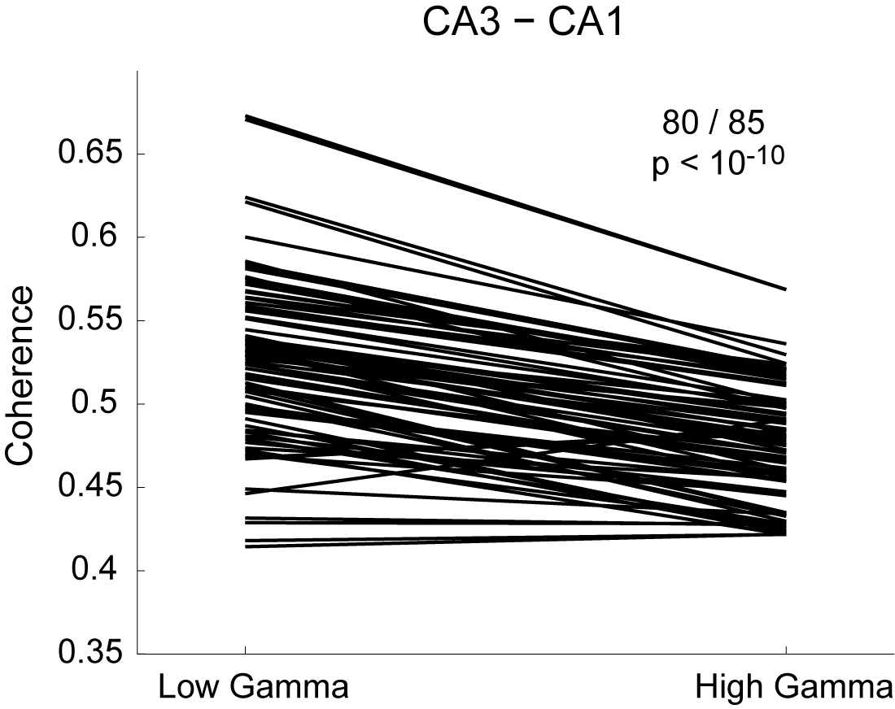
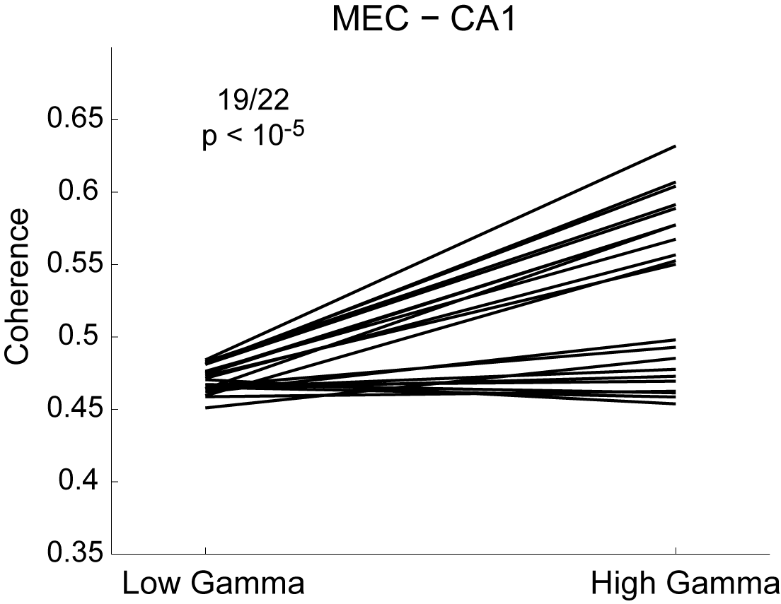
Coherence During Low and High Gamma Events
Low and high gamma modulate CA1 spiking
Replication of Colgin et. al., Nature (2009)
Notes:
7/6/2010
24

Slide 25
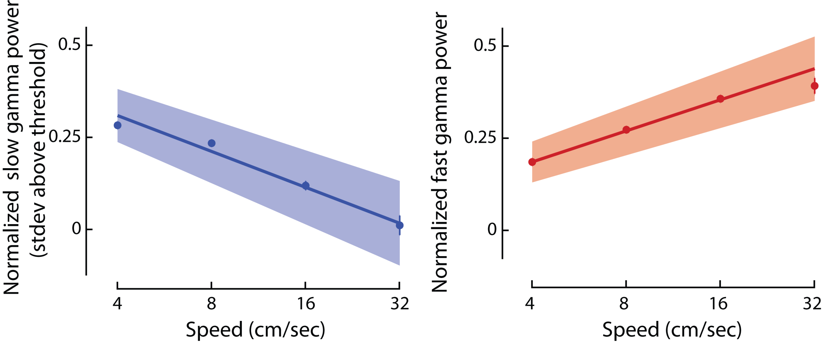
speed modulation of gamma
Slow Gamma
Fast Gamma
Notes:
7/6/2010
25

Slide 26
conclusion
Behavior (speed) smoothly modulates the hippocampal circuit, specifically the SC pathway.
Behavior regulates the balance between internal and external processing.
Encoding/Associating – Retrieval – Consolidation
Trisynaptic Pathway
DG
CA3
EC
EC
CA1
Direct Pathway
Internal Processing
External Processing
Speed

Slide 27
Acknowledgements
Frank Lab: Loren, Maggie Carr, Mattias Karlsson,
Steve Kim, Annabelle Singer, Yuri Dabaghian,
Surya Ganguli, Patricia Correia, Sheri Harris, Shantanu Jadhav, P. Walter German, Kenneth Kay
Feng Zhang, Karl Deisseroth
Funding:
Sloan Swartz Foundation, NIH, Helen Hay Whitney Foundation

Slide 28
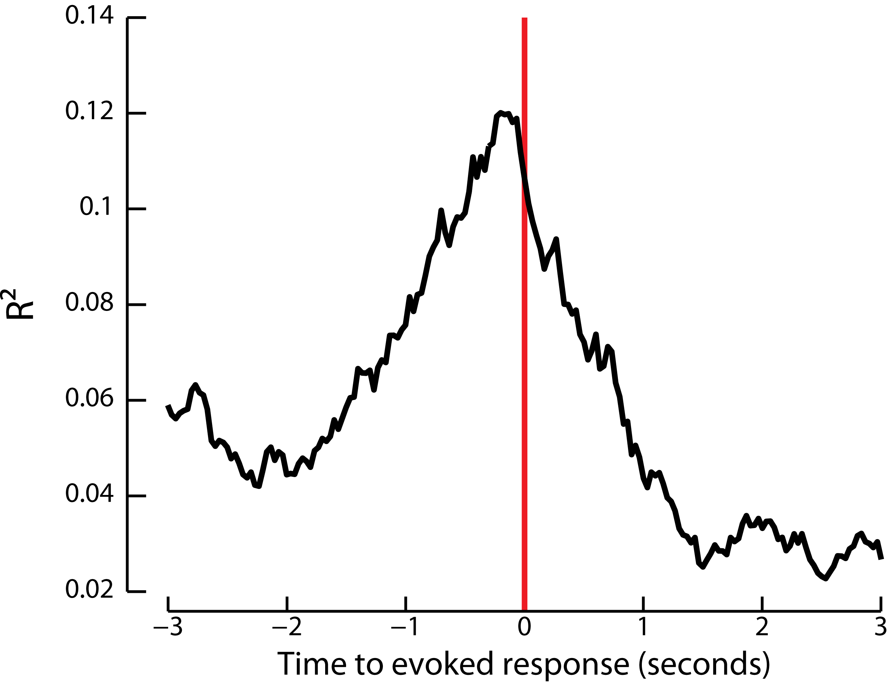
R² vs lagged speed

Slide 29
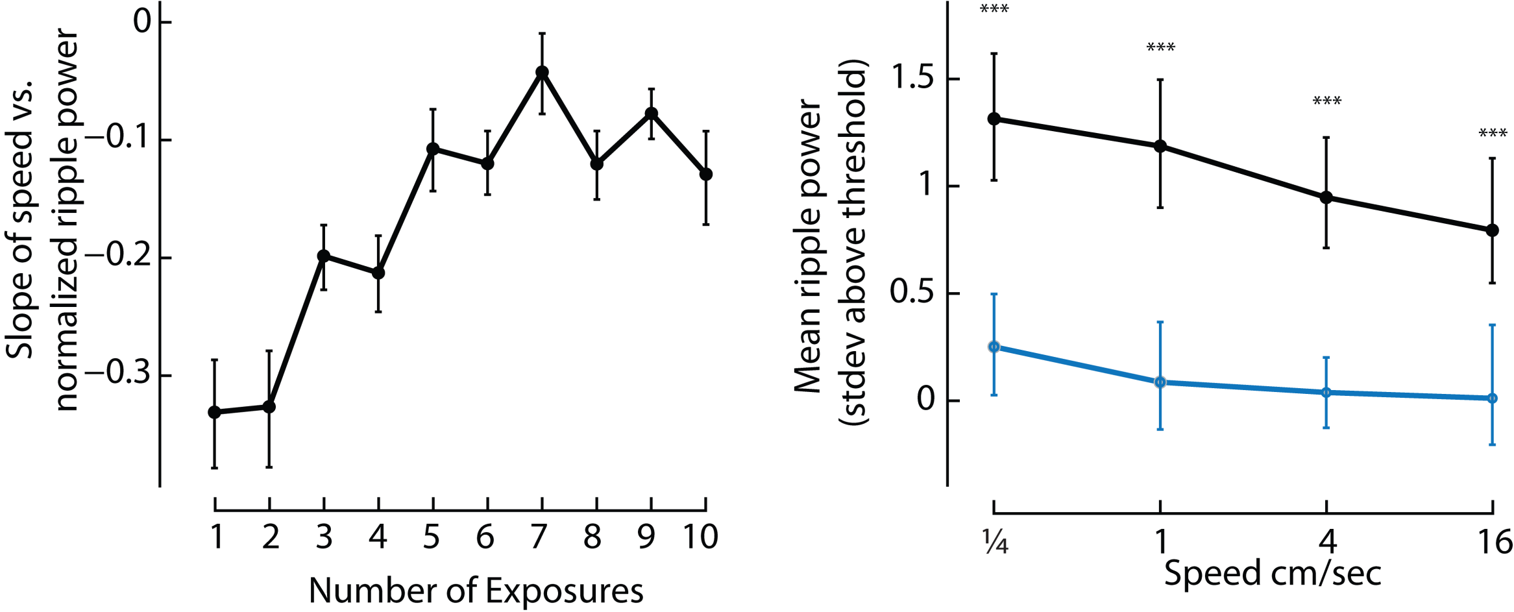
propagation of ripples – learning
Novel
Familiar

Slide 30
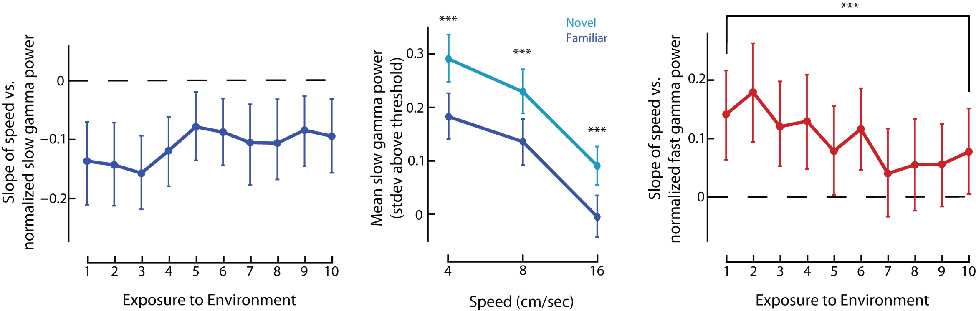
gamma and novelty

