Slide 1
Seeing into Insight
Jonathan W. Schooler
University of California Santa Barbara Parallels between Sight and Insight

Slide 2
Parallels between Sight and Insight
Core thesis
    There are striking parallels between the information processing characteristics of vision and insight.

Slide 3

Suddenly apparent alternative coherent representations: Vision
  Static
    Figure Ground

Slide 4

Suddenly apparent alternative coherent representations: Vision
  Static
    Figure Ground
    Reversible Images

Slide 5
Suddenly apparent alternative coherent representations : Vision
Dynamic
  Rotating Necker cube

Slide 6
Suddenly apparent alternative coherent representations: Vision
Dynamic
  Rotating Necker cube
  Spinning dancer illusion

Slide 7
Suddenly apparent alternative coherent representations: Insight
Historical
  Archimedes volume of a crown
  Newton- Terrestrial vs. celestial motion
  Relativity- Gravity and acceleration are identical
Everyday
  Humor
    Puns
  Insight problems
    Aha problems- Metcalfe demonstration of suddenness
    Backward vs. forward reasoning
      Lilly pond

Slide 8
Recognizing additional dimensions
Vision: The Magic Eye
A particularly profound alternative coherent representation

Slide 9
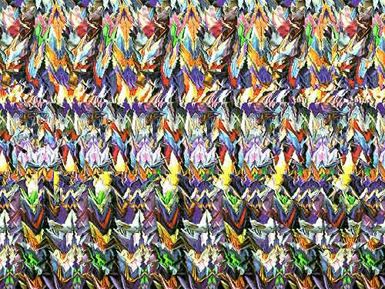

Slide 10
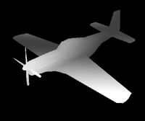

Slide 12
Recognizing additional dimensions Insight
Historical
  Flatland
  Relativity
  String Theory
Insight
  6 matches problem

Slide 13
Evidence for overlap in processing between representational shifts in vision and insight
Relationship between insight problem solving and recognizing out of focus picture
  Schooler et al 1996

Slide 14
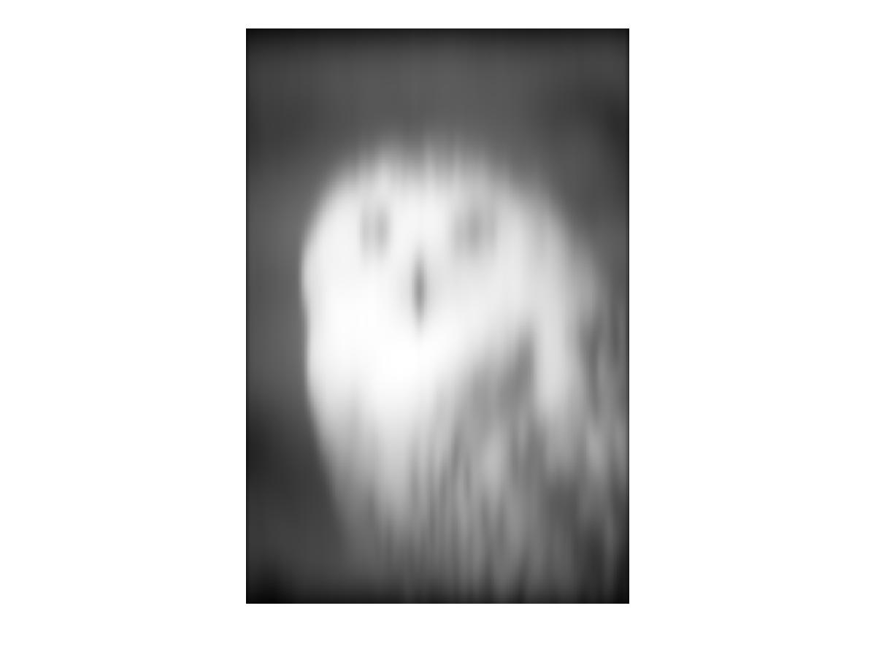

Slide 15
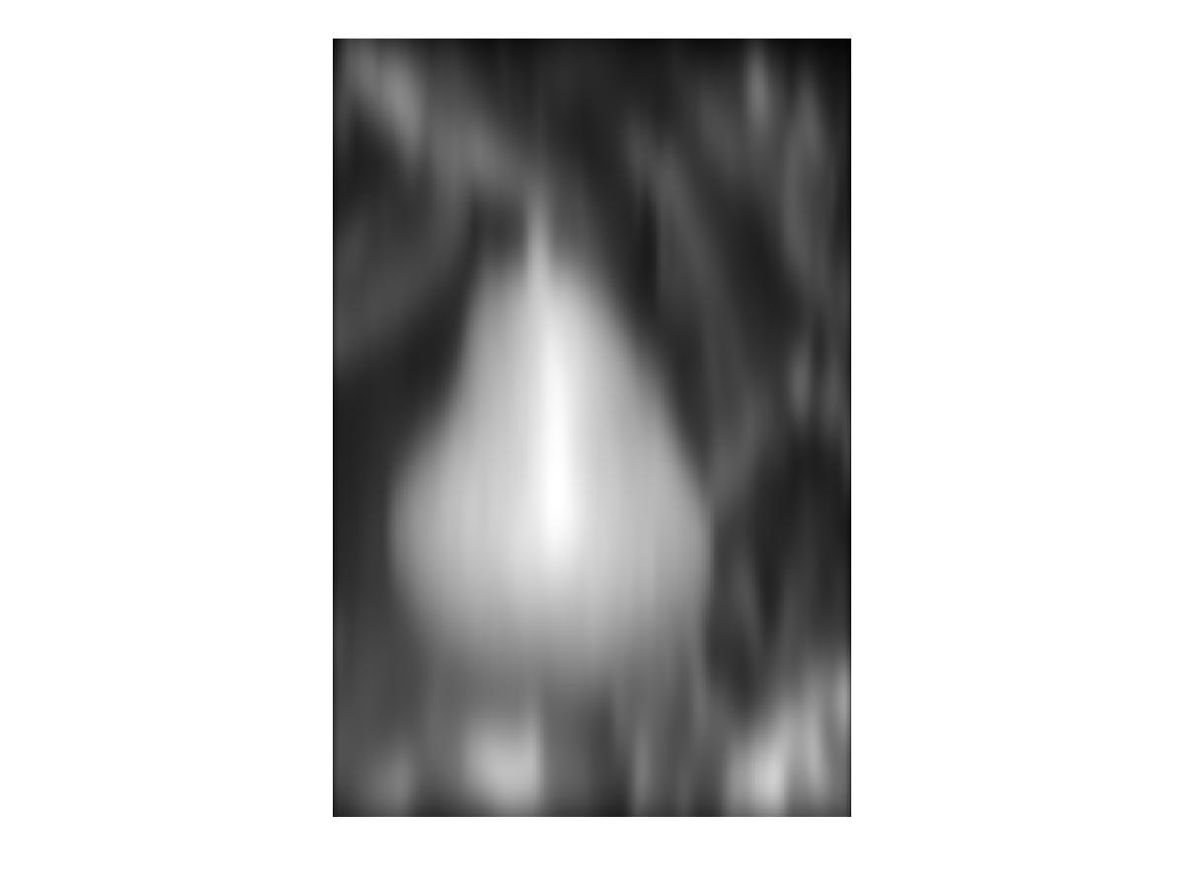

Slide 16
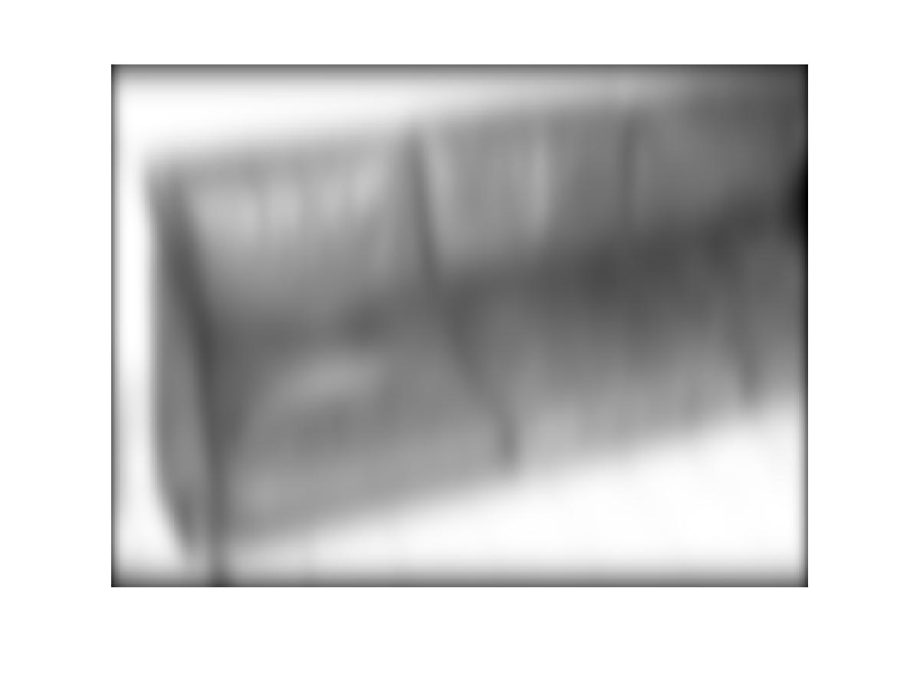

Slide 17


Slide 18
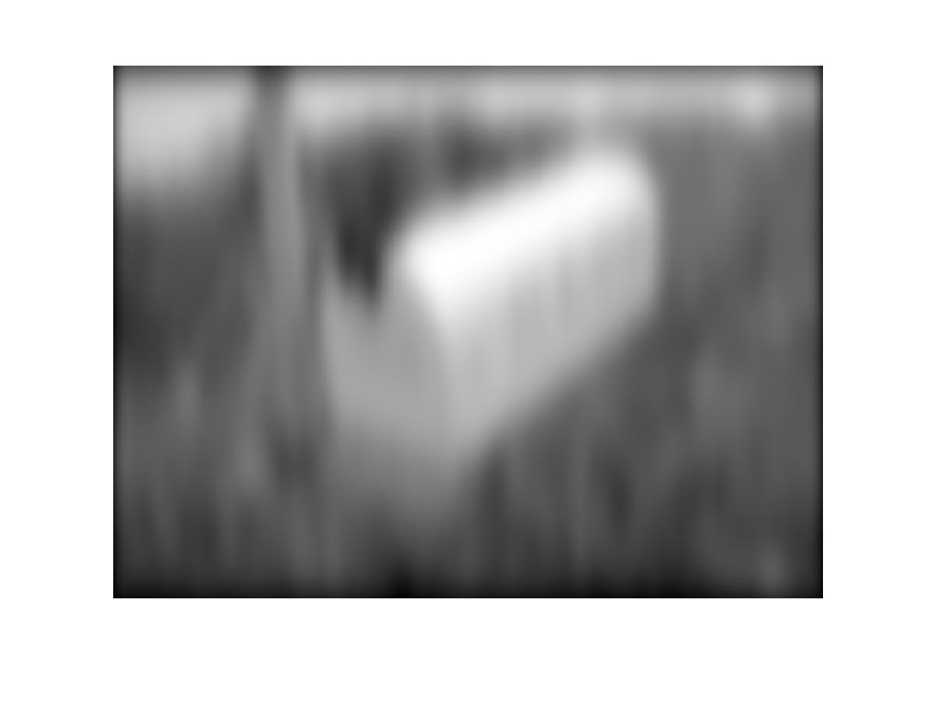

Slide 19
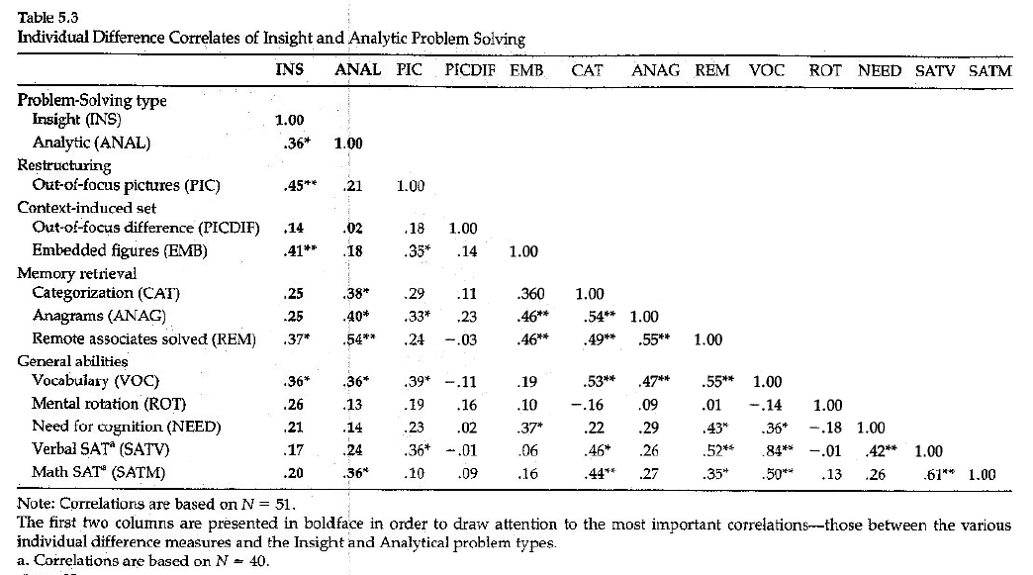
Evidence for overlap in processing between representational shifts in vision and insight
Relationship between insight problem solving and recognizing out of focus picture

Slide 20
Entrenchment in vision
Bruner and Potter effect

Slide 22
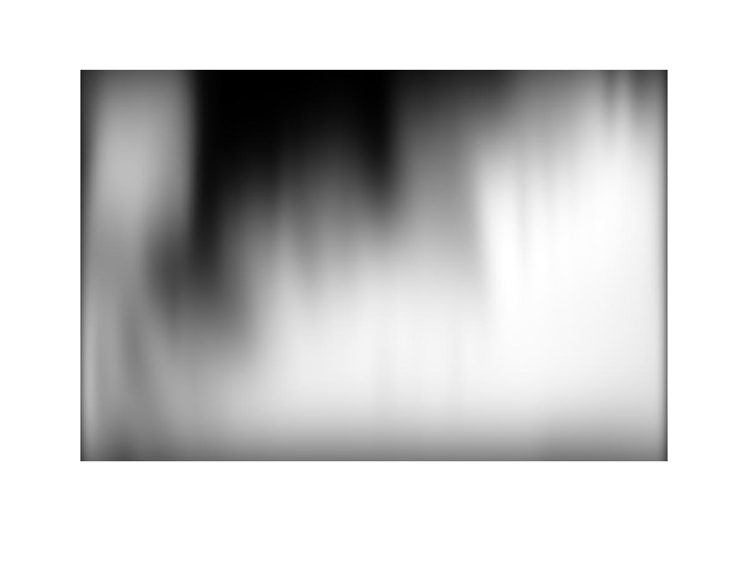

Slide 25


Slide 26


Slide 27


Slide 28


Slide 29


Slide 30


Slide 31


Slide 32


Slide 33


Slide 34


Slide 35


Slide 36


Slide 37


Slide 38


Slide 39
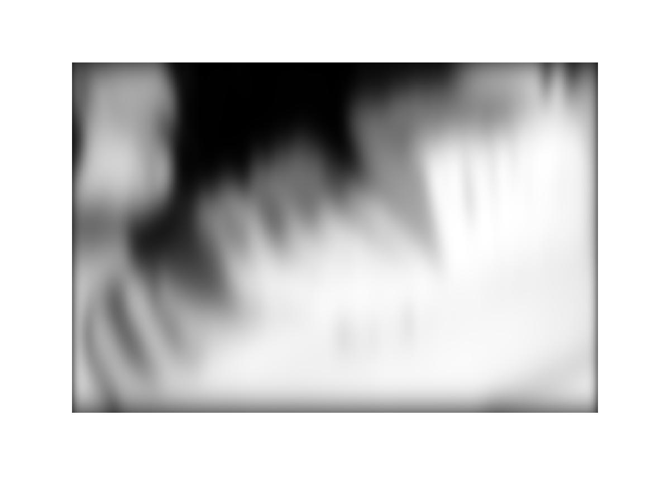

Slide 40


Slide 41


Slide 42


Slide 43


Slide 44


Slide 45


Slide 46


Slide 47


Slide 48


Slide 49


Slide 50


Slide 51

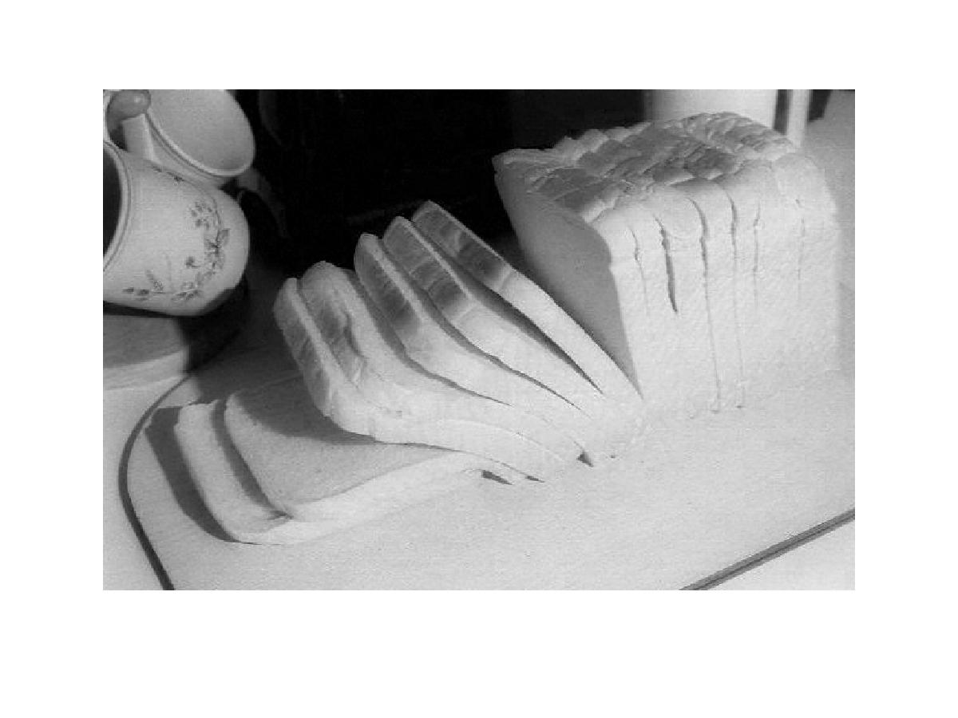

Slide 53
Entrenchment Insight: Mental set
The Reverend Sol Looney prophesized that at a particular place and time he would walk on water.
Smith and Blakenship-
  Mental sets constrain creativity

Slide 54

Alternative Global Local Focus in Vision

Slide 55
Alternative Global Local Focus in Vision

Slide 56

Alternative Global Local Focus in Vision

Slide 57

Alternative Global Local Focus in Vision

Slide 58
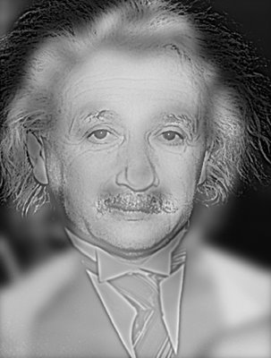
Alternative Global Local Focus in Vision
Einstein/ Marilyn (High low pass filter)

Slide 59
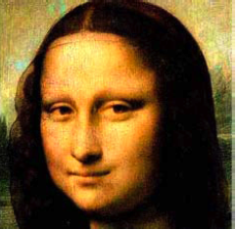
Alternative Global Local Focus in Vision
The mystery of the Mona Lisa’s smile
  Original

Slide 60
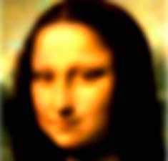
Alternative Global Local Focus in vision
The mystery of the Mona Lisa’s smile
  Low spatial frequency filter

Slide 61
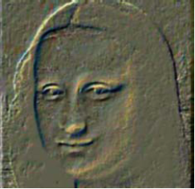
Alternative Global Local Focus in vision
The mystery of the Mona Lisa’s smile
  High spatial frequency filter

Slide 62

Alternative Global Local Focus in vision
The mystery of the Mona Lisa’s smile
  Low spatial frequency filter High spatial frequency

Slide 63
Alternative Global Local Focus in Vision
Rod’s
  central
  detail oriented vs.
  Small grain size
Cones
  peripheral,
  more sensitive
  less acuity
  Greater neural convergence
  Large grain size

Slide 64
Alternative Global/Local focus in
insight problem solving
Beeman’s’ Theory of Asymmetric Dynamic Semantic Fields
Left Hemisphere Right Hemisphere
- relatively finer coding - relatively coarser coding
home
master
room
arm
rest
key
note
chain
Better selection Weaker activation;
Better at detecting, building Better at detecting, building
close connections distant, unusual conxns

Slide 65
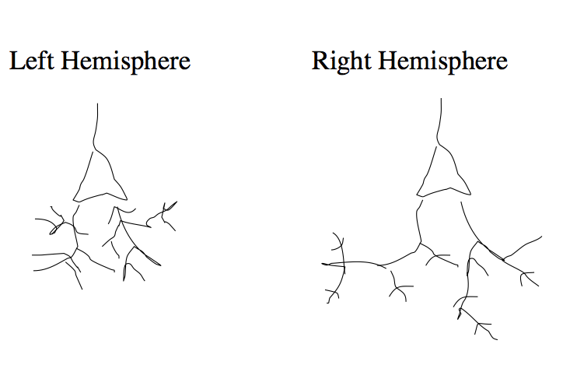
Asymmetrical dendritic branching in Broca’s, Wernicke’s, STG

Slide 66
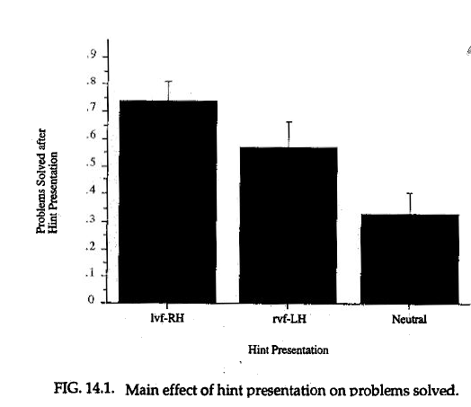
Right Left Hemisphere Differences in Insight Problem Solving: Fiore & Schooler,1997

Slide 67
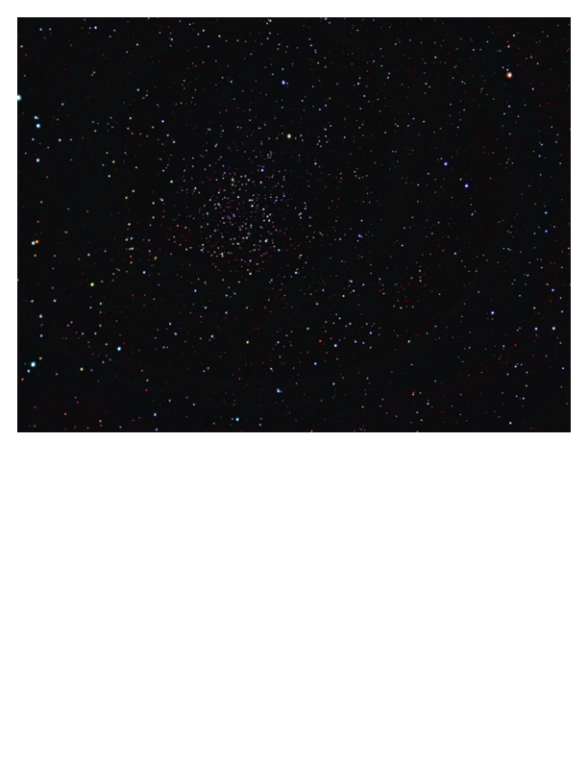
Trade-off between Global and Local Systems Vision
Perceiving a faint star

Slide 68
Trade-off between Global and Local Processing: Visual memory- Verbal Overshadowing
Basic paradigm
  View a face
  Describe it or engage in an unrelated activity
  Line up
Several reasons to predict verbal description should help
  Benefits of verbal rehearsal
  Value of language
Nevertheless…..

Slide 69
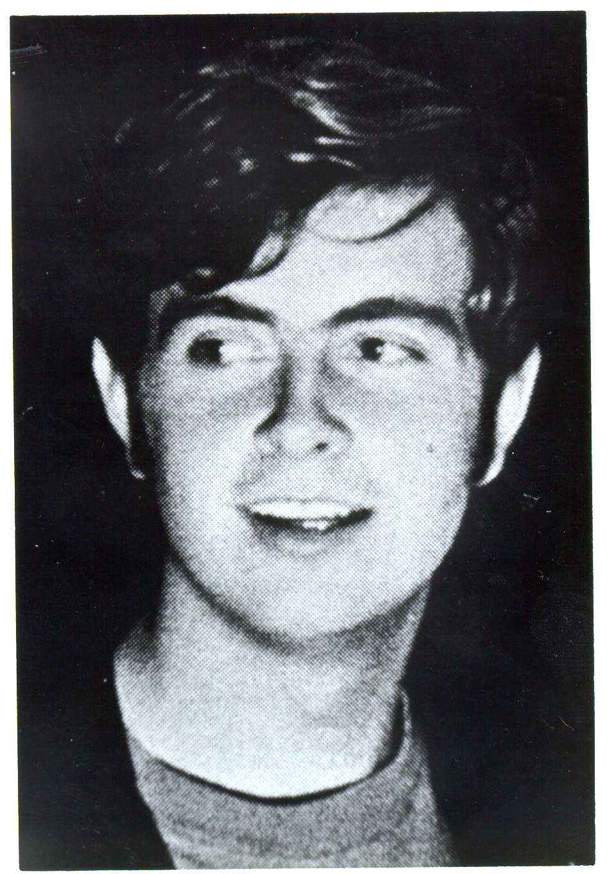

Slide 71
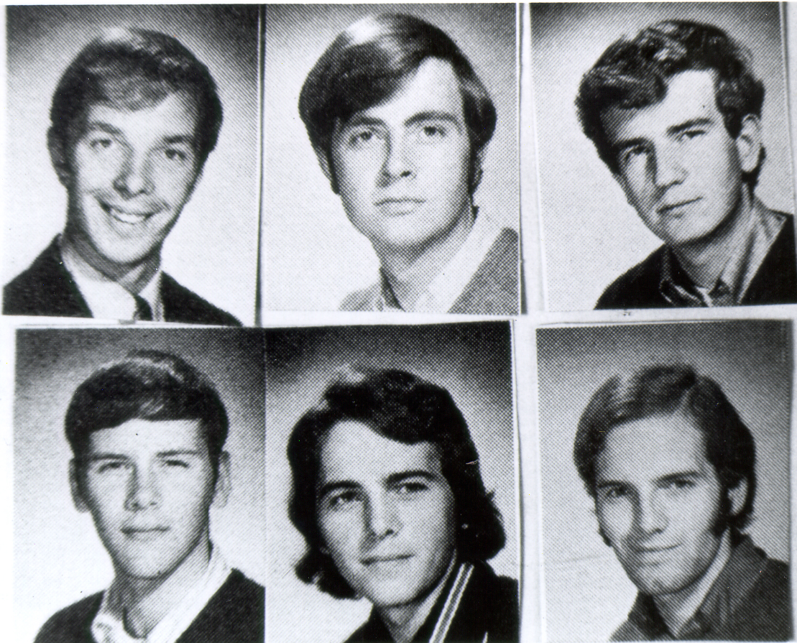

Slide 72
Face and Statement Recognition Accuracy
Schooler & Engstler-Schooler, 1990
Mean Percent Correct

Slide 74
Trade-off between between Global and Local: Visual memory
Macrae & Lewis (2004) examined impact of Alternative Global Local Focus on face recognition

Slide 75
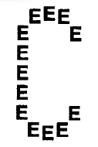
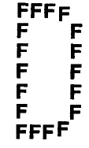
Examples of Navon Figures

Slide 76
Face Recognition Performance
Macrae & Lewis (2003)

Slide 77
Trade-off between global/local in Insight. Verbal Overshadowing (Schooler et al 1993)
Insight
  A dealer in antique coins got an offer to buy a beautiful bronze coin. The coin had an emperors head on one side and the date 544 BC stamped on the other. The dealer examined the coin, but instead of buying it, he called the police. Why?
Non-Insight
  The police were convinced that either A,B,C, or D had committed a crime. Each of the suspects, in turn, made a statement, but only one of the four statements was true. Who is telling the true and who committed the crime.
    A said, “I didn’t do it”
    B said “A is lying”
    C said “B is lying”
    D said “B did it”
B is telling the truth, A committed the crime.

Slide 78
The Effects of Verbalization on Problem Solving
Schooler, Ohlsson & Brooks, 1993
Mean Percentage of Problems Solved

Slide 79
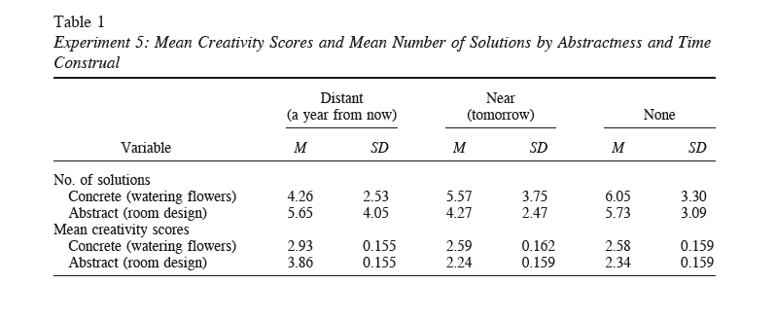
Trade-off between between Global and Local: Insight- Temporal Construal
Forster, et al 2004
Imagine yourself tomorrow vs a year from now

Slide 80
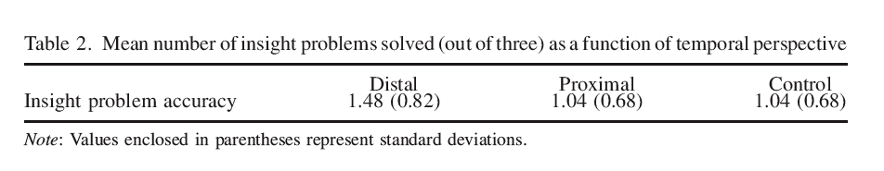
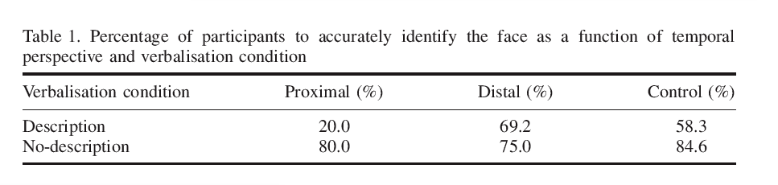
Hunt & Carroll 2008
Temporal construal’s simultaneous impact on
      Insight (replicating Forster et al)
      Verbal overshadowing in face recognition

Slide 81
Yeomans, Chin, & Schooler in prep
Examined the impact of Navon manipulation on insight problem solving and hemispheric activation
Activation assessed by a line bisection task

Slide 82


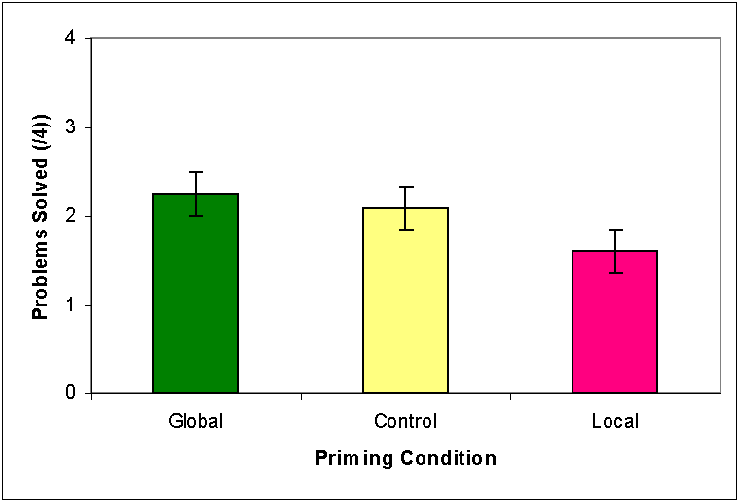
Insight Problem Performance
*

Slide 83
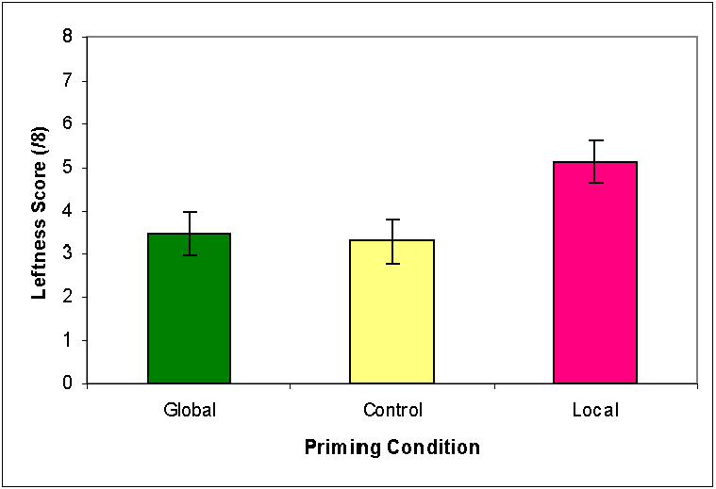
Left Hemisphere Activation
*

Slide 84
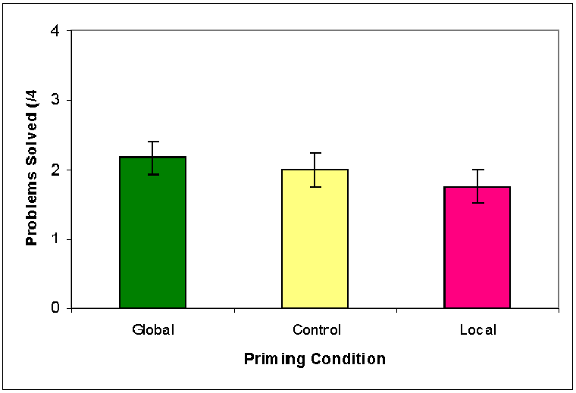
Insight Problem Performance
(Controlled for lateralization)‏
N.S.

Slide 85
Parallels between Sight and Insight
Similar information processing
  Suddenly apparent coherent organizational structures
  A particularly powerful shift is the recognition of an additional dimension
  Entrenchment reduces possibility of shifting
  Distinct global and local processing systems
  Tradeoff between global and local systems
Commonality in actual processes
  Visual shifts predictive of conceptual shifts
    (out of focus pic identification predictive of insight
  Visual shifts influence conceptual shifts insight
    Engaging in visual local processing impairs insight
  Likely both tap disparities between right and left hemisphere processing

Slide 86
Implications
Overlap between insight and vision reveal
  Striking commonalities between evolutionarily primitive and advanced cognitive processes
  Core principles of information extraction
  Common systems involved in high and low level information processing
    Global local
    Right hemisphere/ left hemisphere
Suggests that perceptual representations may provide a powerful format for thinking about cognition

Slide 87
Wild Speculations
What happens when we represent consciousness in perceptual terms- i.e. as motion through space/time?
Standard view- Reality is dynamic. Objects move, the observer is stationary
Alternative view- Reality is static. The observer moves through static space time

Slide 88
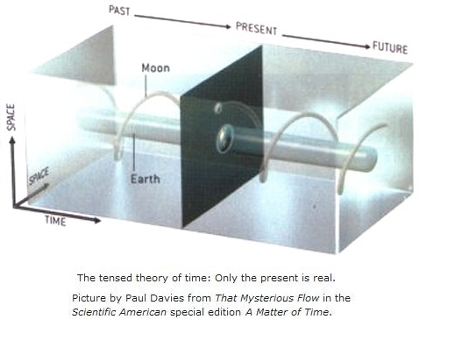
Example of a Block Universe

Slide 89

Sample interval of observation

Slide 90

The observer moving through the block universe

Slide 91
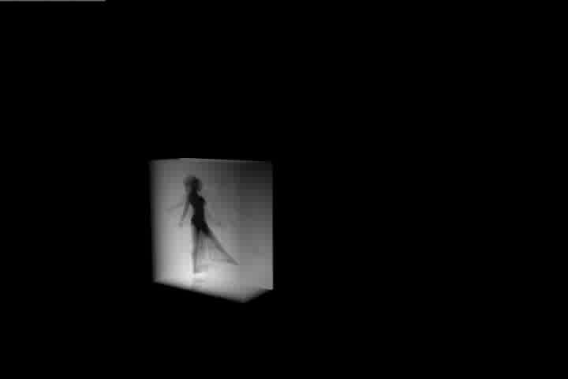
Moving through the block

Slide 92

Moving forward

Slide 93

Every which way

Slide 94

More of it all

Slide 95

Could perceptual aesthetics relate to the meaningfulness of an insight?
Think of consciousness as moving through a block universe may not be right but it sure is pretty

