Slide 1
The neural dynamics of insight
John Kounios, Drexel University
Mark Jung-Beeman, Northwestern University

Slide 2
Insight is sudden,…
Experiential Level: Sudden and disconnected from preceding thought.
Behavioral Level: Sudden availability of information about the correct response (Smith & Kounios, 1996, JEP:LMC).
Neural Level: Sudden burst of gamma-band neural oscillations.
Notes:
Most people are familiar with the phenomenon of insight, which is colloquially known as the “Aha! Moment.”
At the experiential level, it’s a sudden comprehension or apprehension which seems may seem disconnnected from the immediately preceding thought.
At the behavioral level, insight is associated with a discrete, all-or-none availability of information about the correct response in a task.
And as Mark Jung-Beeman described in the previous talk, insight is associated with a sudden burst of high-frequency oscillatory activity.

Slide 3
Insight is sudden,…
Experiential Level: Sudden and disconnected from preceding thought.
Behavioral Level: Sudden availability of information about the correct response (Smith & Kounios, 1996, JEP:LMC).
Neural Level: Sudden burst of gamma-band neural oscillations.

Slide 4
Insight is sudden,…
Experiential Level: Sudden and disconnected from preceding thought.
Behavioral Level: Sudden availability of information about the correct response (Smith & Kounios, 1996, JEP:LMC).
Neural Level: Sudden burst of gamma-band neural oscillations.

Slide 5
…but has antecedents at various time scales.
Resting States
Preparatory States
Sensory Gating
Notes:
But, the sudden nature of an insight masks the fact that insights are the culmination of a series of states and processes at various time scales.
Let’s examine three of these antecedents. Going backwards in time from the insight itself,
we find that an Aha! is immediately preceded by transient sensory gating,
and before that by transient preparation occurring just before a problem is presented,
and before that, by resting brain states that can bias a person toward insight or noninsight processing of a problem.

Slide 6
Right-Hemisphere Hypothesis
Semantic Coding
  LH - Fine coding: Strong, focused activation of close associates. Important for comprehension of direct, literal, language.
  RH - Coarse coding: Weaker, diffuse activation of remote associates. Important for comprehension of metaphor and jokes.
Notes:
Example: “John is tight-fisted.”
Neuroimaging and lesion studies support hemispheric distinction.
We hypothesized that the RH may be involved in solving insight problems for the same reason it is important for drawing inferences, getting jokes, and understanding metaphors: larger semantic fields allow semantic overlap for distantly related words.

Slide 7
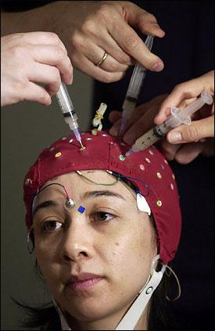
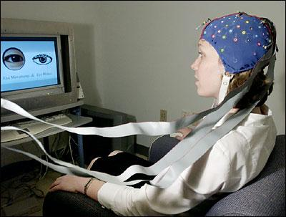

Slide 8
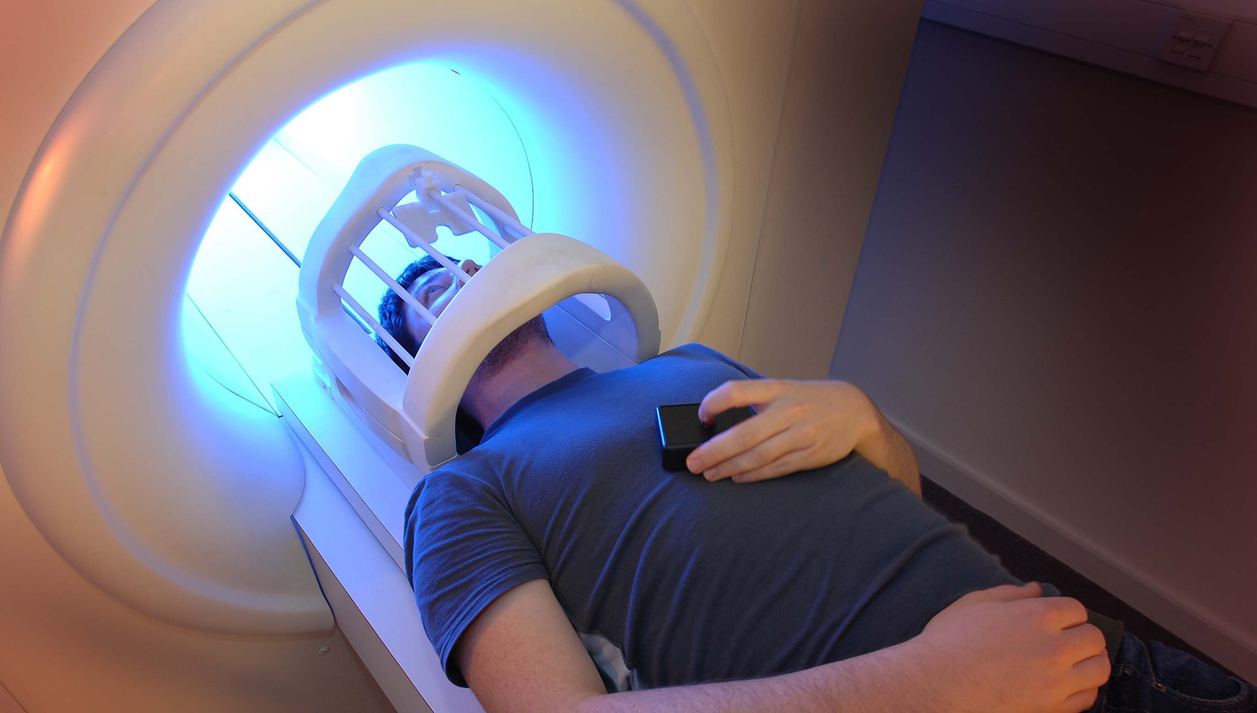

Slide 9
Compound Remote Associates
Jung-Beeman et al., PLoS Biology (2004)
hot
dog
catcher
food
Notes:
I think the RH may be involved in solving insight problems for the same reason it is important for drawing inferences, getting jokes, and understanding metaphors: larger semantic fields allow semantic overlap for distantly related words.
To explore contributions of each hemisphere to solving insight-like problems, we’ve created problems much like a subset of those on the Remote Associates Test…. affectionately referred to as the RAT, this test was designed as a test of creativity and has been used, by several researchers, as a small and manageable, but still insight-like problem. Subjects were given 3 words and asked to produce a fourth word that had something in common with all three.
Our problems were like a subset of the RAT problems - the solution word formed a compound word or phrase with each of the 3 problem words.
We’ve developed a large set of these Compound Remote Associate Problems. I won't tell you how we affectionately refer to these, but I will tell you that my colleague Ed Bowden is responsible for most of the... Compound Remote Associate Problems coming from our lab..
The ability to solve this type of problem strongly correlates with the ability to solve classic insight problems. So although these are very simple problems, we think they serve as a useful model task to study at least some of the processes involved in solving insight problems.

Slide 10
Transient Visual Gating
(Jung-Beeman et al., PLoS Biology, 2004)
Gamma
Alpha
Notes:
First, as Mark described in the preceding talk, solving a compound remote associate problem with insight is associated with a burst of high-frequency oscillatory activity in the right anterior temporal lobe.
But this is immediately preceded by a burst of insight-related alpha-band activity measured over right posterior cortex.

Slide 13
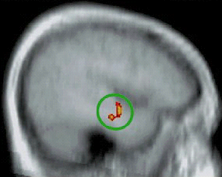

Slide 14
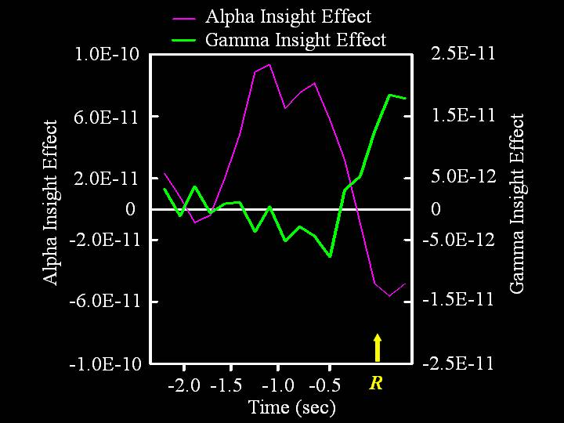

Slide 15
Alpha-band oscillations
(8-13 Hz)
The brain’s dominant rhythm
Reflects neural inhibition
Posterior alpha reflects visual gating
Notes:
So what are alpha oscillations?
Alpha is the brain’s dominant rhythm and reflects neural inhibition.
In particular, parietal-occipital alpha….

Slide 16
Hypothesis:
The brain transiently reduces visual inputs to
increase signal-to-noise ratio of the solution.

Slide 17
Preparatory Effects
(Kounios et al., Psych Sci, 2006)
Notes:
Continuing backward in time from the moment of insight, we’ve found that even before a problem is presenting, the brain can prepare to solve the upcoming problem either with insight processing or with noninsight analytic processing….

Slide 18
Neural activity 2 sec prior to the presentation of each problem
Insight
Analytic
Notes:
We found that even before a compound remote associate problem is presented, if the upcoming problem will be solved with insight, then there is greater neural activity measured over left and right posterior temporal cortex, right frontal cortex, and mid-frontal cortex.
In contrast, if the upcoming problem is going to be solved with analytic processing, then there is greater neural activity over posterior cortex.
This suggests that analytic processing involves greater visual attention to the monitor on which the problem will be presented.
In contrast, insight processing involves greater activity in semantic processing areas and in the anterior cingulate which is involved in cognitive control and may activate these semantic areas and perhaps mediate the attentional flexibility involved in switching from prepotent to nonprepotent solution possibilities.

Slide 19
Neural activity 2 sec prior to the presentation of each problem
L Post. M/STG
Ant. Cingulate
Post. Cingulate
R Post. M/STG
Notes:
These EEG results were mostly replicated with fMRI.

Slide 20
Two forms of preparation
Noninsight/Analytic:
  Increased visual attention to the display
Insight:
  Mobilization and control of cognitive resources
  Activation of temporal-lobe semantic-processing areas
  Inwardly directed attention

Slide 21
Resting-State Brain Activity (Kounios et al., Neuropsychologia, 2008)
What causes insight preparation?
Directed vs. undirected cognition
Measuring EEG during the “resting state.”
Individual differences in resting-state brain activity.
Notes:
And finally, we face the question of what factors bias a person toward insight preparation versus analytic preparation. One possibility is that individual differences in resting-state brain activity may bias a person toward preparing for and engaging in either insight processing or analytic processing.
Resting state brain activity is what occurs when a person is not engaged in the directed cognitive activity associated with explicit task performance.
There is a long history of measuring resting-state EEG, and individual differences in resting state EEG, and more recently fMRI, are associated with individual differences in personality, intelligence, and psychopathology. So we decided to examine the possibility that individual differences in resting state activity are associated with insight versus analytic processing strategy during problem solving.

Slide 22
Anagram Task
Record subjects’ resting-state EEG.
Then, present a series of anagrams.
Subjects press button to indicate that an anagram has been solved.
Elicit insight judgments.
Notes:
We measured subjects resting-state EEG before they were told what would follow.
Anagram task; insight judgments.

Slide 23
Analyses
Divide subjects into Hi-Insight and Lo-Insight groups.
Compare resting-state EEG for two groups.
Predictions
  Hi-Insight subjects will show more RH and/or less LH activity.
  Hi-Insight subjects will show evidence of less-focused, more diffuse attention.
    Hi-Insight: less posterior alpha and beta.

Slide 24
Analyses
Divide subjects into Hi-Insight and Lo-Insight groups.
Compare resting-state EEG for two groups.
Predictions
  Hi-Insight subjects will show more RH and/or less LH activity.
  Hi-Insight subjects will show evidence of less-focused, more diffuse attention.
    Hi-Insight: less posterior alpha and beta.

Slide 25
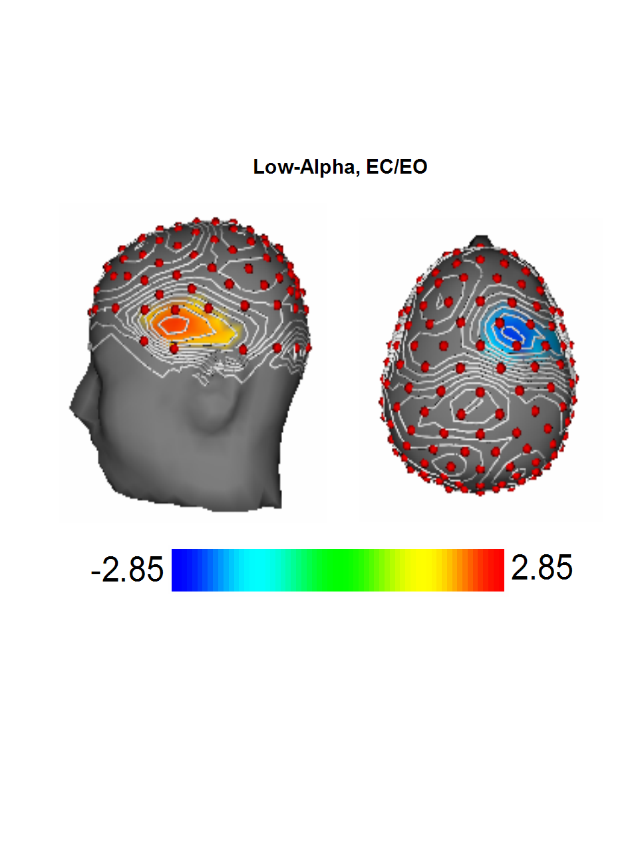
HI: greater R frontal activity
LI: greater L inferior frontal activity
(Alpha = inhibition)

Slide 26
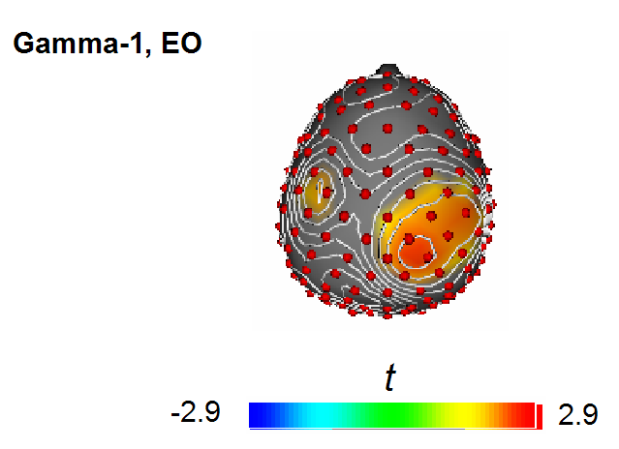
Gamma-band activity:
HI-LI larger over R parietal cortex

Slide 27
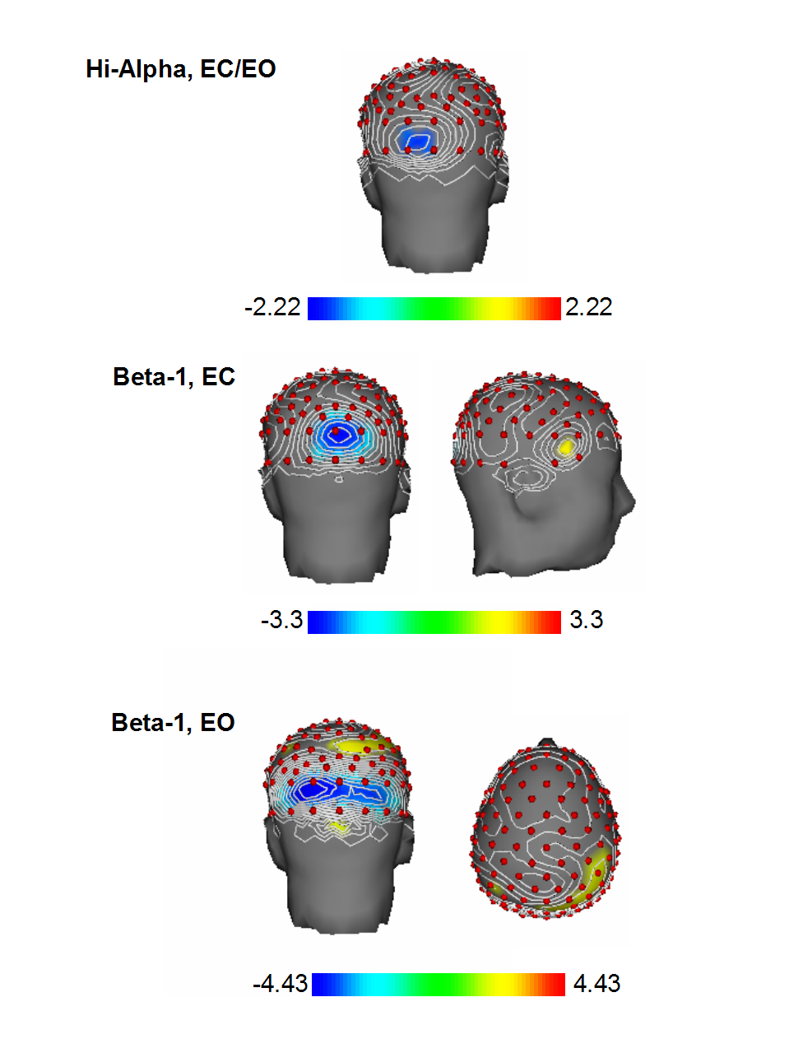
HI: Less alpha
HI: Less beta

Slide 28

Open questions
Trait vs. state?
Genetic contribution?
Notes:
We don’t know whether these insight-related differences in resting-state brain activity reflect transient, but relatively slowly changing states, or whether they reflect relatively stable traits. EEG is relatively stable.
And if these differences are stable, we don’t know if they are genetically determined. EEG is heavily genetically loaded.
Much work to do!

Slide 29
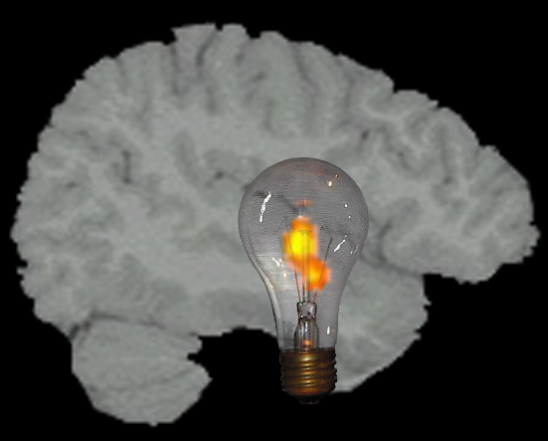
Thank you.
Resting States
Preparatory States
Sensory Gating

Slide 30
Collaborators
Mark Jung-Beeman
Stella Arambel-Liu
Edward Bowden
Jessica Fleck
Deborah L. Green
Richard Greenblatt
Lisa Payne
Paul Reber
Jennifer Frymiare Stevenson
Notes:
But first, I would like to acknowledge my collaborators….

